Slide 1
Environmental Problems, Their Causes, & Sustainability
Chapter 1

Slide 2
Lesson 1-1
What Are Three Principles of Sustainability?
Concept 1-1A Nature has sustained itself for billions of years by relying on solar energy, biodiversity, and nutrient cycling.
Concept 1-1B Our lives and economies depend on energy from the sun and on natural resources and natural services (natural capital) provided by the Earth.

Slide 3
Environmental Science Is a Study of Connections in Nature
Environment: everything around us that is not us. Living and nonliving things with which we interact.
Ecology: the biological science that studies how organisms (living things) interact with one another and their environment.
Species: a group of organisms with a unique set of characteristics that are able to mate and produce fertile offspring.
Ecosystem: set of organisms that live in a defined area that interact with one another and their environment of nonliving matter and energy.

Slide 4
Crash Course Ecology: 5 Human Impacts on the Environment
https://www.youtube.com/watch?v=HS9LoX79lYA

Slide 5
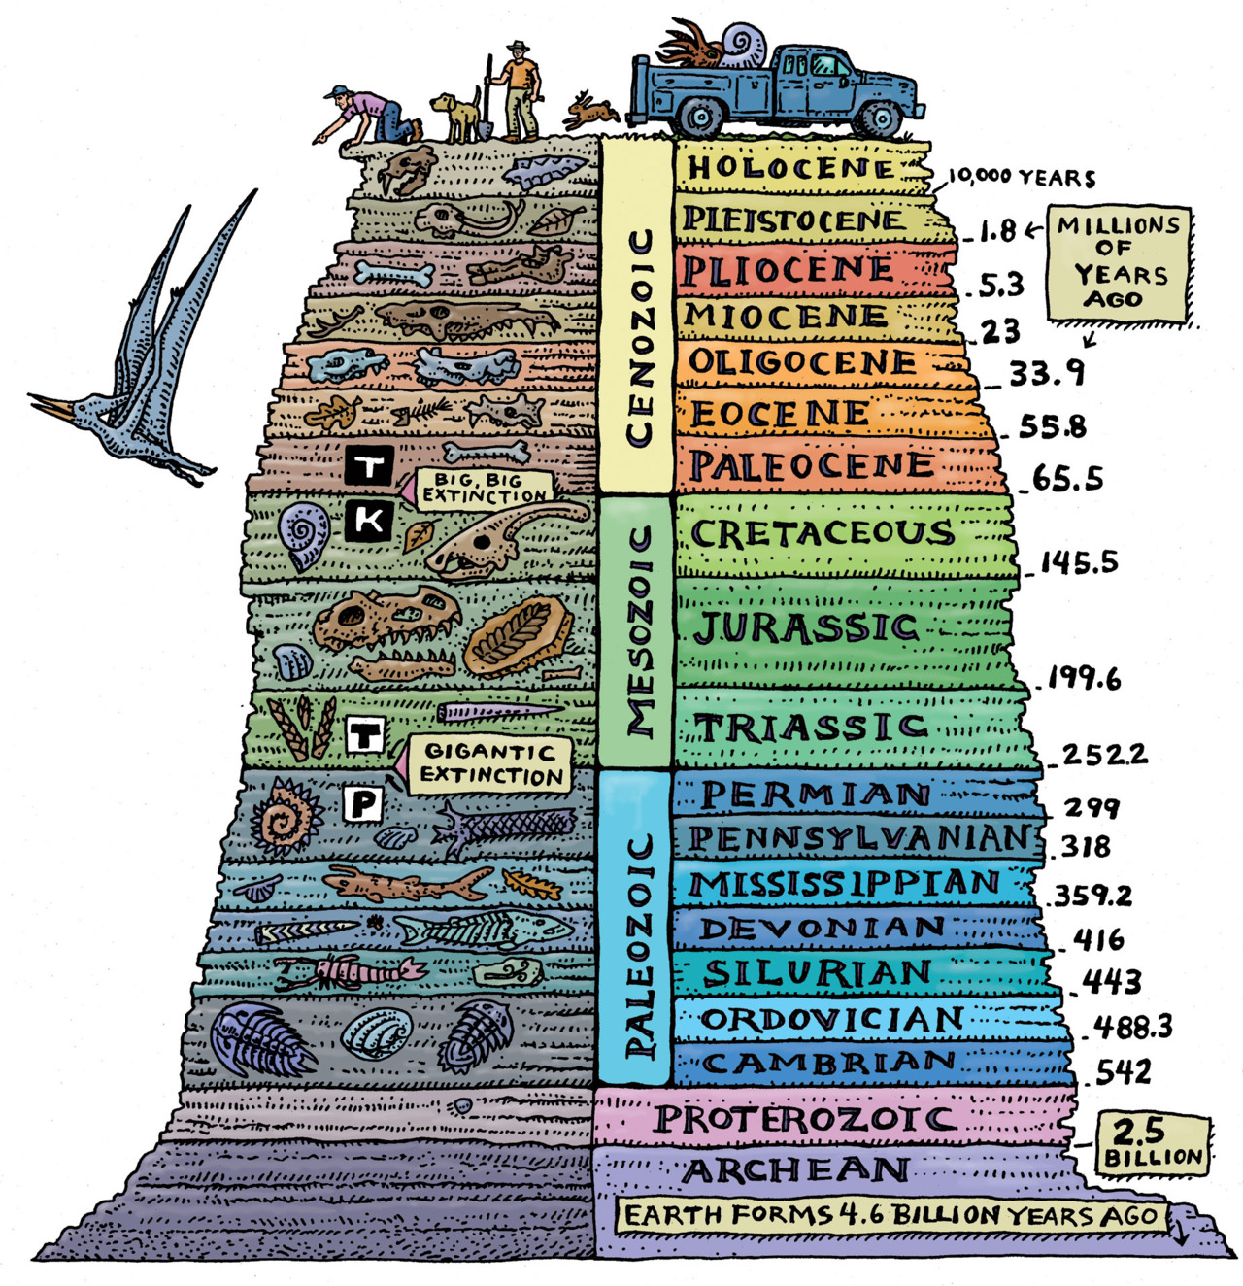
Nature’s Survival Strategies Follow Three Principles of Sustainability
We named ourselves Homo sapiens, which is Latin for “wise man”.
We are a very smart species, but are we wise?
Many argue that a species in the process of degrading its own life-support system could not be considered wise.

Slide 6
Nature’s Survival Strategies Follow Three Principles of Sustainability
There are three themes relating to the long-term sustainability of life on this planet: solar energy, biodiversity, and chemical cycling.
Life must rely on the sun, promotion of multiple options for life, and reduction of waste.
These are the three principles of sustainability or lessons from nature.

Slide 7
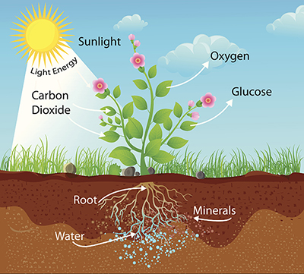
Nature’s Survival Strategies Follow Three Principles of Sustainability
Reliance on Solar Energy
  Photosynthesis provides nutrients (chemicals) that most organisms need to stay alive.
  No Sun = No Plants
  Sun also contributes indirectly through wind and flowing water.

Slide 8
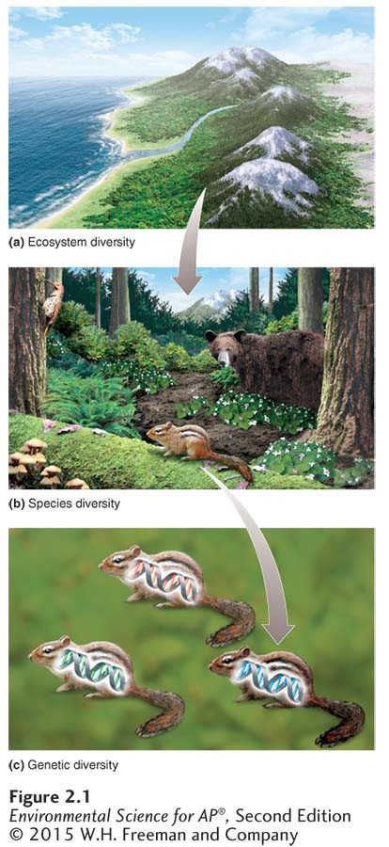
Nature’s Survival Strategies Follow Three Principles of Sustainability
Biodiversity
  Variety of organisms, the natural systems in which they exist and interact.
  The natural services organisms and living systems provide free of charge.
  Provides countless ways for life to adapt to changing environments.

Slide 9

Nature’s Survival Strategies Follow Three Principles of Sustainability
Chemical (Nutrient) Cycling
  Circulation of chemicals from the environment through organisms and back to the environment.
  Earth receives no new supplies of these chemicals. Recycled!!

Slide 10
Sustainability Has Certain Key Components
Natural Capital = Natural Resources + Natural Services
  Natural Capital: the natural resources and natural services that keep us and other forms of life alive and support our human economies.
  Natural Resources: materials and energy in nature that are essential or useful to humans. Often classified as renewable or nonrenewable.
  Natural Services: processes in nature such as purification of air and water and renewal of topsoil, which supports life and human economies.
  Natural capital can support earth’s diversity of species as long as we use its natural resources and services in a sustainable fashion.

Slide 11
3 Components of Sustainability
Component 1: Nutrient cycling in topsoil (upper layer of soil) is important to plant growth and is a vital natural service.
Component 2: Many human activities can degrade natural capital by using normally renewable resources faster than nature can restore them.
Component 3: Solutions. Solutions to environmental problems involve scientific as well as political processes. The search for solutions often involves conflicts and trade-offs.
Sustainability begins at personal and local levels!

Slide 12
Some Resources Are Renewable & Some Are Not
Resources are anything that we can obtain from the environment to meet our needs and wants. Resources are both directly and indirectly available.
Perpetual resources (Ex: solar energy) are continuously available.
Renewable Resources (Ex: forests or fish populations) that takes from several days to several hundred years to replenish as long as we do not use it up faster than nature can replenish.
  The highest rate at which we can use a renewable resource indefinitely without reducing its available supply is called its sustainable yield.

Slide 13
Some Resources Are Renewable & Some Are Not
Nonrenewable resources are resources that exist in a fixed quantity, or stock, in the Earth’s crust.
  On a time scale of millions to billions of years, geologic processes can renew such resources. Humans can deplete these resources much faster than nature can form them.
  Examples: Energy Resources (coal and oil), Metallic Mineral Resources (Cu ad Al), and Nonmetallic Mineral Resources (salt and sand).

Slide 14
Some Resources Are Renewable & Some Are Not
As we deplete nonrenewable resources, we can find substitutes. Ex: alternative energy sources, or plant based plastics.
We can also recycle or reuse resources to extend supplies.
Reuse involves using a resource over and over in the same form. Ex: washing and refilling glass bottles.
Recycling involves collecting waste materials and processing them into new materials. Ex: aluminum cans

Slide 15
Countries Differ in Levels of Sustainability
As populations grow, there is more demand for resources. Governmental ad societal leaders are responsible for maintaining and expanding national economies, which can lead to growing environmental problems.
Economic Growth is an increase in a nation’s output of goods and services. This is usually measured by the percentage change in a country’s gross domestic product (GDP).
GDP is the annual market value of all goods and services produced by all businesses, foreign and domestic, operating within a country.

Slide 16
Countries Differ in Levels of Sustainability
Changes in a country’s economic growth per person are measured by per capita GDP, the GDP divided by the total population.
Economic development is an effort to use economic growth to improve living standards.
The United Nations (UN) classifies the world’s countries as economically more developed or less developed, based primarily on their average income per person.

Slide 17
Countries Differ in Levels of Sustainability
More-developed countries are those with high average income and they include the US, Canada, Japan, Australia, New Zealand, and most European countries.
According to the UN and World Bank data, the more-developed countries have 19% of world’s population, use about 88% of all resources, and produce about 75% of the world’s pollution and waste.

Slide 18
Countries Differ in Levels of Sustainability
All other nations, in which 81% of the world’s people live, are classified as less-developed countries.
Most of these countries are located in Africa, Asia, and Latin America.
  Middle-Income, Moderately-Developed Countries include China, India, Brazil, Turkey, Thailand, and Mexico.
  Low-Income, Least-Developed Countries include Congo, Haiti, Nigeria, and Nicaragua.

Slide 19
Paradise Reef Activity
http://video.wgcu.org/video/2365794811/

