Slide 1
APES C1L2 How Are Our Ecological Footprints Affecting the Earth?
Concept 1-2 As our ecological footprints grow, we are depleting and degrading more of the Earth’s natural capital.
Textbook pages 12-20

Slide 2
We Are Living Unsustainably
We are living unsustainably, thus accelerating degradation of our natural capital. This process is known as environmental degradation or natural capital degradation.
In 2005, the UN released its Millennium Ecosystem Assessment. According to the study, human activities have degraded about 60% of the Earth’s natural services, most in the past 50 years.
Good News! We now have the knowledge and tools to make improvements!

Slide 3
Pollution Comes from a Number of Sources
Pollution: any presence within the environment of a chemical or other agent such as noise or heat at a level that is harmful to the health, survival, or activities of humans or other organisms.
Pollutants can enter the environment naturally (Ex: volcanic eruptions), or through human activities (Ex: burning fossil fuels, dumping of chemicals).

Slide 4
Pollution Comes from a Number of Sources
The pollutants we produce come from 2 types of sources:
Point Sources are single, identifiable sources. Ex: smokestack of a coal-burning factory, drainpipe of a factory, or exhaust pipe of an automobile.
Non-point Sources are dispersed and often difficult to identify. Ex: pesticides blown from land into air, fertilizer runoff, trash from land into waterways.

Slide 5
Pollution Comes from a Number of Sources
Point Source (China)
Non-Point Source (Philippines)

Slide 6
Pollution Comes from a Number of Sources
There are 2 main types of pollutants:
Biodegradable pollutants are harmful materials that natural processes can break down over time. Ex: human sewage, newspapers
Nondegradable pollutants are harmful chemicals that natural processes cannot break down over time. Ex: lead, mercury, arsenic

Slide 7
Pollution Comes from a Number of Sources
Pollutants can have 3 types of unwanted effects.
They can disrupt or degrade life-support systems for humans and other species.
They can damage wildlife, human health, and property.
They can create nuisances such as noise and unpleasant smells, tastes, and sights.

Slide 8
Pollution Comes from a Number of Sources
We have tried to deal with pollution in 2 very different ways.
Pollution cleanup, or output pollution control, which involves cleaning up or diluting pollutants after we have produced them.
Pollution prevention, or input pollution control, which reduces or eliminates the production of pollutants.

Slide 9
Pollution Comes from a Number of Sources
Environmental scientists have identified 3 problems with relying primarily on pollution cleanup.
It is only a temporary solution as long as there are no improvements in pollution control technology.
Cleanup often removes a pollutant from one part of the environment only to cause pollution in another.
Once pollutants become dispersed into the environment at harmful levels, it usually costs too much to reduce them to acceptable levels.

Slide 10
Pollution Comes from a Number of Sources
We need both pollution prevention (front-of-the pipe) and pollution cleanup (end-of-the-pipe) solutions.
Putting more emphasis on prevention because it works better and is cheaper in the long run.

Slide 11
The Tragedy of the Commons: Overexploiting Commonly Shared Renewable Resources
There are 3 types of property or resource rights.
Private Property: where individuals or companies own the rights to land, minerals, or other resources.
Common Property: where the rights to certain resources are held by large groups of individuals.
Open-Access Renewable Resources: Owned by no one and available for use by anyone at little or no charge. Ex: atmosphere, open ocean, ground water

Slide 12
The Tragedy of the Commons: Overexploiting Commonly Shared Renewable Resources
Many common-property and open-access renewable resources have been degraded.
In 1968, biologist Garrett Hardin called such degradation the tragedy of the commons.
It occurs because each user reasons, “If I do not use this resource, someone else will. The little bit that I use or pollute is not enough to matter, and anyway, it’s a renewable resource.”

Slide 13
Garrett Hardin on the Tragedy of the Commons Video Clip
https://www.youtube.com/watch?v=L8gAMFTAt2M

Slide 14
Tragedy of the Commons & the Problem with Open Access Video Clip
https://www.youtube.com/watch?v=WYA1y405JW0

Slide 15
What Happened to the Grand Banks Cod? Video Clip
https://www.youtube.com/watch?v=L5wR8Iu2Q00

Slide 16
The Tragedy of the Commons: Overexploiting Commonly Shared Renewable Resources
There are 2 major ways to deal with this difficult problem.
Use a shared renewable resource at a rate well below its estimated sustainable yield by using less of the resource, regulating access to the resource, or doing both. Ex: governments can establish laws and regulations limiting harvests.
Convert open-access renewable resources to private ownership. Cannot use this option for the atmosphere or the ocean.

Slide 17
Ecological Footprints: A Model of Unsustainable Use of Resources
Many people in lesser developed countries use fewer resources (devoted mostly to meeting basic needs) resulting in a low environmental impact.
However, people in some extremely poor countries clear virtually all available trees in order to survive.
In contrast, many individuals in more-developed nations enjoy affluence, or wealth, consuming large amounts of resources far beyond basic needs.

Slide 18
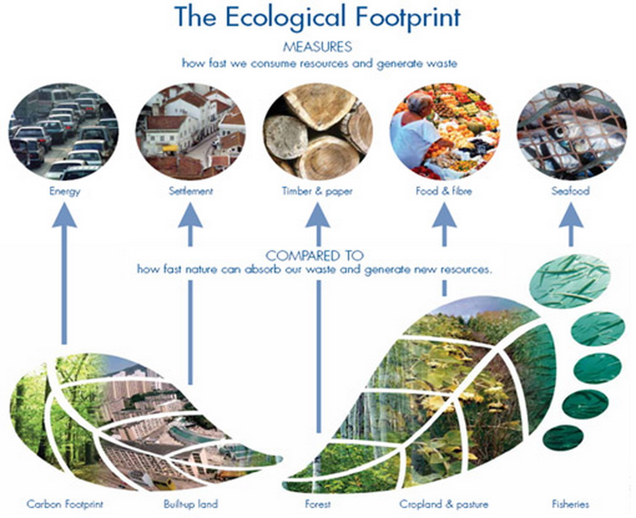

Slide 19
Ecological Footprints: A Model of Unsustainable Use of Resources
The per capita ecological footprint is the average ecological footprint of an individual in a given country or area.
If a country’s total ecological footprint is larger than its biological capacity to replenish renewable resources and to absorb wastes and pollution, are said to have an ecological deficit.
According to Rees and Wackernagel (developers of ecological footprint), it would take a land area of 5 more planet Earths is everyone consumed as much as the average American.

Slide 20
Ecological Footprints: A Model of Unsustainable Use of Resources

Slide 21
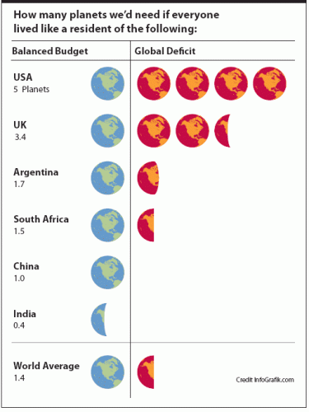

Slide 22
Ecological Footprints: A Model of Unsustainable Use of Resources

Slide 23
IPAT Is Another Environmental Impact Model
In the early 1970s, Paul Ehrlich and John Holdren developed a model showing how population size (P), affluence (resource consumption per person) (A), and the beneficial and harmful environmental effects of technologies (T) help to determine the environmental impact (I) of human activities.
I = P x A x T
Impact = Population x Affluence x Technology

Slide 24
IPAT Is Another Environmental Impact Model
In most less-developed countries, the key factors in total environmental impact are population size and the degradation of renewable resources as a large number of poor people struggle to stay alive.
In more-developed countries, high rates of per capita resources use and the resulting high per capita levels of pollution and resource depletion and degradation usually are the key factors determining overall environmental impact.
In other words, overconsumption of about 1 billion people is putting tremendous pressure on our life-support systems.

Slide 25
Case Study China’s New Affluent Consumers
https://www.youtube.com/watch?v=1EaDlvibc4w

Slide 26
Case Study China’s New Affluent Consumers
Suppose China’s economy continues to grow at a rapid rate.
Environmental policy expert Lester R. Brown estimates that if projections are accurate, China will need 2/3 of the world’s current grain harvest, twice the world’s current paper consumption, and more than all the oil currently produced in the world.

Slide 27
Natural Systems Have Tipping Points
One problem that we face in dealing with environmental degradation is the time delay between unsustainable use of renewable resources and the resulting harmful environmental effects.
Time delays can allow an environmental problem to build slowly until it reaches a threshold level, or ecological tipping point, which causes an often irreversible shift in the behavior of a natural system.
Reaching a tipping point is like stretching a rubber band. At some point, it breaks.

Slide 28
Natural Systems Have Tipping Points
3 potential tipping points that we now face are:
The collapse of certain populations of fish due to overfishing.
Premature extinction of many species resulting from humans overhunting the or reducing their habitats.
Long-term climate change caused in part by the burning of oil and coal, which emits gases into the atmosphere that cause it to warm more rapidly than it would without such emissions.

Slide 29
Natural Systems Have Tipping Points
https://www.youtube.com/watch?v=QlU5-cixpZM
https://www.youtube.com/watch?v=QkkKZgKmdP4

Slide 30
Cultural Changes Have Increased Our Ecological Footprints
Culture is the whole of a society’s knowledge, beliefs, technology, and practices. Human cultural changes have had profound effects on Earth.
Homo sapiens sapiens have walked the planet for about 200,000 years (of Earth’s 4.5 billion years). Until about 12,000 years ago, we were hunter-gatherers.
Since then, 3 major cultural changes have occurred.

Slide 31
Cultural Changes Have Increased Our Ecological Footprints
Agricultural Revolution which began 10,000-12,000 years ago when humans learned how to grow crops and raise animals.
Industrial-Medical Revolution which began about 275 years ago when people invented machines for large-scale production of goods in factories.
Information-Globalization Revolution which began about 50 years ago when we developed new technologies for gaining rapid access to information and resources on a global scale.

Slide 32
Cultural Changes Have Increased Our Ecological Footprints
Each of these cultural changes gave us more energy and new technologies with which to alter and control more of the planet to meet our needs and wants.
They have allowed for expansion of human populations because of increased food supplies and longer life spans.
Each also resulted in greater resource use, pollution, and environmental degradation as they allowed us to dominate the planet and expand ecological footprints.

Slide 33
Cultural Changes Have Increased Our Ecological Footprints
Many environmental scientists and other analysts now call for a fourth major cultural change in the form of a sustainability revolution during this century.
This cultural transformation would involve learning how to reduce our ecological footprints and to live more sustainably.

