Slide 1
Freshwater Ecosystems
Chapter 7.1

Slide 2
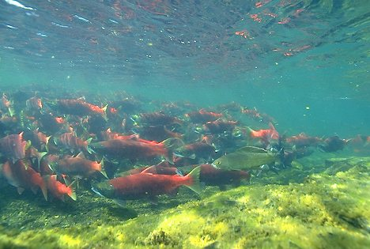
Characteristics of Aquatic Ecosystems
Factors such as temperature, sunlight, oxygen, and nutrients determine which organisms live in which areas of the water

Slide 3
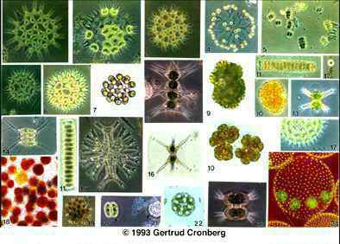
Characteristics of Aquatic Ecosystems
Organisms in aquatic ecosystems are grouped by their location and adaptation
Plankton: organisms that cannot swim against currents (are drifters)
Phytoplankton are the food base for most aquatic ecosystems

Slide 4
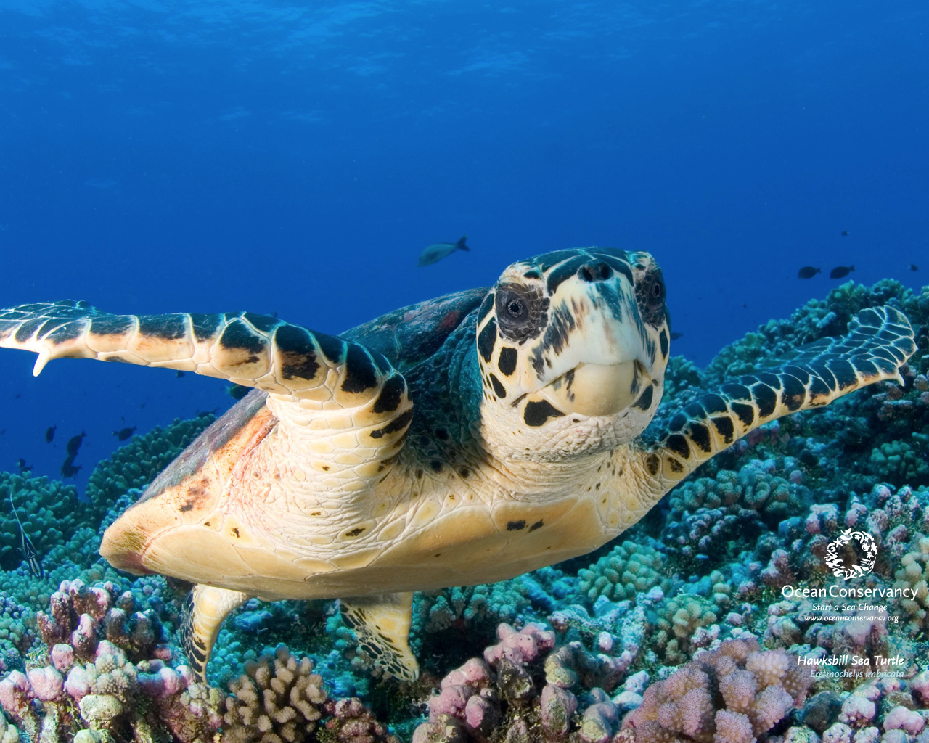
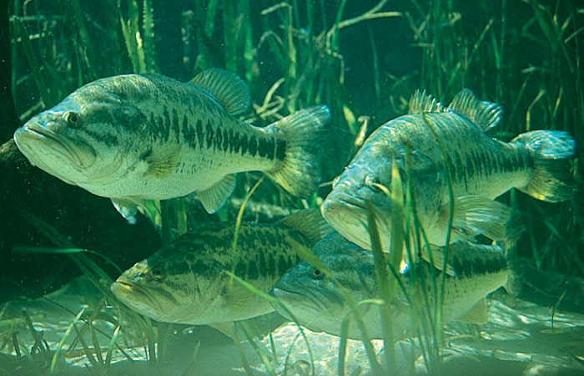
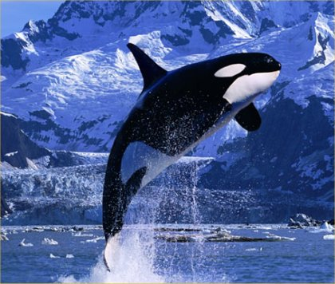
Characteristics of Aquatic Ecosystems
Nekton: free-swimming organisms
Examples: Fish, turtles, whales

Slide 5
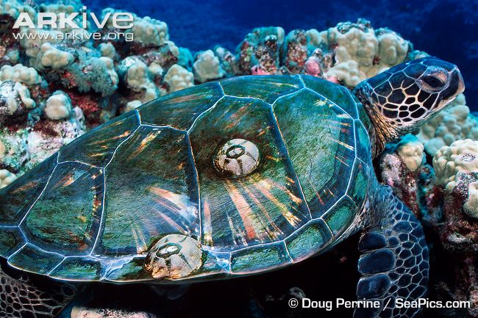
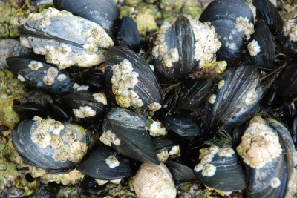
Characteristics of Aquatic Ecosystems
Benthos: bottom-dwelling organisms
Mussels, worms, barnacles

Slide 6
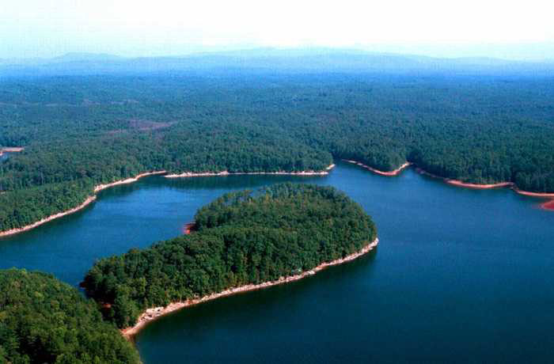
Lakes and Ponds
Divided into zones:
Littoral zone: near the shore, aquatic life is diverse and abundant including plants and photosynthetic phytoplankton
Benthic zone: bottom of the lake, inhabited by decomposers, insect larvae and clams

Slide 7
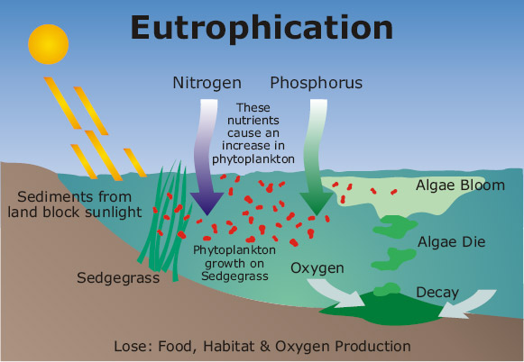
Lakes and Ponds
Eutrophication is an increase in the amount of nutrients in an aquatic ecosystem

Slide 8
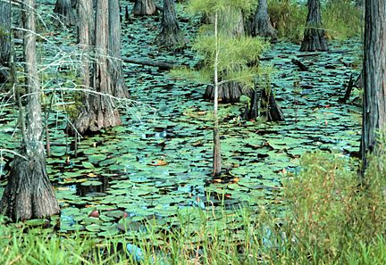
Freshwater Wetlands
Are areas of land that are covered with freshwater for at least part of the year
Marshes: contain non-woody plants such as cattails
Swamps: contain woody plants such as trees and shrubs

Slide 9
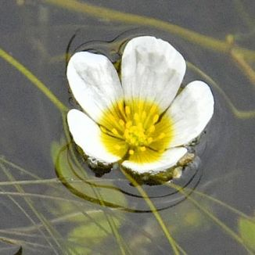
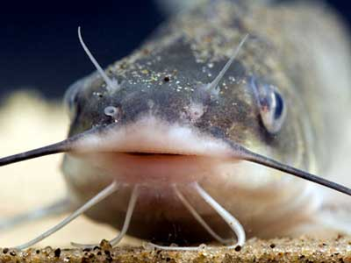
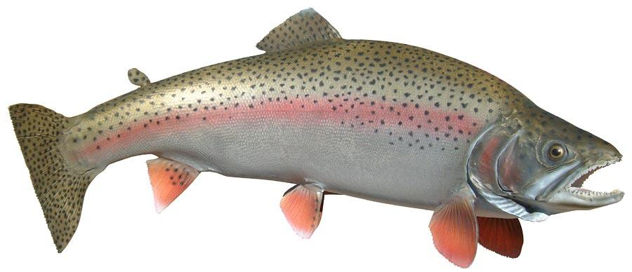
Rivers
Upstream: mosses, trout and minnows
Downstream: crowfoot, catfish and carp

