Slide 1
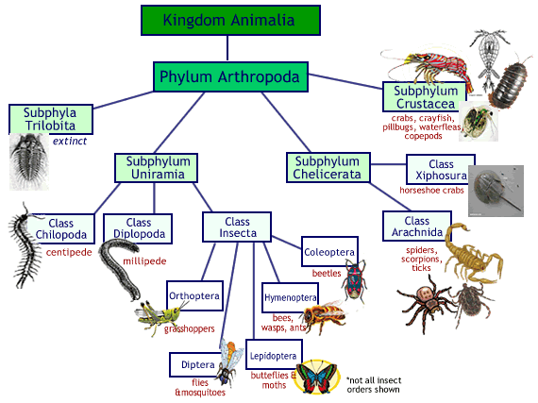
Arthropoda

Slide 2
Characteristics
Makes up 75% of all animal species. Total number of arthropod species is MORE than all other species combined.
Included insects, spiders, and crustaceans
Arthropod means “Jointed Foot”
All arthropods have jointed appendages

Slide 3
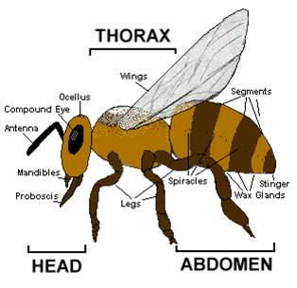
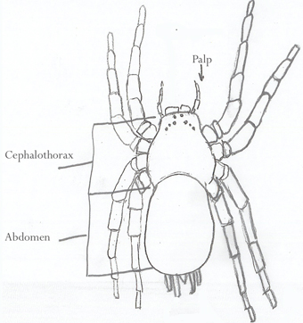
Characteristics
Segmented body
Adults have 3 segments → head, thorax, and abdomen
Some have a fused head and thorax → the cephalothorax

Slide 4
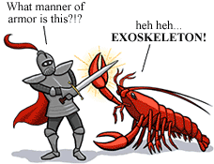
Characteristics
Exoskeleton for protection and support
Exoskeleton is shed during molting
Made of chitin

Slide 5
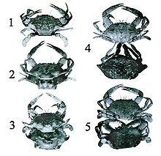
Ecdysis
Periodic shedding of the exoskeleton
Necessary as the arthropod grows
4 Stages:
Glands secrete enzymes
New procuticle and epicuticle are secreted
Old exoskeleton splits
Calcium carbonate deposits harden the new exoskeleton
Arthropods are vulnerable to predators for a few hours as the new exoskeleton hardens

Slide 6
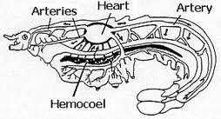
Characteristics
Open circulatory system
Hemocoel: Internal cavity for the open circulatory system
Fluid surrounds the organs for the exchange of nutrients, wastes and gases

Slide 7
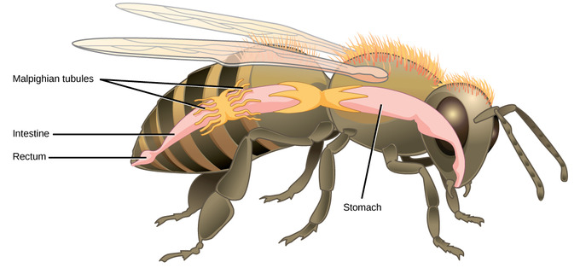
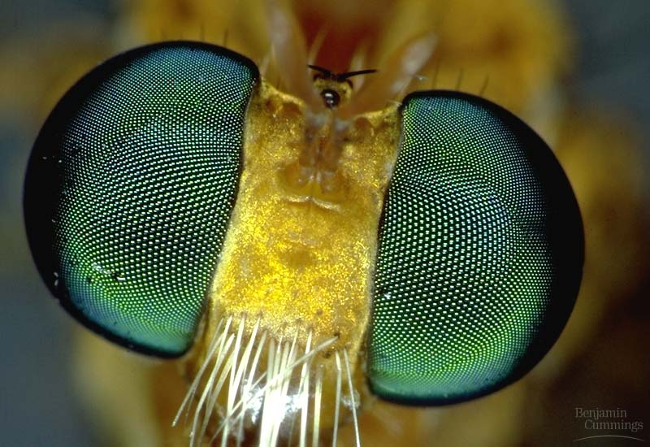
Characteristics
Compound eyes (have many individual units)
Excretory structures called Malpighian tubules
Wings in many of the groups
Respiration using spiracles and trachea

Slide 8
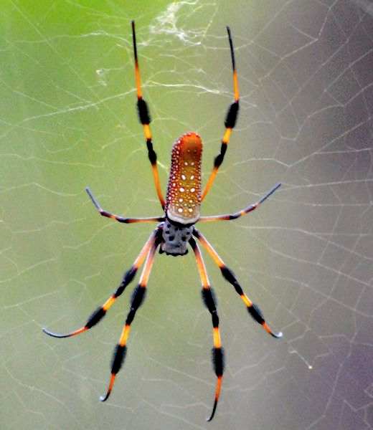
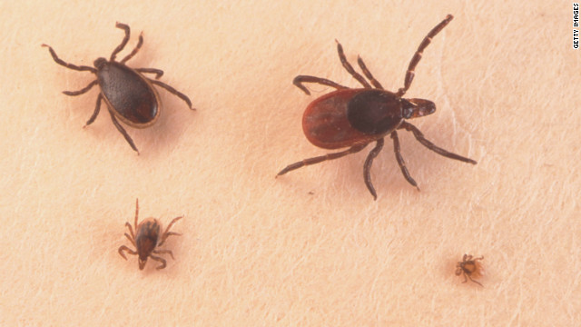
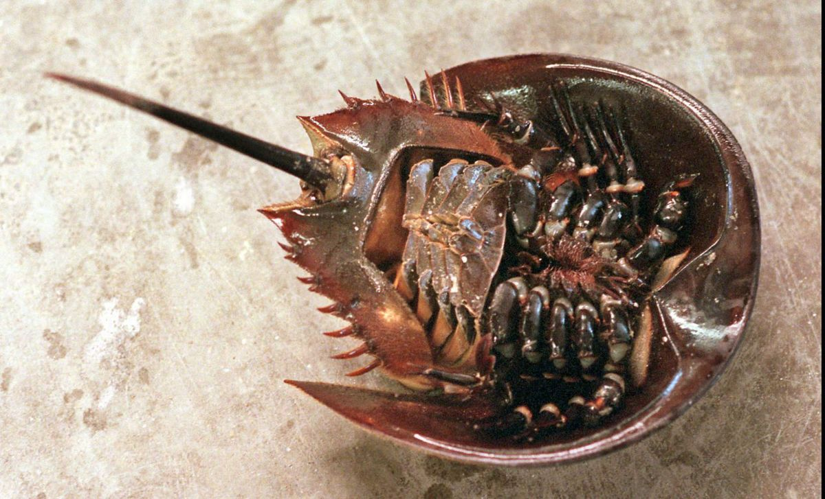
Subphylum Chelicerate
Includes (Class Arachnida) spiders, ticks, scorpions, mites and horseshoe crabs
Have a cephalothorax (fused head& thorax) and abdomen
No antenna

Slide 9
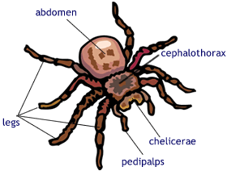
Subphylum Chelicerate
Spinnerets in spiders make webs
Have 6 pairs of jointed appendages:
Chelicerae - claws or fangs (1 pair) - (spiders have venom)
Pedipalps - used for feeding, sensing, transferring sperm (1 pair)
Walking legs - movement (4 pairs)

Slide 10
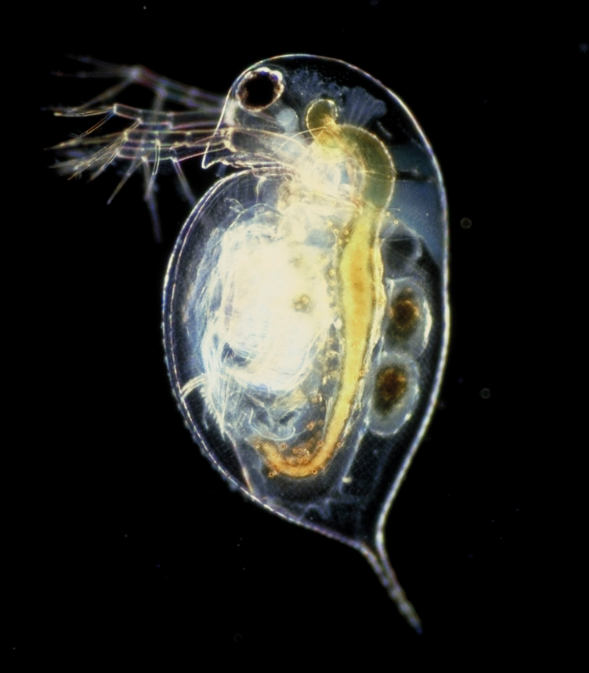
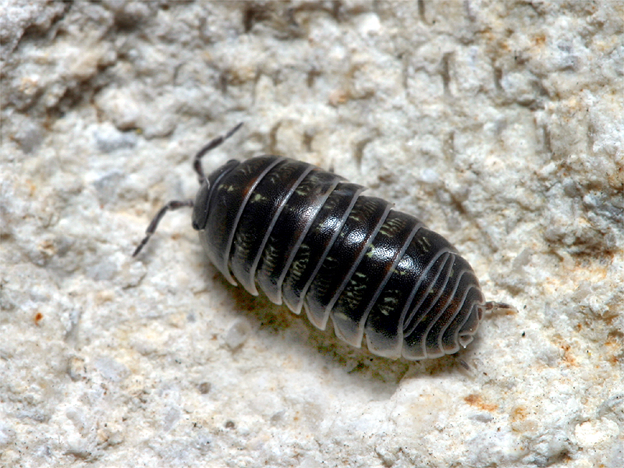
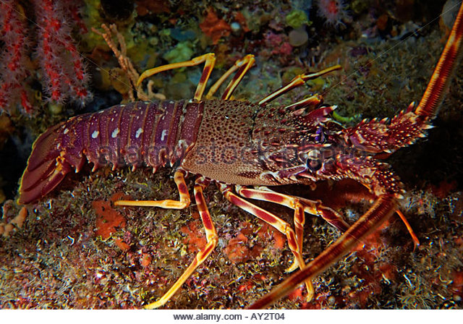
Subphylum Crustacea
Marine members include shrimp, lobster, barnacles, & crabs
Terrestrial crustaceans called isopods (pillbugs or roly-poly's)
Freshwater members include crayfish and daphnia

Slide 11
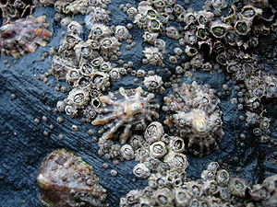
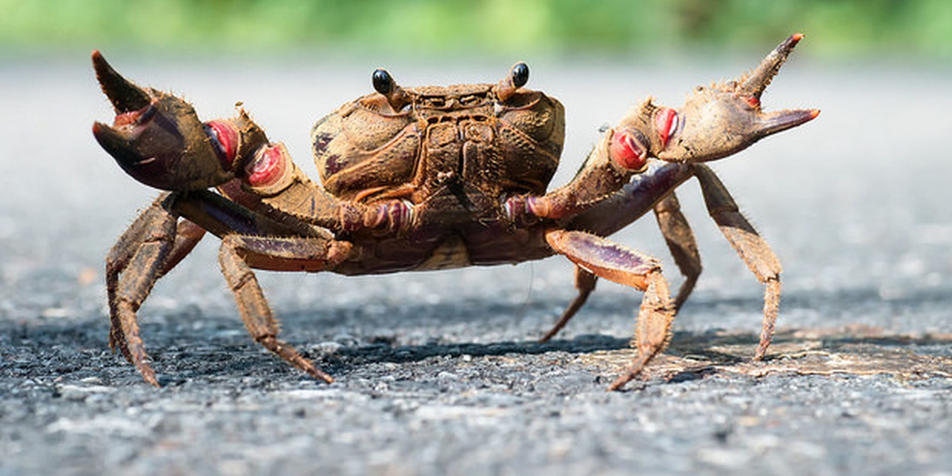
Subphylum Crustacea
All have mandibles for chewing or tearing
Have cephalothorax & abdomen
Barnacles are sessile
Lobsters and large custraceans are called Decapods (Deca=10)
Have 10 pairs of jointed appendages
Breathe through gills

Slide 12
Subphylum Uniramia
Includes 3 classes --- Chilopoda (centipedes), Diplopoda (millipedes), and Insecta

Slide 13
Class Chilopoda
Centipedes (predators)
Name means "100 legs"
Flattened body
Have 1 pair of legs per body segment
Pincers can inject venom

Slide 14
Class Diplopoda
Millipedes
Name means "1000 legs"
Have 2 pairs of legs per body segment
Rounded body
Scavengers or herbivores

Slide 15
Class Insecta
3 pairs of legs
3 body parts - head, thorax, abdomen
Wings in most
All appendages attach to the thorax
9-11 segments in abdomen
Mandibles for chewing

Slide 16
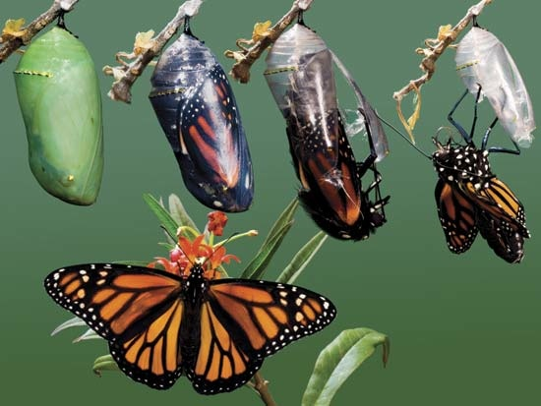
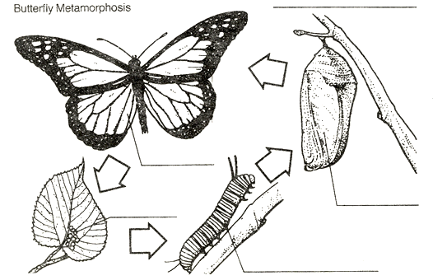
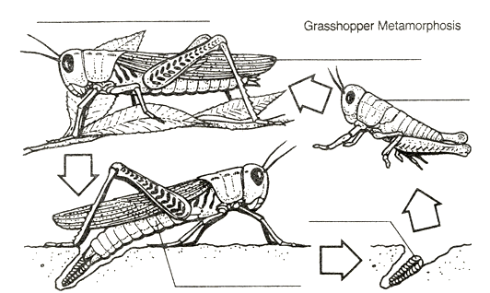
Insect Life Cycle
Metamorphosis - dramatic physical change
Complete metamorphosis: Larva →pupa → adult (example: butterflies) Incomplete metamorphosis: Egg →nymph →adult (example: crickets)

Slide 17
Social Insects
Honeybees
Queen: Lays eggs (1 queen per hive)
Drones: a few males to fertilize eggs
Workers: all infertile females
Termites
Reproductives (king, queen, swarmers)
Soldiers
Workers
Some wasps

