Slide 1
What is a Biome?
Chapter 6

Slide 2
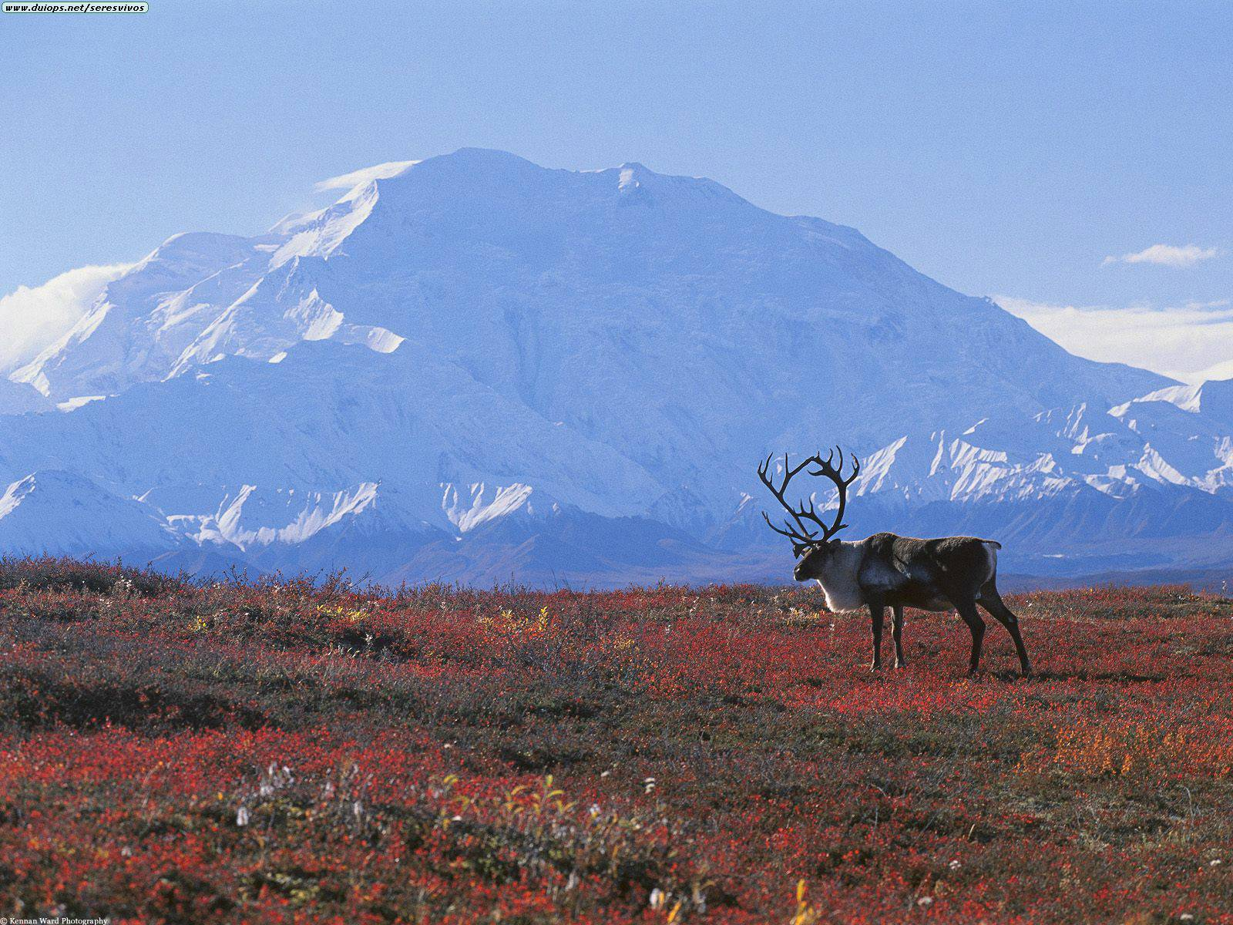
Biomes
Biome: is a large region characterized by a specific type of climate and certain types of plants and animal communities

Slide 3
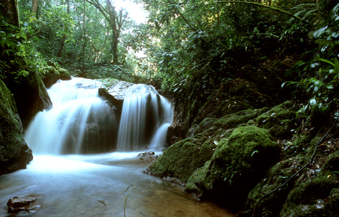
Biomes and Vegetation
Biomes are described by their vegetation because plants that grow in a certain region are most noticeable characteristics of that region
Depending on types of plants present in a biome depends on what types of other organisms are found in a biome
Plants in a particular biome have adaptations that enable them to survive there.

Slide 4
Biomes and Climate
Biomes are defined by their plant life, but what factors determine which plants can grow in a certain area depends mainly on the climate.
Climate is the weather conditions over a longer period of time
Includes temperature, precipitation, humidity, and winds
Temperature and precipitation are the two most important factors

Slide 5
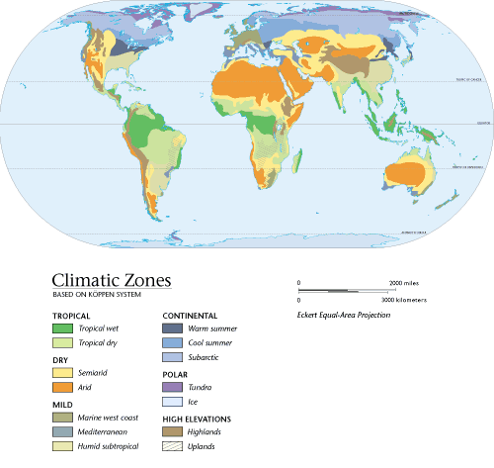

Slide 6
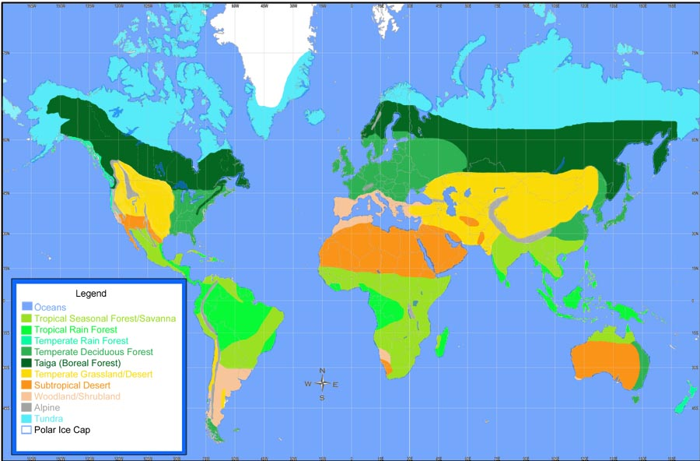

Slide 7
Latitude and Altitude
Biomes and vegetation vary with latitude and altitude.
Latitude: is the distance north or south of the equator
Is measured in degrees
Altitude is the height of an object above sea level
Climate gets colder as latitude and altitude increase

Slide 8
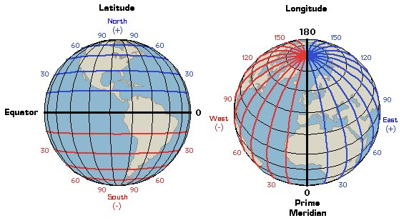

Slide 9
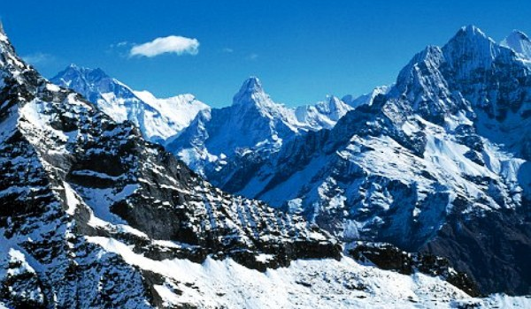

Slide 10
Forest Biomes
Chapter 6 Section 2

Slide 11
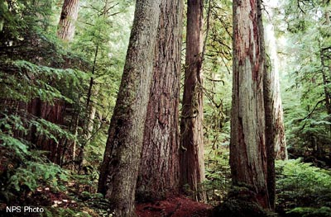
Forest biomes
Forests are the most widespread and are home to the greatest diversity of plants, animals and other organisms
Greatest species diversity
Trees need lots of water, so precipitation must be plentiful

Slide 12
Tropical Rain Forests
Tropical rain forests are located in a belt around the equator
They help regulate world climate and play vital roles in the nitrogen, oxygen and carbon cycles
Humid and warm and get around 200-450 cm of rain a year
Strong sunlight year round
Ideal for a wide variety of plans and animals

Slide 13
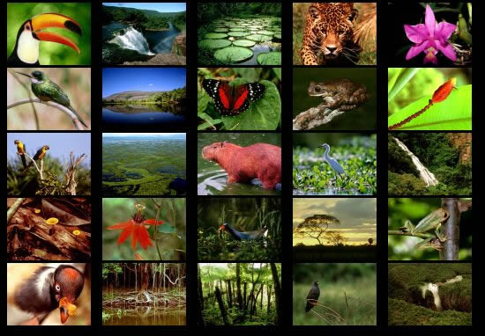

Slide 14
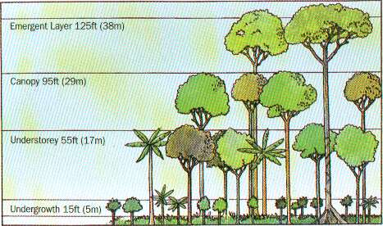
Tropical Rain forests
Layers of the Rain Forest
Emergent layer: top layer
Canopy: primary layer; divided into the upper and lower
Understory: little to no sunlight, short plants

Slide 15
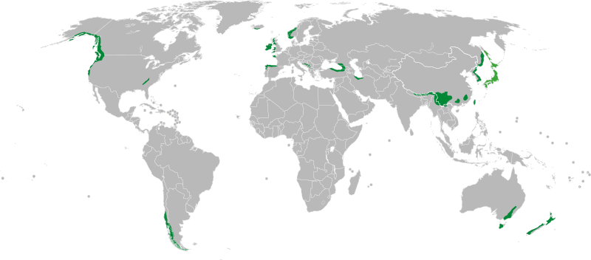
Temperate rain Forests
Temperate Rain forest have large amounts of precipitation, high humidity and moderate temperatures
Main plants: Evergreen trees, ferns, Douglas fir, redwoods

Slide 16
Temperate Deciduous Forests
Temperate deciduous forests: trees drop their leaves each fall
Located between 30º ^{to} 50º north latitudes
Seasons – temperatures range from below freezing to 35ºC
Plants: grow in layers like the tropical rain forest – includes maples, oaks, birch, shrubs, ferns, mosses
Animas – bears, squirrels, deer, birds (migrate south)

Slide 17
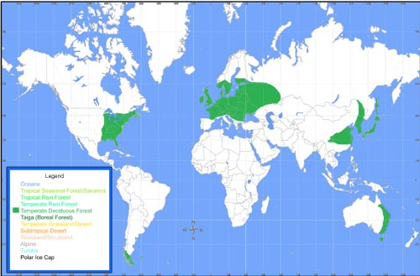

Slide 18
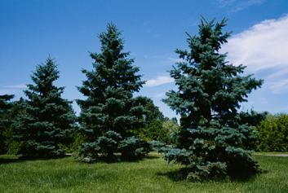
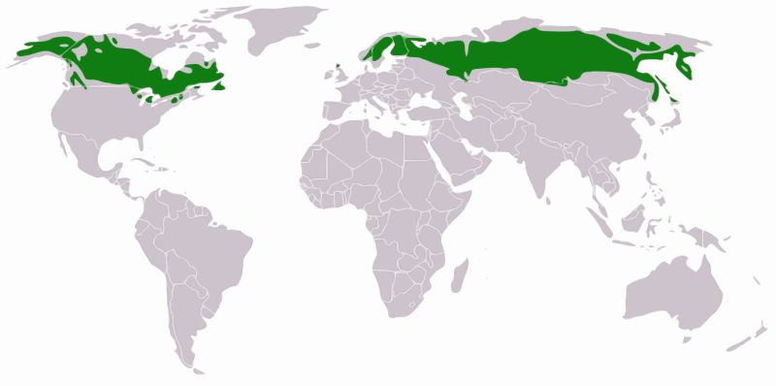
Taiga
Taiga is the northern coniferous forest that stretches in a broad band across the Northern hemisphere just below the artic circle
Plant growth is most abundant during the summer
Plants: conifer trees (needle-like leaves)
Animals: birds that migrate south, many animals migrate in the winter,

