Slide 1
Biomes

Slide 2
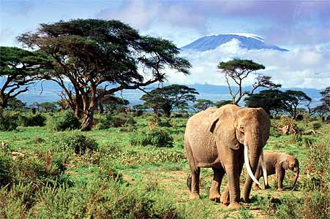
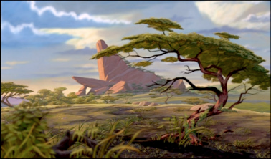
Savannas
Savanna is a tropical biome dominated by grasses, shrubs, and small trees
Wet season for a few months of the year
Animals: antelopes, giraffes, elephants, cheetahs, lions, hyenas
Plants: must be able to survive the long dry seasons

Slide 3
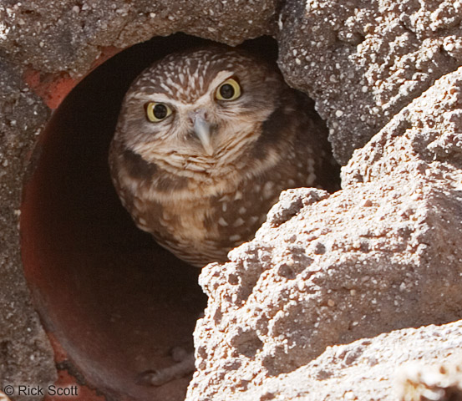
Temperate Grasslands
Temperate grassland covers large areas of the interior of continents
Plants: grasses and wildflowers, shrubs and trees only grow where the soil contains extra water like on banks of streams
Animals: bison, badgers, prairie dogs, burrowing owls

Slide 4
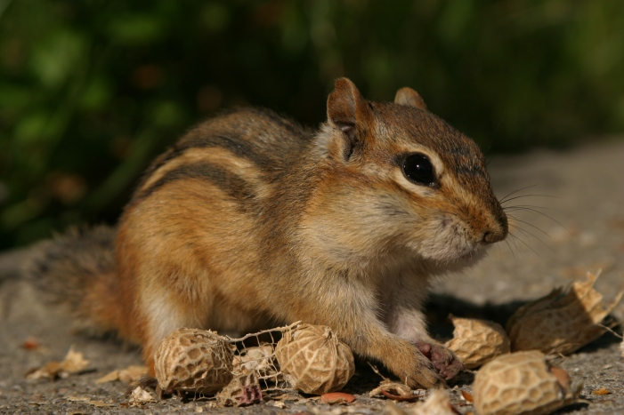
Chaparral
Chaparral is a temperate shrubland that has moderately dry, coastal climates, with little or no rain in the summer
Plants: low-lying, evergreen shrubs and small trees that tend to grow in dense patches
Animals: are often camouflaged including quails, lizards, chipmunks

Slide 5
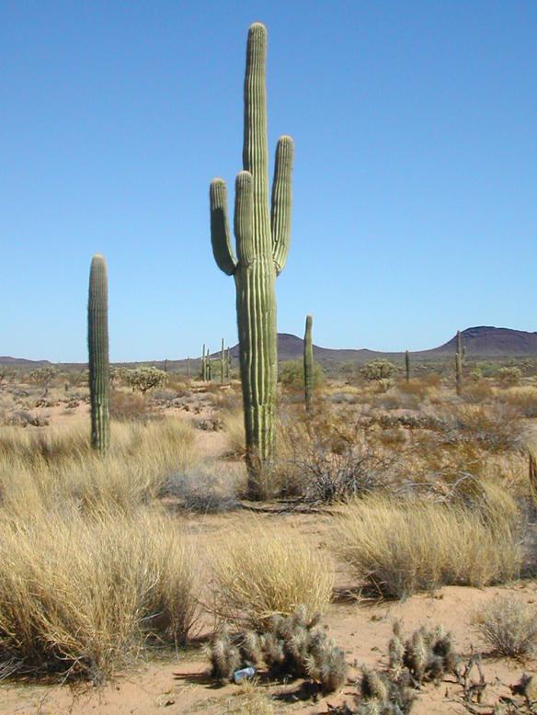
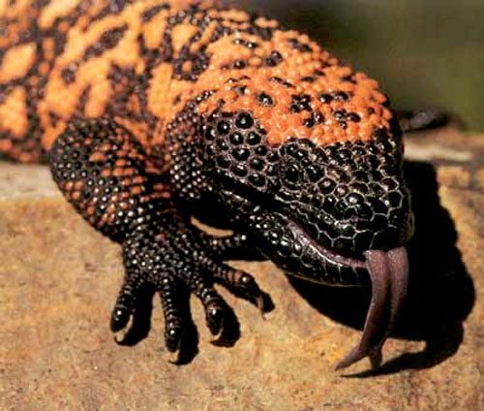
Deserts
Deserts are areas that have widely scattered vegetation and receive very little rain
Plants: all plants have adaptations for obtaining and conserving water
Animals: reptiles with thick, scaly skin that prevents water loss; insects and spiders that have body armor to help them retain water

Slide 6
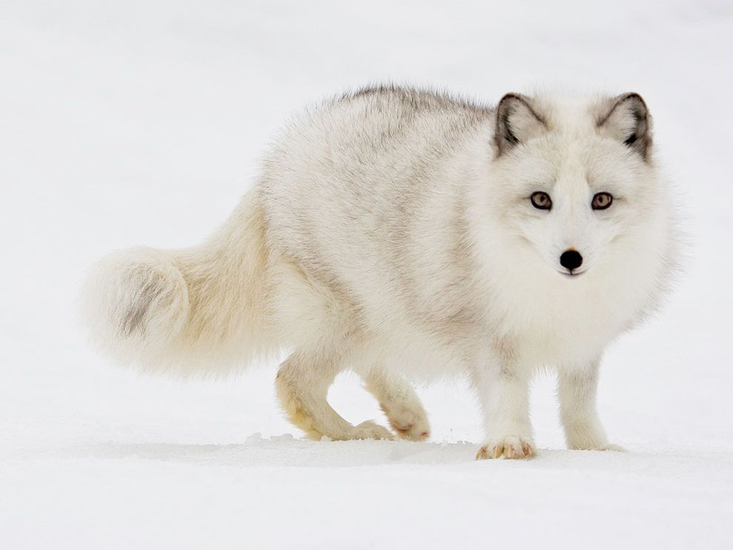
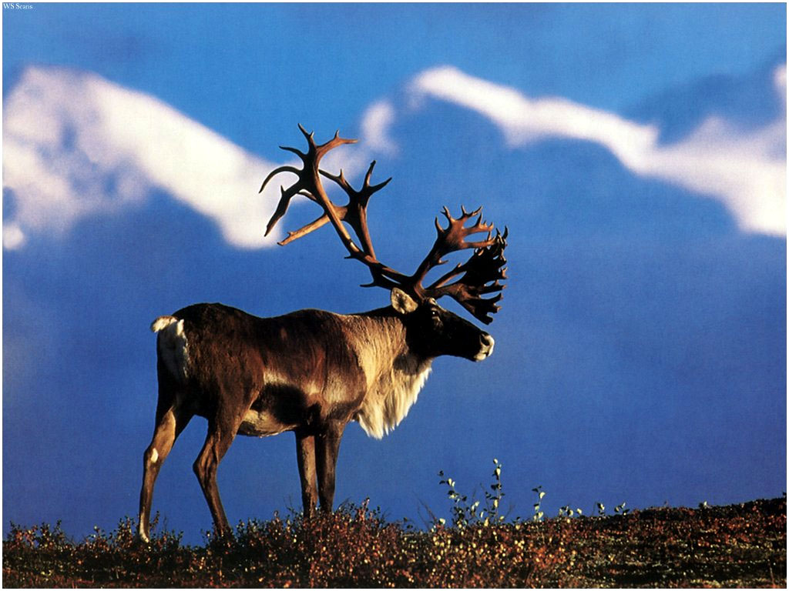
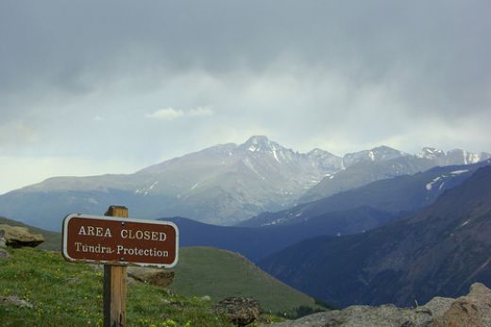
Tundra
Tundra is located in northern artic regions
Permafrost = deeper layers of soil are permanently frozen throughout the year
Vegetation: mosses and lichens cover the rocks, wildflowers, dwarf versions of willows and birch trees
Animals: migratory birds, caribou, wolves, moose, artic foxes

Slide 7
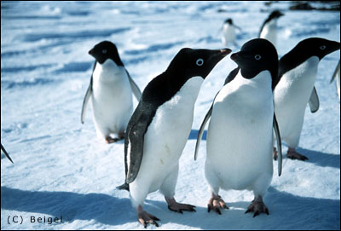
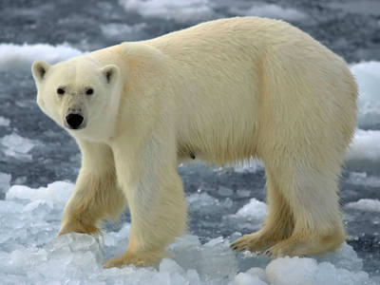
Polar Ice
Climate: pretty much below freezing year round
Antarctica and Most of Greenland
Plants: It’s ICE – there are no higher plants. In some cases algae may grow in the snow which gives it a pinkish color
Animals: polar bears, penguins, seals, whales

