Slide 1
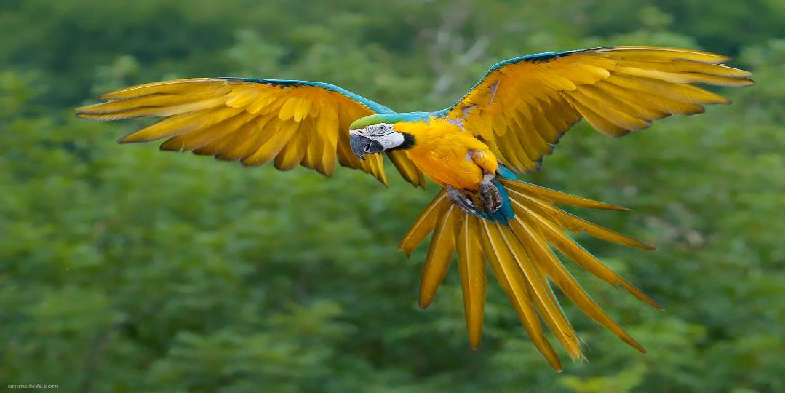
Birds Kingdom Animalia Phylum Chordata Class Aves

Slide 2
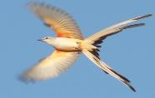
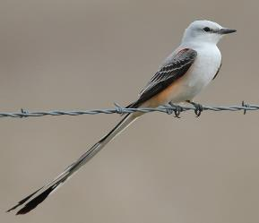
Characteristics of Birds
1. Closely related to reptiles
2. Maintains internal body temperature: Endothermic
3. 2 legs covered with scales
4. Front limbs modified into wings
5. Body covered with feathers
6. Lay eggs with calcium shell
7. Beak with no teeth
8. Hollow Bones = reduces weight
9. Bones are fused = reduces weight

Slide 3
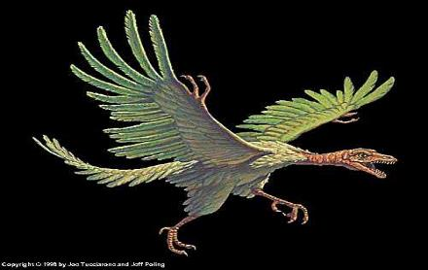
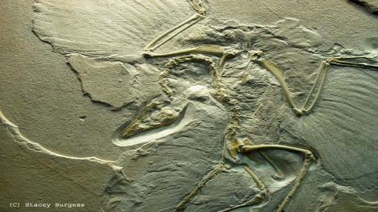
Evolution of Birds
Paleontologists consider birds a dinosaur with feathers
Archaeopteryx is an early bird
Archaeopteryx means dinosaurlike & birdlike

Slide 4
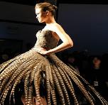
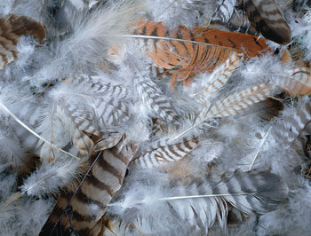
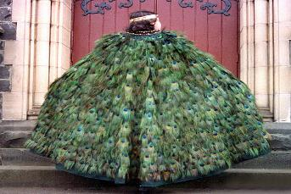
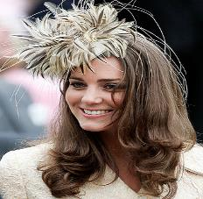
Feathers
Feathers are made of a protein called keratin
Keratin gives feathers strength & flexibility

Slide 5
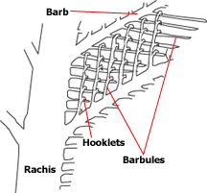
Parts of the Feather
Central shaft: The central shaft of a feather is divided into two regions.
1. The calamus is the part of the shaft closest to the bird's body. It is hollow and does not contain any vanes.
2. The distal end of the central shaft is referred to as the rachis. The rachis is solid and is defined as the area to which vanes are attached.

Slide 6
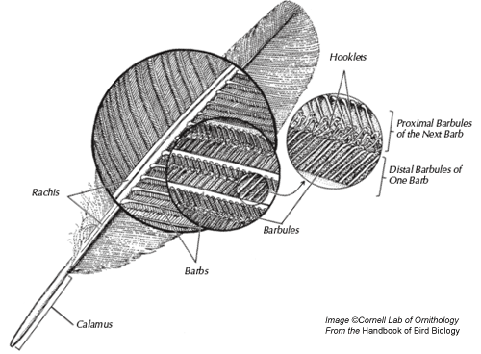
Parts of the Feather
Vanes:
The vanes extend from each side of the feather. A series of parallel branches called barbs make up the vane.
Extending from the barbs are a series of short branchlets called barbules. Tiny hooklets tie the barbules, and ultimately the barbs, together. This somewhat complex arrangement creates the strong but light structure of the feather.

Slide 7
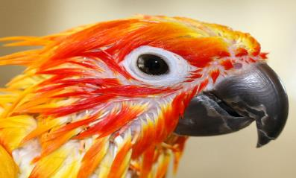
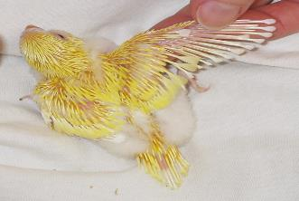
Pin Feathers
Pin Feathers: A pin feather, sometimes called a "blood feather", is a developing feather on a bird. Unlike a fully-developed feather, the pin feather has a blood supply flowing through it. If the pin feather is damaged, a bird can bleed heavily.

Slide 8
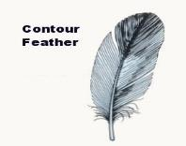
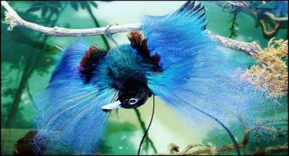
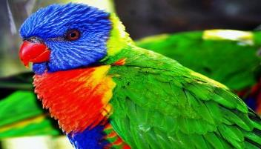
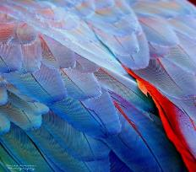
Types of Feathers
1. Contour Feather: Are the outer feathers
Give birds their coloring
Used for flight
The contour feathers tend to lie on top of each other, much like shingles on a roof. The feathers tend to repel water, keeping the body dry and well insulated.

Slide 9
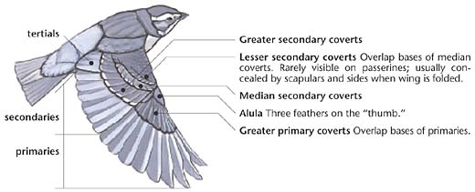
Types of Feathers
2. Remiges: Large flight feathers.
The outer remiges are referred to as the primaries and are the largest and strongest of the flight feathers. They are attached to the skeletal equivalent of the "hand" of the bird.
The inner remiges are called the secondaries and are attached to the "forearm" of the bird. They are located between the body of the bird and the primaries. The secondaries provide lift in both soaring and flapping flight.

Slide 10
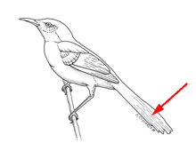
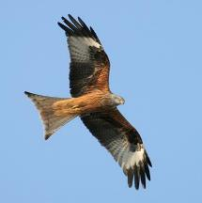
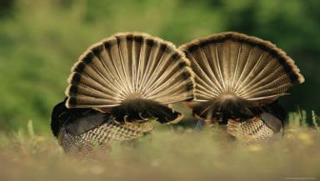
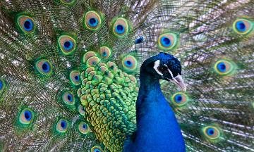
Types of Feathers
3. Rectrices: Tail feathers
The tail feathers are used to provide stability and control. They are referred to collectively as rectrices.

Slide 11
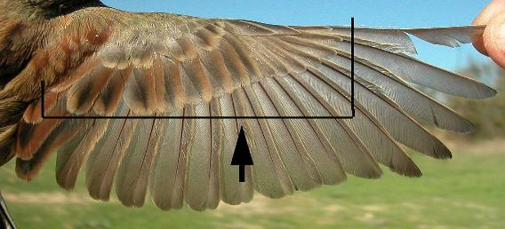
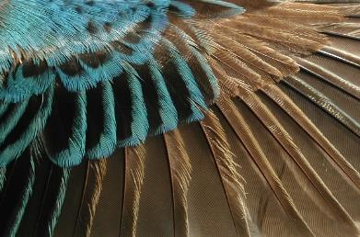
Types of Feathers
4. Coverts: Bordering and overlaying the edges of the remiges and the rectrices on both the lower side and upper side of the body are rows of feathers called coverts. The coverts help streamline the shape of the wings and tail while providing the bird with insulation.

Slide 12
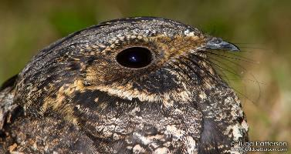
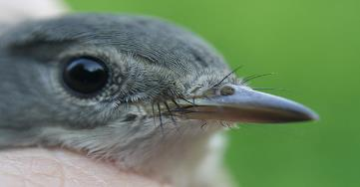
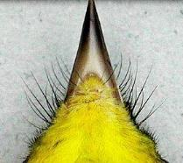
Types of Feathers
5. Bristles: “whisker-like” feathers Specialized feathers, bristles are small contour feathers which lack barbs.
Bristles project from the beak of many insect-eating birds, including flycatchers, nightjars and even the American Robin. They are believed to provide protection for the bird's eyes as it consumes wriggly prey. The bristles may also provide tactile feedback, like the whiskers on a dog or cat.

Slide 13
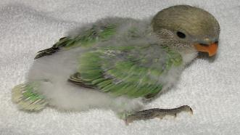
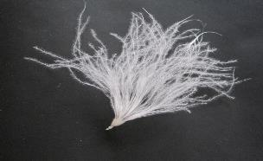
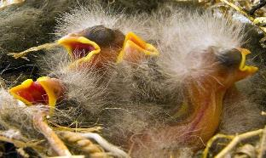
Types of Feathers
6. Down Feathers: Inner feathers that are soft, finely-divided feathers used to help keep warm
Trap a layer of air to provide insulation
Lack hooks to lock the feathers together
Down feathers are the feathers that cover the bodies of young birds.

Slide 14
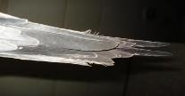
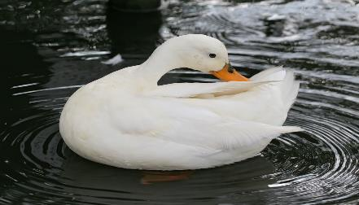
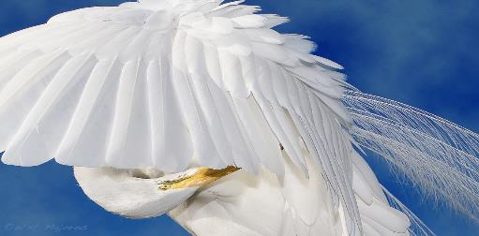
3 Reasons for Preening
Preening: The process by which birds groom and care for their feathers.
Birds spend several hours a day preening
The bird uses its beak like a comb to draw together
the barbs and barbules to stop feathers from fraying

Slide 15
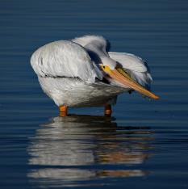
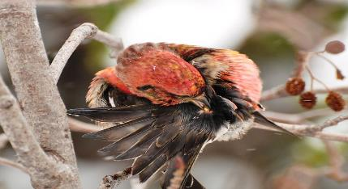
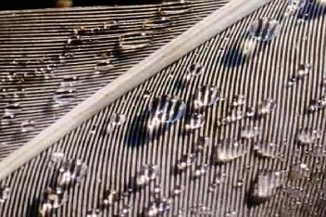
3 Reasons for Preening
Birds have ONE oil gland in their skin at the base of
their tail called the uropygial gland.
They squeeze oil from this gland with their beak, and coat their feathers with the oil.
The oil helps water proof the feathers & protects against parasites like lice.

Slide 16
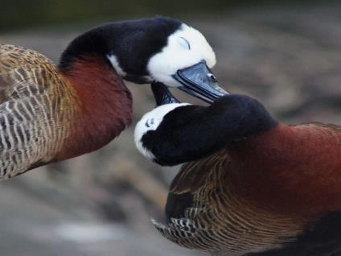
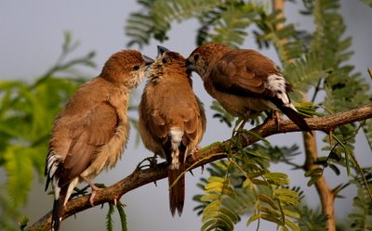
3 Reasons for Preening
Preening helps with pair bonding during breeding season.

Slide 17
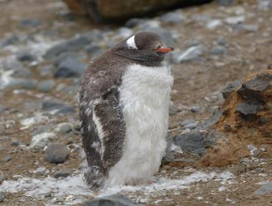
Molting
When a bird’s feathers become worn-out & damaged, it is replaced by new feathers.
Molting: Process of shedding feathers and replacing them with new feathers
Most birds molt once a year
Some molt with a season,
others molt a little at a time.

Slide 18
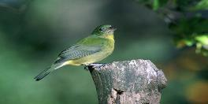
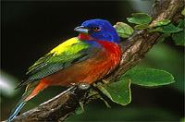
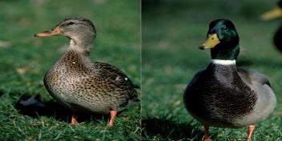
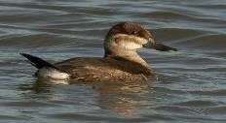
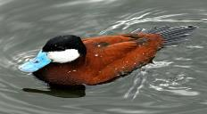
Sexual Dimorphism
Plumage can help birds (& people) identify who are males and who are females.
Males tend to be more colorful
Females tend to have camouflaged coloring

Slide 19
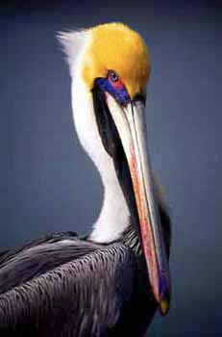
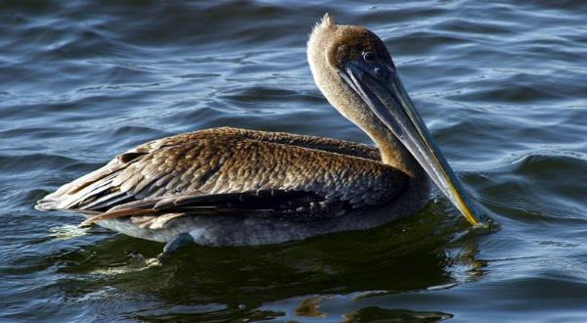
Age
Coloring can sometimes determine the age of a bird
Adolescent birds can be a different color than those who are of breeding age.
Adolescent Brown Pelican
Adult Brown Pelican

Slide 20
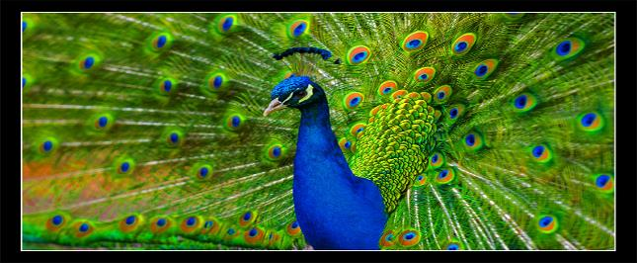
Breeding Plumage
Feathers are a form of advertising
Male birds show off their plumage to the female
Demonstrates vigor & skill of a bird’s display which indicates fitness as a mate.

Slide 21
Feeding
Birds eat often to generate heat – endothermic
Smaller birds eat more often than larger ones
Have beaks or bills, NO teeth
Insectivore: Insect eaters - short/fine beaks
Seed eaters: short/broad/thick beaks
Carnivore: Meat eaters - strong hooked beaks
Nectarivore: Nectar eaters - long/thin beaks
Piscivore: Fish eaters – long with hook on end

Slide 22
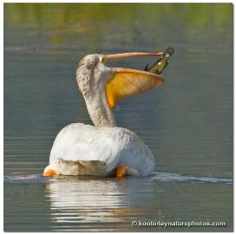
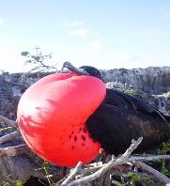
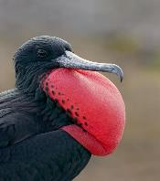
Feeding Techniques
Some birds have a gular pouch; also called a throat pouch.
Pelicans use their pouch to scoop fish
Frigate birds use their pouch to attract a mate
This pouch can also be used to release heat.

Slide 23
Feeding Techniques
Plunge Dive: Bird flies high above the water to spot fish. Then pulls its wings back to plunge into the water to catch the fish.

Slide 24
Feeding Techniques
Skimmers: Fly along the surface of water with bill open. When the bill is touched by a fish, it snaps shut.
Black Skimmers

Slide 25
Feeding Techniques
Canopy Feeding: The bird brings its wings up over its head to create a shadow over the water. Fish think it is a hiding place, and the bird can see the fish much easier.
Reddish Egret Canopy Feeding

Slide 26
Feeding Techniques
Nectar feeding: Hummingbirds have long straw like beaks. They suck out nectar from flowers.
Are the only birds that can fly backwards!
They MUST eat about every 15 minutes.
Important to plants!....helps with pollination

Slide 27
Feeding Techniques
Impels its food on thorns & barbed wire fences
A method of “storing” food

Slide 28
Digestive System
Birds can not chew food
Crop: Structure located at the lower end of the esophagus in which food is stored and moistened.

Slide 29
Digestive System
Birds swallow food and store it in their crop. Then the food passes into their stomach. Then the food passes into the gizzard.
The gizzard can grind the food with previously-swallowed stones and pass it back to the true stomach.
Because they lack teeth, birds swallow stones or grit to aid in digestion. All birds have gizzards, but not all will swallow stones or grit. The stones help grind the food in the gizzard.

Slide 30
Courtship
Includes colorful feathers, songs, dances, aerial displays, postures, or calls.
Males must attract a mate.
The sequence of courtship:
Territory defense and song
Mate attraction displays
Courtship feeding
Selection of the nesting site

Slide 31
Nests
A brood patch is a patch of featherless skin that is visible on the underside of birds during the nesting season. This patch of skin is well supplied with blood vessels at the surface making it possible for the birds to transfer heat to their eggs when incubating.
The purpose of a nest is for birds to have a protected, warm place to incubate their eggs and then to raise their young once they hatch.

Slide 32
5 Major Types of Nests
Cavity: Is a hollowed-out opening in the trunk of a tree either found naturally in dead trees or purposely made by birds.
- The opening is much smaller than the actual nest inside.
Examples: Chickadees, Nuthatches, woodpeckers, & Bluebirds

Slide 33
5 Major Types of Nests
Cup: Made from materials such as grass, moss, string, or spider web. Nest is course on the outside of the nest, and soft materials to cushion the inside.
Examples: Sparrows, Finches, Hummingbirds

Slide 34
5 Major Types of Nests
Pendulum: Built from mosses and small twigs into a hanging sac-like shape. Usually suspended from a small tree branch.
Examples: Kinglets & Orioles

Slide 35
5 Major Types of Nests
Platform: Mostly flat and supported by tree limbs. Commonly found on the ground in marshy areas or tops of large dead trees. Raptor’s nest can be extremely large.
Examples: Raptors, Crows, Some Waterfowl

Slide 36
5 Major Types of Nests
Spherical: Globe or ball-shaped. Made of grasses with a single opening. Some make an “active” nest that the bird is using, and a “dummy” nest to defer or confuse predators away from the active nest.
Examples: Marsh Wrens

Slide 37
Eggs
Clutch: A group of eggs in a nest.
Eggs come in many shapes, sizes, & colors.
Incubation ranges from a few days to several weeks depending on the species of bird.
Chicks have an egg tooth to chip at the egg in order to hatch.
Hatching takes a lot of effort and hard work for the chick. Can take hours.

Slide 38
Label your egg diagram!

Slide 39
Anatomy of the Egg
Shell: hard calcium carbonate crust covering and protecting the egg.
Air space: part of the egg containing only air.
Vitellus or yolk: part of the egg which develops into an embryo once the egg has been fertilized.
Albumen or white: white of the egg, which nourishes the embryo once the egg has been fertilized.
Chalaza - a spiral, rope-like strand that anchors the yolk in the thick egg white. There are two chalazae anchoring each yolk; one on the top and one on the bottom.
Embryo: bird which has not yet hatched.

Slide 40
Baby Chicks
Precocial: Hatch with eyes open, able to walk & swim, and covered in down.
Examples: Ducks, Chickens, and Gulls

Slide 41
Baby Chicks
Altricial: Hatched with eyes closed & naked; helpless and completely dependant on parents.
Examples: Robins, Cardinals, & most song birds

Slide 42
Baby Chicks
Mother and Father birds catch food for their babies.
Some parents must swallow the food and store the food in its crop before feeding it to their babies. This helps with the digestion process, and then they regurgitate the food into the baby’s mouth.

Slide 43
Fledglings
Fledge: (of a young bird) having acquired its flight feathers
A young bird that has recently fledged but is still dependent upon parental care and feeding is called a fledgling.

Slide 44
Baby Chicks
Myth: If you touch a baby chick, then the mother will reject it because it can smell humans.
Most birds have very poor sense of smell.
If you can see the nest that the baby fell from, return it to the nest, and the parents will take care of the rest.

Slide 45
Groups of Birds

Slide 46
Birds of Prey
Live by killing and eating other animals
Have hooked beaks
Have large feet with strong curving talons (claws) – used for capturing and grasping prey
Birds of prey seize their prey with their feet as they swoop down from the air
Eagles are the largest birds of prey

Slide 47
Birds of Prey
2 groups of birds of prey:
Nocturnal: Hunt at night
Diurnal: Hunt during the day
Able to “lock” on to prey – They see 8 times better than humans do

Slide 48
Parrots
Most know what a parrot looks like
Have curved strong bills
Ability to mimic human speech
Some can live for 50 years

Slide 49
Parrots
Often kept as pets
Many species are victims of the pet trade: captured from the wild and most are transported in inhumane conditions.

Slide 50
Parrots
Problems with pet parrots:
Loud
Messy
Needs lots of space & attention
Get bored easily
Can be destructive

Slide 51
Perching/Song “Passerines”
Passerines: Perching birds make up the largest group of birds
Beaks are designed for the type of food they eat
Perching foot = 3 toes point forward & one points backward

Slide 52
Groups of Birds
Wading Birds: Includes herons, flamingos, storks, spoonbills, and ibises
Long skinny legged and live near shallow water
Have long splade toes to distribute weight in mud
Eat fish, crustaceans, mollusks, and small mammals

Slide 53
Groups of Birds
Lobed feet: Includes coots & grebes
Lobes that aid in swimming and walking on mud & vegetation

Slide 54
Groups of Birds
Swimming Birds: Have short legs with webbed feet. Ducks do not have teeth. The lamellae look like teeth, but are formed out of the hard material of the mandible that allows the duck to strain food from the water.

Slide 55
Groups of Birds
Woodpeckers: Have strong bills for drilling and drumming on trees and long sticky tongues for extracting food. Two toes forward & two toes backwards. This foot arrangement is good for grasping the limbs and trunks of trees. Members of this family can walk vertically up a tree trunk, which is beneficial for activities such as foraging for food or nest excavation.

Slide 56
Flightless Birds
Penguins: Live in southern hemisphere. Most are cold weather, but the Jackass penguin lives off the coast of south Africa. Wings are used for swimming and steering.

Slide 57
Flightless Birds
Ostrich: Found in Africa. Have very long strong legs used to reach speeds of 40 mph. Weighing up to 250 lbs, it is the largest bird. Wings are used during mating displays. Lay 3 lbs eggs.
They do not burry their heads in the sand (myth).

Slide 58
Flightless Birds
Kiwi: Found in New Zealand. It is about the size of a chicken, and lays the largest egg of all birds (compared to its body size). The egg is almost as big as an ostrich egg.

Slide 59
Migration
Migration: Periodic movement and return of animals from one place to another.
Immigration: Movement of individuals into an area occupied by an existing population, and stay.

Slide 60
Migration
Why Migrate?
- Seasons change habitats
- Birds move to a more suitable habitat during unfavorable seasons (winter)
- Find food, shelter, water, & a place to raise family

Slide 61
Migration
How Birds Navigate their Migration:
- Some use landmarks like rivers & mountains to guide them.
- Some use earth’s magnetic fields
- Some use the positions of the stars & sun

Slide 62
Migration
Migration pattern depends on the species
Flyways: Routs birds take to accomplish their journey.
The U.S. has 4 main flyways: Pacific, Central, Mississippi, and Atlantic.

Slide 63
Migration
Many ornithologists study birds near radio towers.
The wires that help support the towers are unseen by the birds, and they collide into them.
The researcher can see which species are flying in the area and how many by identifying the corpses of birds on the ground around the towers.

Slide 64
Symbol of Fertility
The Stork is a symbol of fertility in Scandanavia. If a stork builds a nest on a person’s house, then they are said to have excellent luck conceiving a baby soon.

Slide 65
More Symbols
Georgia State Bird: Brown Thrasher
Dove: Peace and Harmony
Ravens: Predicts a death
Owl: Prophet of doom – Also seen as wise

Slide 66
One for the Record Books
Largest Bird (9 ft tall): Ostrich
Fastest bird/animal (200 mph): Peregrine Falcon
The Smallest Bird (2.5’’): Bee Hummingbird

Slide 67
One for the Record Books
Fastest Swimmers: Gentoo Penguin
Longest Migration (25,000 miles per year): Arctic Tern
Largest Tongue: Flamingo
Largest Wing Span: Wandering Albatross (9-14 feet wide)

