Slide 1
Cardiac Cycle
Cardiac Cycle = events of one complete heart beat or pumping cycle
The two atria contract at the same time, then they relax while the two ventricles simultaneously contract.
The contraction phase of the ventricle chambers is called systole.
The relaxation phase is called diastole.
At a normal heart rate, one cardiac cycle last for 0.8 seconds!

Slide 2
Cardiac Cycle Pathway
Atria contract (arterial systole)- blood rushes in ventricles
Ventricles contract(ventricular systole)
Atrioventricular valves close/ atria relax- Sound 1 of beat- “Lubb”
Semilunar valves open
Ventricular diastole(ventricles relax)
Atria relax (arterial diastole)
Blood enters atria from veins
Pressure increases in atria as blood fills
Atriventricular valves open/ Semilunar valves close- Sound 2 of beat- “Dubb”
Blood moves into ventricles (back to first bullet)

Slide 3
Heartbeat Sounds
TIME
VENTRICULAR SYSTOLE AND DIASTOLE
SYSTOLE- PUMPING BLOOD TO BODY AND LUNGS
DIASTOLE- BLOOD REFILLING IN HEART
S1- “LUB” SOUND
S2- “DUB” SOUND

Slide 4
CARDIAC CYCLE CLIP-https://www.youtube.com/watch?v=5tUWOF6wEnk
Heart sounds- http://depts.washington.edu/physdx/heart/demo.html
Heart murmur- turbulence in heart beat
Normal/functional-beats more quickly such as fever, anemia, hyperthyroidism, and pregnancy.
Other reasons- valve problems, congenital abnormalities, heart attack, stroke, aneurism

Slide 5
Pulse “Heart Rate”
Pulse
Pressure wave of blood
Monitored at “pressure points” in arteries where pulse is easily palpated
Pulse averages 70–76 beats per minute at rest
40-60 –athletes
Above normal- tachycardia
Below normal- bradycardia

Slide 6
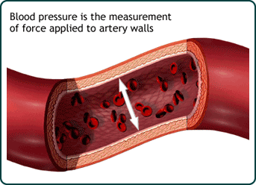
Blood Pressure
Force/ Surface Area
Blood Pressure readings are ranges
Ex. 115/75
Where? Draw pic on board
When?

Slide 7
Blood Pressure
Measurements by health professionals are made on the pressure in large arteries
Systolic—pressure at the peak of ventricular contraction
Diastolic—pressure when ventricles relax
Write systolic pressure first and diastolic last (120/80 mm Hg)
Pressure in blood vessels decreases as distance from the heart increases

Slide 8
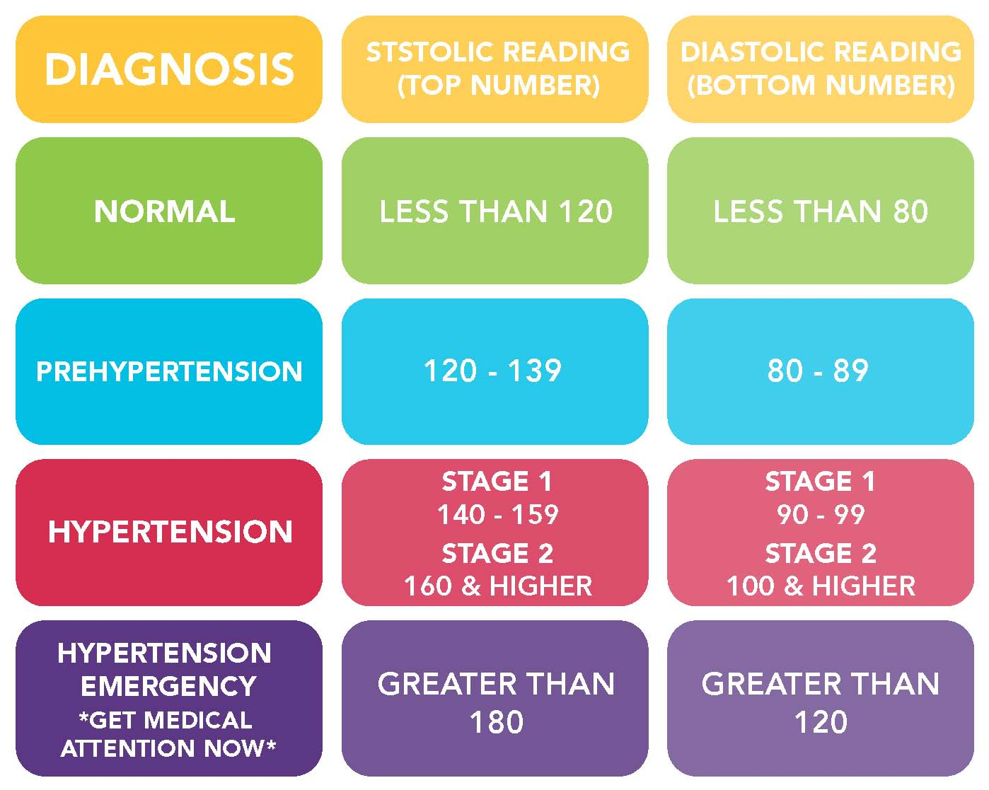
Blood Pressure

Slide 9
Measuring Arterial Blood Pressure

Slide 10
Measuring Arterial Blood Pressure

