Slide 1
Food and Agriculture
Holt Environmental Science
Chapter 15

Slide 2
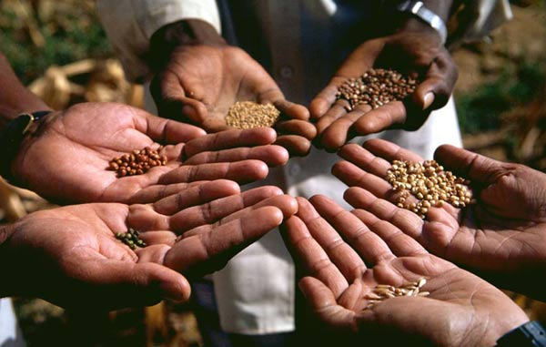
Feeding the World
Section 1

Slide 3
Feeding the world
Famine – widespread starvation caused by a shortage of food
Current world population is about 7 billion people
How can food production be increased without irreversibly damaging the environment?

Slide 4
Humans and Nutrition
The human body uses food as a source of energy and as a source of materials for building and maintaining body tissues.
The amount of energy that is available in food is expressed in Calories (Cal)
1 Cal = 1 kilocalorie = 1,000 calories

Slide 5
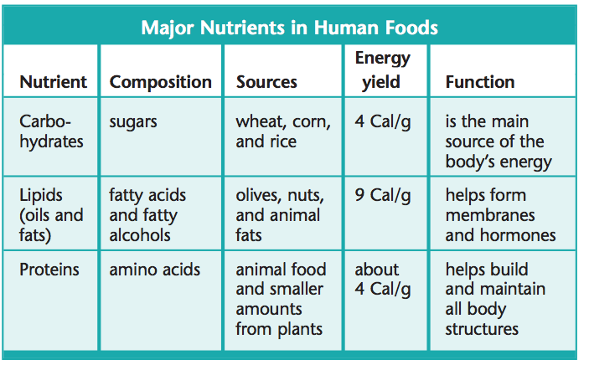
Humans and Nutrition

Slide 6
Humans and Nutrition
Malnutrition is a condition that occurs when people do not consume enough Calories or do not eat a sufficient variety of foods to fulfill all of the body’s needs

Slide 7
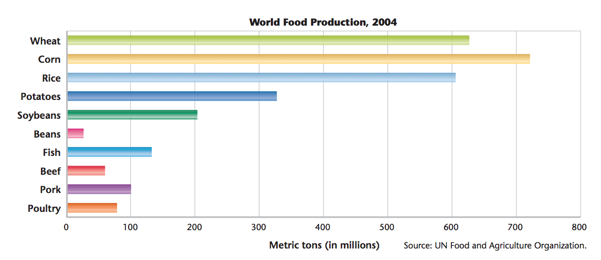
Humans and Nutrition
A person’s diet is the type and amount of food that he or she eats.

Slide 8
Diets around the World

Slide 9
The Ecology of Food
The efficiency of a given type of agriculture is a measure of the quantity of food produced on a given area of land with limited inputs of energy and resources
On average, more energy, water, and land are used to produce a Calorie from food from animals than from a plant

Slide 10
The Ecology of Food
Yield: the amount of food that can be produced in a given area
Researches hope to increase the food production by studying plants and other organisms that have a high yield.
They want organisms that can thrive in various climates and don’t require large amounts of fertilizer, pesticides or fresh water

Slide 11
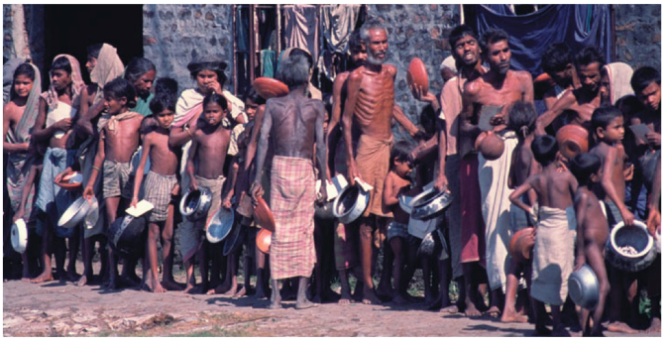
World Food Problems
Malnutrition is almost entirely a result of poverty
Extreme poverty = income less than a dollar per day

Slide 12
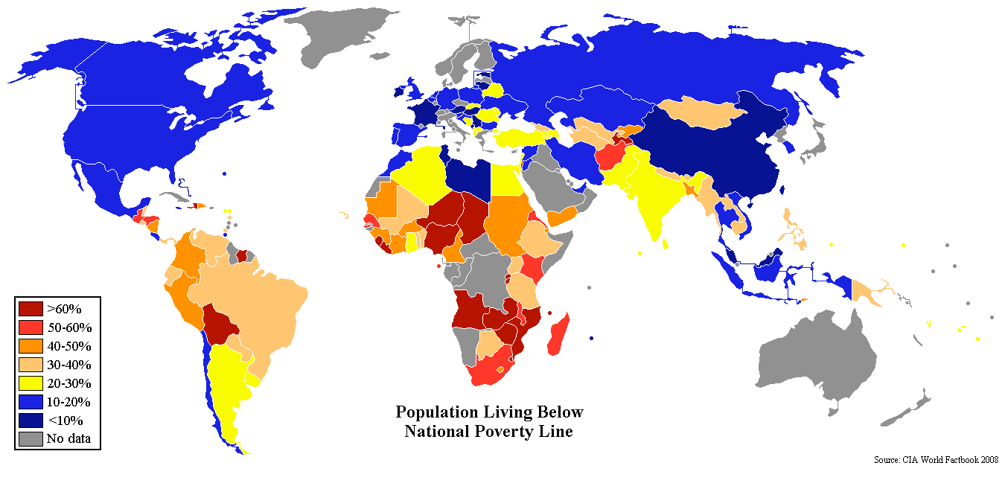
World Food Problems

Slide 13
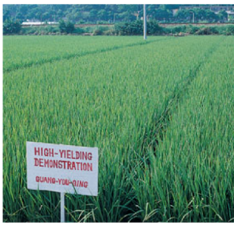
The Green Revolution
New varieties of grains produce large yields when given enough water, fertilizer, and pesticides
The Green Revolution reduced the price of food and improved the lives of millions of people

Slide 14
Crops and Soil
Section 2

Slide 15
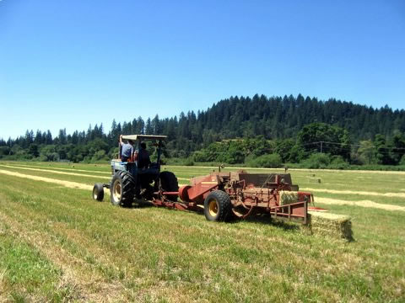
Crops and Soil
Much of the Earth’s surface cannot be farmed. Only about 10% of the Earth’s surface is arable land.
Arable land is land that can be used to grow crops.

Slide 16
Agriculture: Traditional and Modern
The basic processes of farming include plowing, fertilization, irrigation and pest control.
Traditional farming: plows pulled livestock, organic fertilizers (manure), fields irrigated by ditches
Modern farming: machinery used to plow, synthetic chemical fertilizers, sprinklers

Slide 17
Fertile Soil: The living Earth
Soil that can support the growth of healthy plants is called fertile soil.
Plant roots grow in top soil, the surface layer of soil, which is usually richer in organic matter than the subsoil is.
Fertile topsoil is composed of living organisms, rock particles, water, air and organic matter

Slide 18
Fertile Soil: The living Earth
Most soil forms when rock is broken down into smaller and smaller fragments by wind, water, and chemical weathering.
Chemical weathering happens when the minerals in the rock react chemically with substances such as water to form new materials.

Slide 19
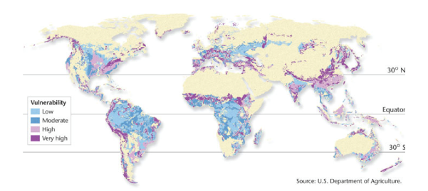
Soil Erosion: A global problem
Erosion is the movement of rock and soil by wind and water
In the US, about half of the original topsoil has been lost to erosion in the past 200 years.
Why is this a problem?

Slide 20
Land Degradation
Land degradation happens when human activity or natural processes damage the land so that it can no longer support the local ecosystem
Desertification is the process in which land in arid or semiarid areas becomes more desert like.

Slide 21
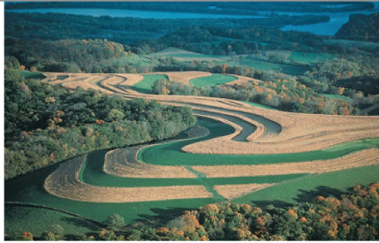
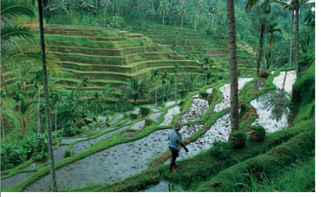
Soil Conservation
Ways to protect and manage topsoil to reduce erosion:
Build soil-retaining terraces on a hill side
Contour plowing on gentle slopes
Leave strips of vegetation instead of plowing the entire hill side
No-till farming

Slide 22
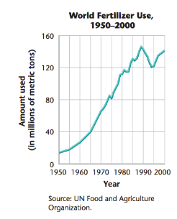
Enriching the soil
Using organic matter or fertilizers, farmers can enrich the soil.
Without fertilizers, world food production would be less than half of what it is today.
Compost: is partly decomposed organic material.

Slide 23
Salinization
The accumulation of salts in the soil is known as salinization
It’s a major problem in California and Arizona, which have low rainfall and naturally salty soil.

