Slide 1
Chemical Reactions
Glencoe Physical Science
Chapter 21

Slide 2
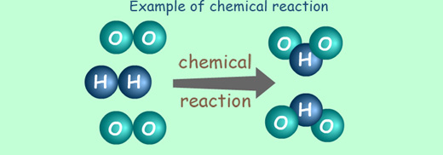
Chemical Reactions
A chemical reaction is a change in which one or more substances are converted into new substances
Original substances are called reactants
New substances are called products
Reactants → Products
2H₂ + O₂ → 2H₂O

Slide 3
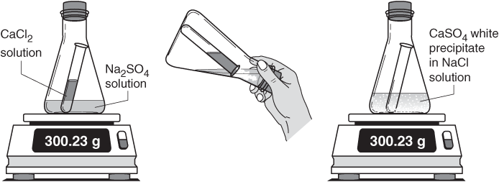
Review: Conservation of Mass
The Law of Conservation of Mass - matter is not created or destroyed, but is conserved
This means the total starting mass of all reactants equals the total final mass of all products

Slide 4
Chemical Equations
A chemical equation is a way to describe a chemical reaction using chemical formulas and other symbols.
Parts of a chemical equation: 6HgO _{(s)} → 6Hg _{(l)} + 3O₂ _{(g)}
Yield Sign
Reactants Products
Small numbers are subscripts
They tell you how many of that element you have
Large numbers in front of a compound are Coefficients
They tell you how many of that compound you have.
These small letters tell you whether it’s a solid (s), liquid (l), gas(g) or aqueous (ag)

Slide 5
Balancing Chemical Equations
To satisfy the Law of Conservation of Mass we must have balanced chemical equations.
A balanced chemical equation has the same number of atoms of each element on both sides of the equation.
Rules to follow:
Never change subscripts
Only adjusting the coefficients
Multiply the coefficient and the subscript to determine how many of an element you have. 5 H₂ = 10, it does not equal 7

Slide 6
How to balance an equation
1. Make a list of each element you have and how many you have on each side of the equation H₂ + O₂ → H₂O
Adjust your coefficients one at a time to balance your equation 2 H₂ + O₂ → 2 H₂O
Check your work.
H = 2
O = 2
H = 2
O = 1
H = 4
O = 2
H = 4
O = 2

Slide 7
Try these on your own:
HgO → Hg + O₂
Li + H₂O → LiOH +H₂
Fe + Cl₂ → FeCl₃
CH₄ + O₂ → CO₂ + H₂O
KClO₃ → KCl + O₂

Slide 8
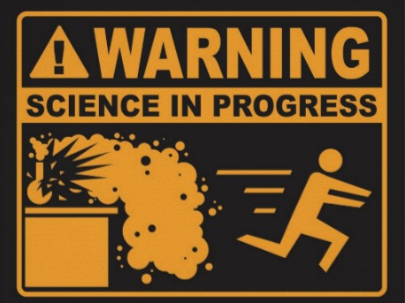
Classifying Chemical Reactions

Slide 9
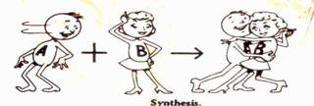
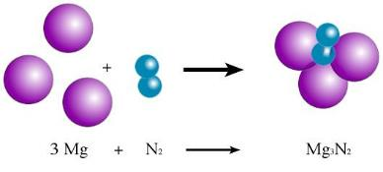
Synthesis Reactions
Two or more elements or compounds combine to make a more complex substance
A + B → AB
H₂ + O₂ → H₂O₂

Slide 10
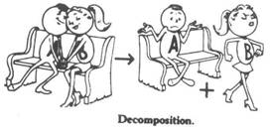
Decomposition Reactions
Compounds break down into simpler substances
AB → A + B
2H₂O → H₂ + O₂

Slide 11
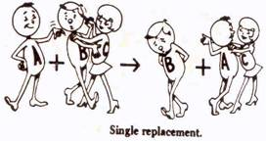
Single Replacement Reaction
Occurs when one element replaces another one in a compound
Also called Single displacement reaction
AB + C → AC + B
Fe+ HCl → FeCl + H

Slide 12
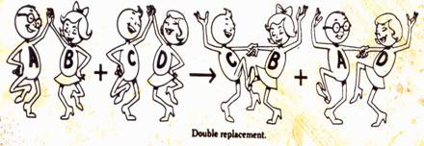
Double Replacement Reaction
Occurs when different atoms in two different compounds trade places
Also called double displacement reaction
AB + CD → AD + CB
KCl + H₂O → K₂O₄ + HCl

Slide 13
What type of reactions are these?
Reaction | Type
Cu + 2AgN₃ → CuN₂ + 2Ag
FeS + HCl → FeCl₂ + H₂S
8 Fe + S₈ → 8 FeS
2 KCl → 2 K + Cl₂
NiCl₂ → Ni + Cl₂
Zn + HCl → ZnCl + H₂
Single Replacement
Double Replacement
Synthesis
Decomposition
Decomposition
Single Replacement

