Slide 1
Chemical Reactions and Energy

Slide 2
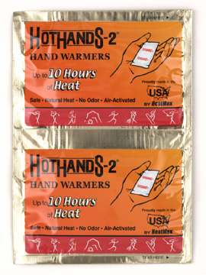
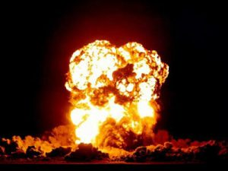
More Energy Out
Exergonic reactions release energy.
Less energy is need to break the original bonds than is released when new bonds form
Results in light or thermal energy being given off by the reaction
When thermal energy is given off, the reaction is called an exothermic reaction.

Slide 3
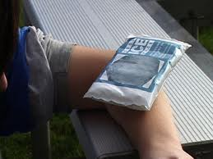
More Energy In
When a chemical reaction requires more energy to break bonds than is released when new ones are formed is called an endergonic reaction.
Light, thermal energy or electricity is needed for the reaction to occur
When the energy needed is in the form of thermal energy, the reaction is called an endothermic reaction

Slide 4
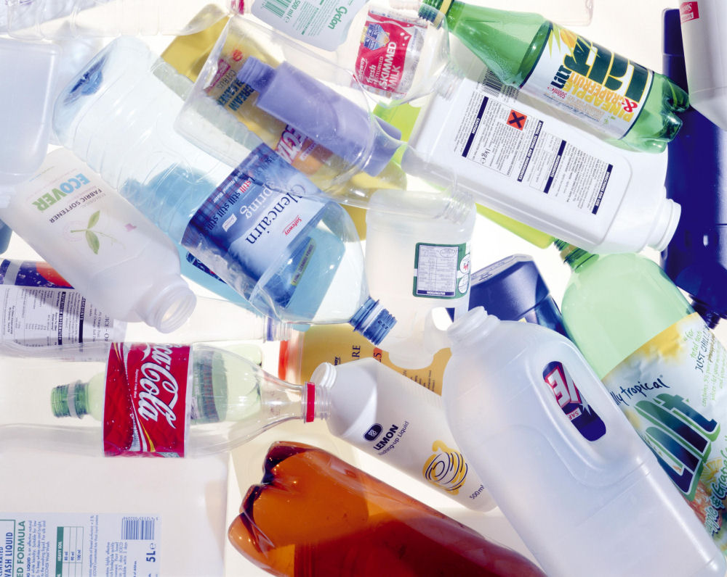
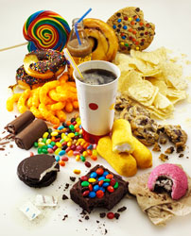
Catalysts and Inhibitors
A catalyst is used to speed up a chemical reaction
Examples: Used in making plastics
An inhibitor is used to slow down a chemical reaction
Examples: Food preservatives

