Slide 1
Covalent Bonds
Physical Science Chapter 20

Slide 2
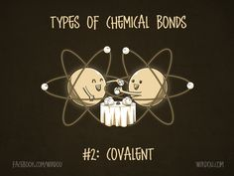
Covalent Bonds
The attraction that forms between atoms when they share electrons is known as a covalent bond.
A neutral particle that forms as a result of electron sharing is called a molecule
A covalent bond forms between two nonmetals.

Slide 3
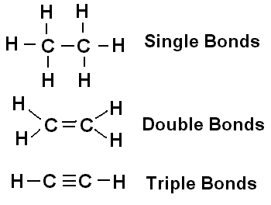
Covalent Bond
Atoms sharing one set of electrons forms a single bond
Atoms can share more than one set of atoms to form multiple bonds

Slide 4
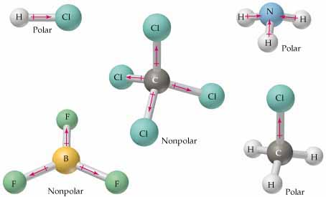
Polarity
Molecules do not always share electrons equally
Depends on the:
Size of the atom
Charge of the nucleus
Total number of electrons the atom contains

Slide 5
Naming Covalent Compounds

Slide 6
You’ll need to know these prefixes
Number of atoms | Prefix
1 | Mono-
2 | Di-
3 | Tri-
4 | Tetra-
5 | Penta-
6 | Hexa-
7 | Hepta-
8 | Octa-

Slide 7
Naming Binary Covalent compounds
Write the name of the first element in the formula. Then add the appropriate prefix to say how many you have of each. CO₂ Carbon (no prefix since it has a subscript of 1)
Write the name of the second element with the ending of –ide with the appropriate prefix to say how many you have. Oxygen = Oxide = dioxide All together = Carbon dioxide
Special Notes:
the last vowel of a prefix is dropped if the element begins with a vowel
Often the prefix mono- will be omitted

Slide 8
Name these compounds
N₂O
CF₄
CO₂

