Slide 1
Digestive System Organs https://www.youtube.com/watch?v=_QYwscALNng
Which structure is first?

Slide 2
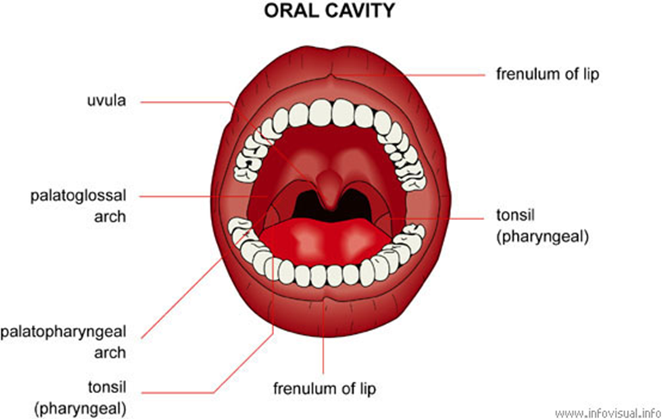
1.Mouth/Oral Cavity
receives food
Mechanical digestion by teeth (mastication)
mixes food with saliva to form bolus

Slide 3
Salivary Glands
Accessory organ, begins chemical digestion of carbohydrates
Secretions-
Saliva
Salivary amylase
splits starch into disaccharides
Lysozyme
Lingual lipase

Slide 4
Salivary Glands
More Secretions-
Lysozyme- antibacterial
Lingual lipase- triglycerides in to fatty acids and monoglycerides
(not activated until stomach is acidic)

Slide 5
2.Pharynx
Primary organ- passageway for food, liquid, and air
Function
voluntary swallowing (deglutition)

Slide 6
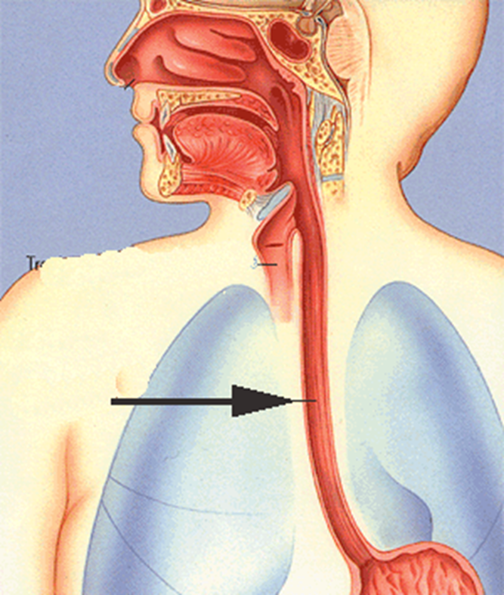
3. Esophagus
Primary organ (25cm)
Location- Thoracic cavity
Food passes through, peristalsis
Sphincter-
1st -Lower esophageal sphincter (cardiac sphincter)

Slide 7
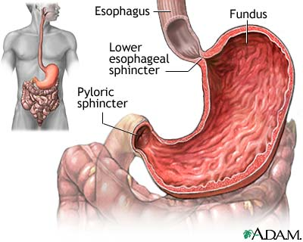
4. Stomach
Primary Organ (6-7 in.)
J-shaped, mixes food w/ gastric juice
Initiates protein digestion (Sm. amounts absorbed here)
Protects from swallowed bacteria
Sphincter
2nd Pyloric Sphincter

Slide 8
4. Stomach
Small % water absorbed
20% alcohol absorbed
Secretes gastrin into blood
Stimulates growth and amt. of secretions of gastric glands
Strengthens contraction of LES
Relaxes PS and IS

Slide 9
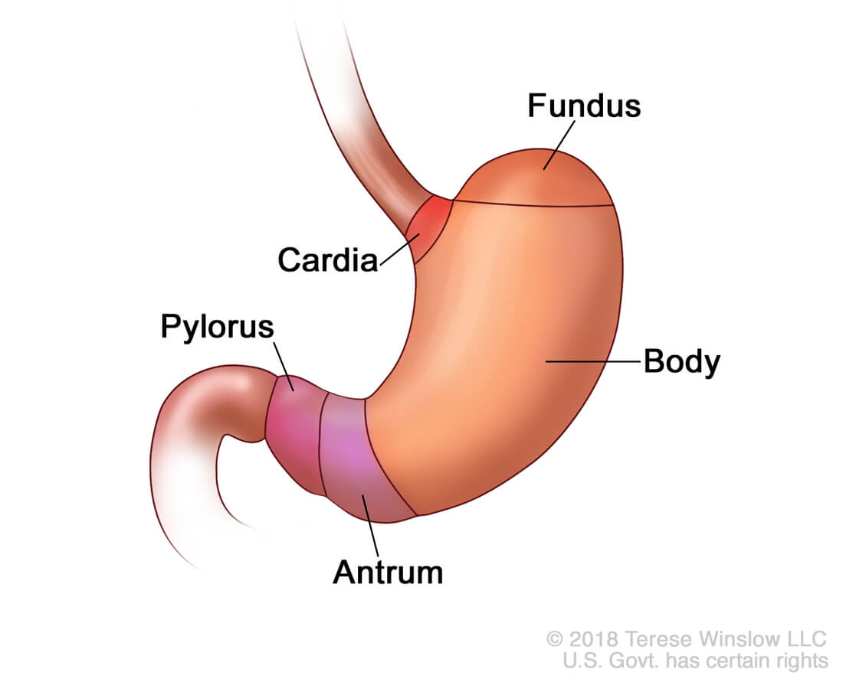
4. Stomach (cont.)
Makes chyme-
the pulpy acidic fluid which passes from the stomach to the small intestine
5 regions- Draw Picture!
Secretions-
Gastric juice
Mucous
Hydrochloric Acid (HCl)
Enzymes
Pepsin
Gastric lipase
Hormone
Gastrin- controls secretion of stomach

Slide 10
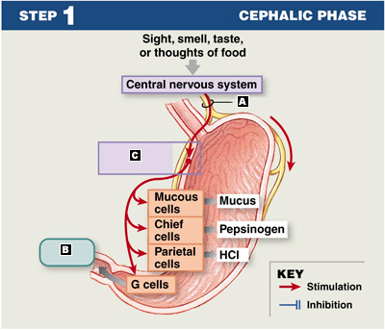
4. Stomach (cont.)
Gastric Secretions/JUICE-
Mucous cells- secrete mucous, prevents pepsin from digesting stomach lining
Chief cells- secretes digestive enzymes-
pepsin- breaks down most proteins-large →medium
gastric lipase- breaks down fats into smaller molecules -> fatty acids and glycerol
Parietal Cells- release HCl (helps activate pepsin) and intrinsic factor (helps absorb vitamin B12)

Slide 11
Pancreas
Accessory organ
Attached to duodenum (start of sm. Int.)
Produces enzymes which break down all categories of food
Secretions-
Pancreatic juice
Enzymes-
Pancreatic amylase: completes digestion of carbohydrate, producing glucose
Pancreatic lipase: continuation of breakdown of fats
Trypsin, chymotrypsin, carboxy-peptidase

Slide 12
Pancreas (cont.)
Hormones Secreted by the Pancreas
Glucagon- increases blood glucose, glycogen in liver and muscle released into blood
Hypoglycemia- very low level of blood sugar (glucose)
Insulin- decreases blood glucose, moves glucose from blood to cells for Energy
Hyperglycemia - blood glucose level is too high
Diabetes

Slide 13
5. Small Intestine
Primary organ- 6m long
2.5 cm diameter
Abdominal cavity
carbohydrate, lipid, protein digestion
Receives secretions from pancreas and liver
Completes digestion of chyme
Absorbs nutrients
Transports wastes to large intestine

Slide 14
5. Small Intestine
3 parts-
Duodenum- (from stomach - bile and pancreatic duct here - 25cm)
Jejunum- 2.5 m folds
Ileum- 3.5m to lg. intestine
Sphincter
ileocecal sphincter

Slide 15
Absorption in Small Intestine
Intestinal glands release water
Villi- small projections increase surface area for absorption
Completes nutrient absorption

Slide 16
Absorption in Small Intestine
Carb digestion begins in mouth, finishes here
Protein digestion begins in stomach, finishes here
Fats entirely broken down in sm. Intestine
Electrolytes diffuse and are actively transported in
Water absorbed

Slide 17
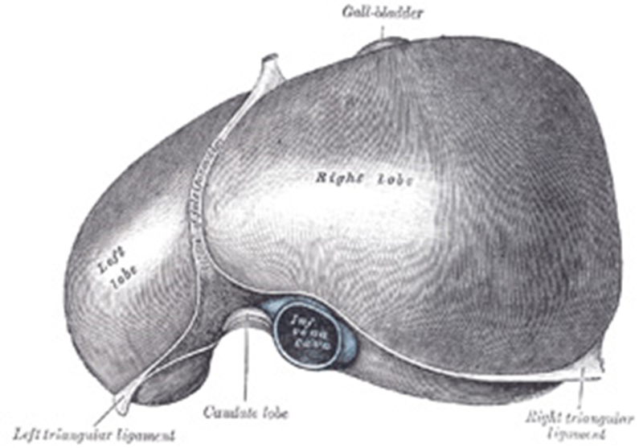
Liver
Accessory Organ (largest gland)
Upper abdomen
Break up fat so enzymes can digest it
Metabolism of proteins, fats, carbs
Storage of several substances
Detoxification
Blood cell production in fetus

Slide 18
Liver
Secretions-
Bile/bile salts- critical for digestion and absorption of fats and fat-soluble vitamins in the small intestine
Other Functions-
Detoxification- blood leaves intestine through veins →hepatic vein→liver
Substances detoxify as they pass through liver by chemical reactions
ex. Alcohol, acetaminophen, other drugs

Slide 19
Liver
Metabolism- use building blocks brought from the small intestine
Change glucose level (making and breaking glycogen from glucose)
Make phospholipids, cholesterol
Changing carbs and proteins to lipids for storage
Makes plasma proteins
Deaminating amino acids
Forms urea
Remove bacteria blood

Slide 20
Liver
Storage
Iron
Copper
vitamins, A, B12, D
https://www.youtube.com/watch?v=O71niTozP-o

Slide 21
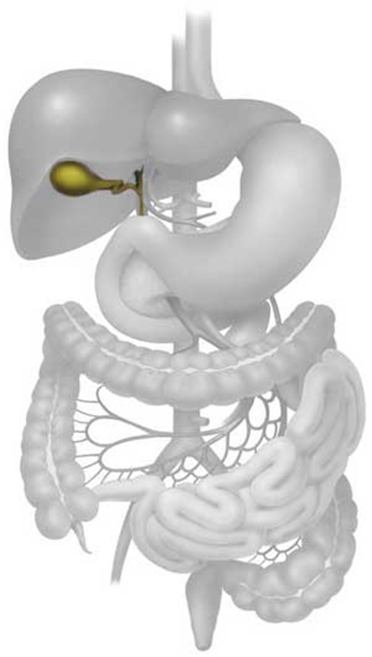
Gallbladder
Accessory organ
Behind liver - connects to sm. Intestine
Injects bile into duodenum following a meal
Function: storage room for bile
Sphincter
Hepatopancreatic sphincter

Slide 22
6. Large Intestine
Primary organ
1.5 m long
Abdominopelvic cavity, surrounds small intestine
Absorbs water, minerals, and electrolytes
Forms and stores feces
AKA-colon

Slide 23
6. Large Intestine (cont.)
5 parts-
Cecum- pouch below ileocecal opening, appendix attaches here
Ascending colon
Transverse colon
Descending colon
Sigmoid colon

Slide 24
7. Rectum & 8. Anus
Primary organs
Pelvic cavity
Functions- peristalsis, final storage spot, “creates urge”, defecation
Sphincters-
Internal anal sphincter
External anal sphincter
https://www.youtube.com/watch?v=s06XzaKqELk

