Slide 1
Electromagnetic Waves
Physical Science Notes

Slide 2
Electromagnetic Waves
Electromagnetic waves are made by vibrating electric charges and don't require a medium to travel through.
The energy carried by an electromagnetic wave is radiant energy.

Slide 4
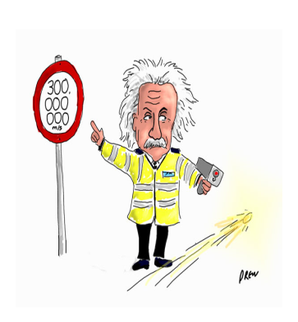
Speed of Light
The "speed of light" is the speed of all electromagnetic waves in a vacuum of space which is 300,000 km/s.
this is nature's speed limit - a medium will only slow down the wave.
Electromagnetic waves usually travel slowest in solids and liquids and fastest in gases.

