Slide 1
Energy Flow though the Ecosystem
APES 1.9 and 1.10

Slide 2
Energy
All life requires energy!
Organisms are grouped based on HOW they obtain their energy.

Slide 3
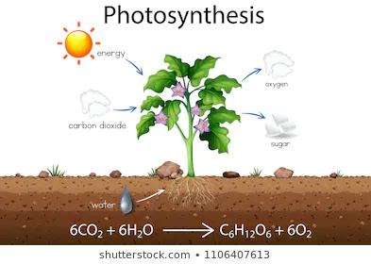
Primary Producers (Autotrophs)
Capture energy from the sun or from chemicals and store it in the bods of energy, making it available to the rest of the community.
Energy from the sun is captured by plants, algae, or bacteria though photosynthesis.

Slide 4
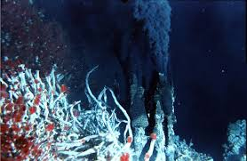
Primary Producers (Autotrophs)
Energy from chemicals is captured by some bacteria though chemosynthesis.

Slide 5
Consumers (Heterotrophs)
Rely on the other organisms for energy and nutrients.
Herbivores: plant eaters
Carnivores: meat eaters
Omnivores: combination eaters
Detrivores: recycle nutrients within the ecosystem by breaking down nonliving organic matter
Use oxygen to break bonds in sugar and release its energy though cellular respiration. (Primary producers do this, too)

Slide 6
Energy in Communities
Even though overall energy is conserved in a system, it is often lost as heat during conversion from one thing to another.
So no process involving energy conversion is 100% efficient.
This limits how many trophic levels there can be in a community.
Tropic level : a rank in feeding hierarchy.

Slide 7
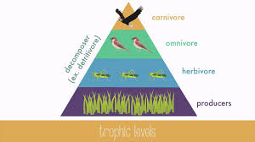
Energy in Communities
Tropic Levels:
Always starts with a PRIMARY PRODUCER
Followed by PRIMARY CONSUMER (1ST LEVEL)
Followed by SECONDARY CONSUMER (2ND LEVEL)
Followed by TERTIARY CONSUMER (3RD LEVEL)
Followed by QUARTERANY CONSUMER (4TH LEVEL)

Slide 8
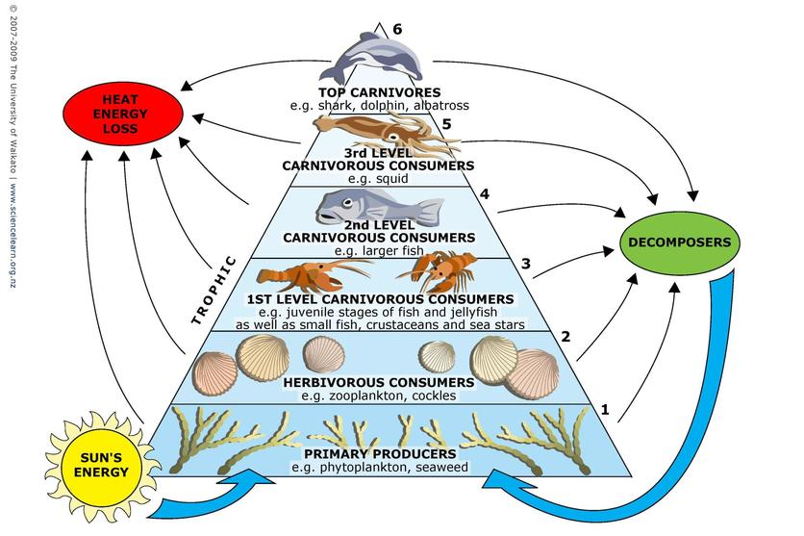
Ten Percent Rule
In general, only about 10% of the energy available at any trophic level is passed to the next.
Most of the rest is lost to the environment as heat.
2nd Law of Thermodynamics

Slide 9
Let’s practice
A total of 15,000 calories of energy exists at the producer level in a community. How much energy will be available for the organisms at teach of the following levels?
Producer = 15,000 calories
Primary Consumer:
Secondary Consumer:
Tertiary consumer:
If the tertiary consumers in a given community have 500 calories of energy available to them, how much energy was available at the secondary consumer level?
1,500 calories
150 calories
15 calories
5,000 calories

Slide 10
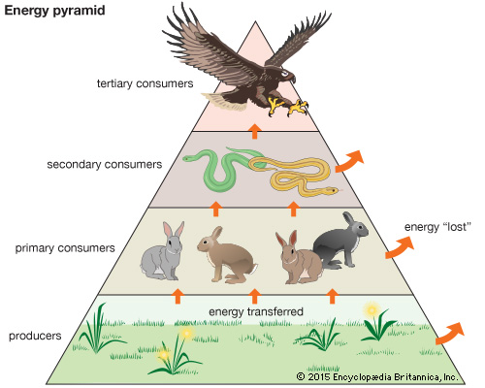
Numbers and Biomass in Communities
A trophic level’s biomass is the mass of living tissue it contains.
In general, there are more organisms and greater biomass at lower trophic levels than higher ones.

Slide 11
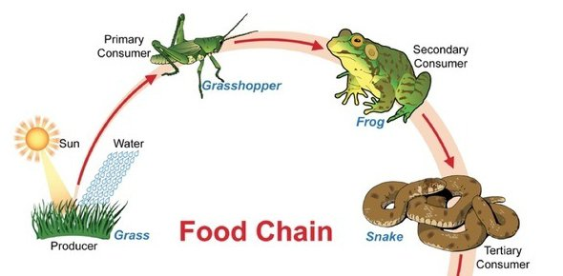
Food Chains
Food chain is the LINEAR series of feeding relationships.
Why would this be an inaccurate way to study feeding relationships?
Because most organisms eat more than one thing!

Slide 12
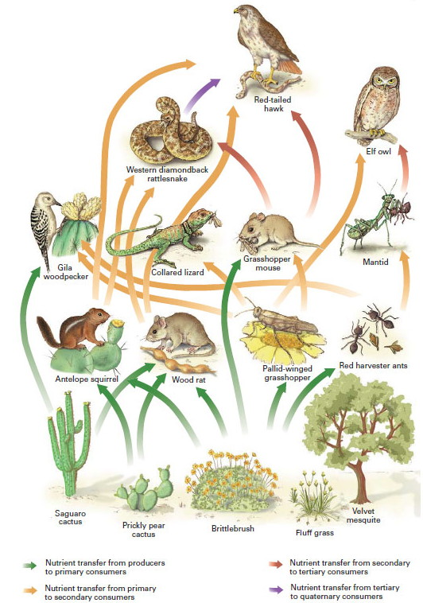
Food Webs
Food webs show the OVERLAPPING and interconnected food chains present in a community.

