Slide 1
Warm Up! Match the phylum to the description ☺
Chordates
Mollusca
Arthropod
Annelids
Animals that have a notochord that supports the body
Exoskeleton made of chitin
Most advanced worms – segmented
Unsegmented soft bodies – some have shells

Slide 2
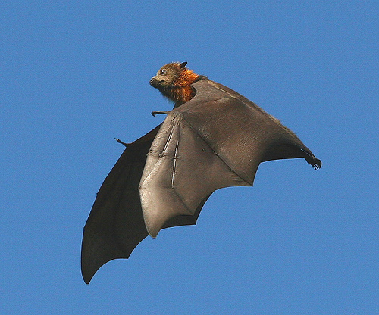
What Animals Do to Survive
Animals carry out the following essential functions:
1. Feed
2. Respire
3. Circulation
4. Excrete
5. Respond
6. Move
7. Reproduce

Slide 3
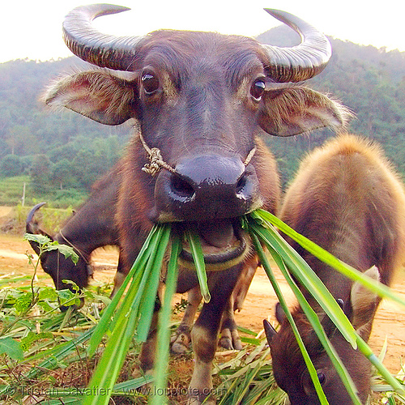
Essential Functions
Feeding: Animals feed in a large variety
of ways.
Carnivore: Eats meat ONLY
Herbivore: Eats plants ONLY
Omnivore: Eats meat & plants
Detritivore: Feeds on plant and animal remains
and other dead matter called detritus
(Includes poop).

Slide 4
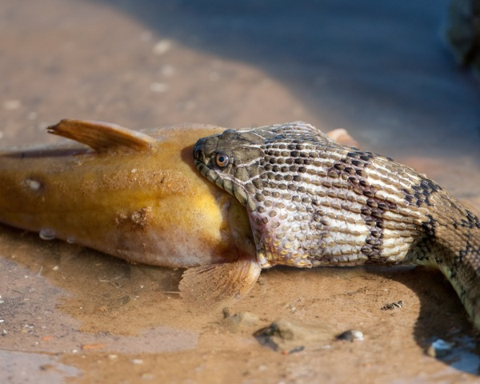
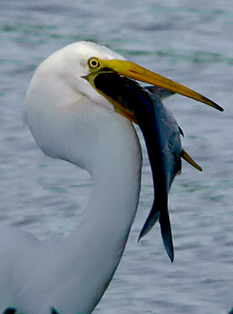
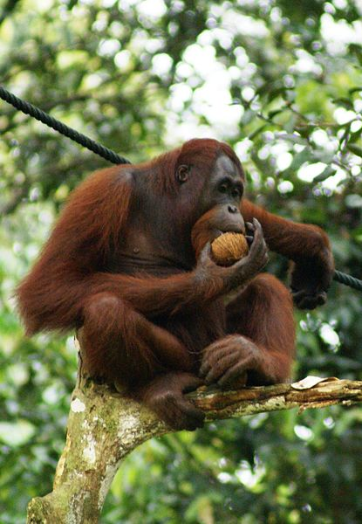
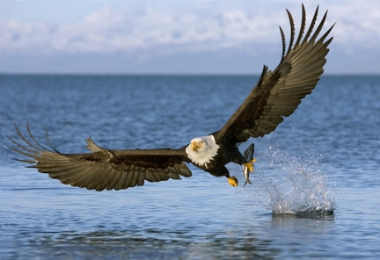
Additional Types of Feeders
Insectivores: Eats insects only
Piscivores: Eat fish only
Frugivores: Eats fruits

Slide 5
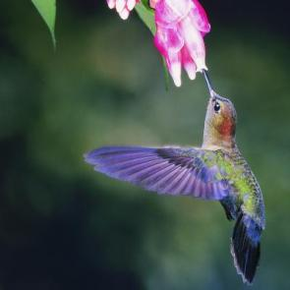
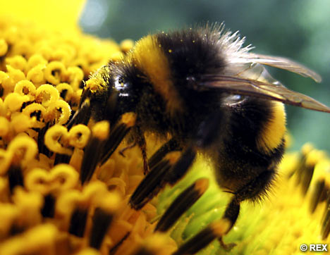
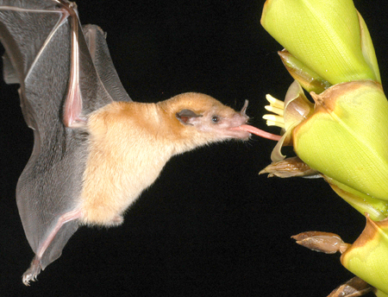
Additional Types of Feeders
Grainivores: Eats seeds only
Mainly birds, mammals, and insects
Nectarivores: Eats nectar only
Includes butterflies, hummingbirds, bees, and many bats
Very important plant pollinators

Slide 6
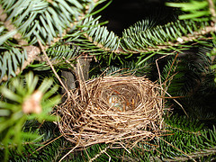
Essential Functions: Feeding Continued
Some animals form symbiotic relationships.
Symbiosis: Is the relationship in which two species live closely together
a. Mutualism
b. Commensalism
c. Parasitism

Slide 7
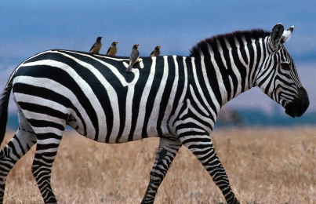
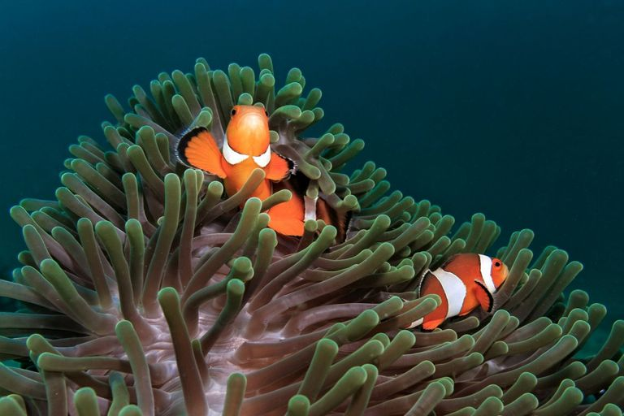
Essential Functions: Feeding Continued
a. Mutualism: Symbiotic relationship in which both species benefit from the relationship.

Slide 8
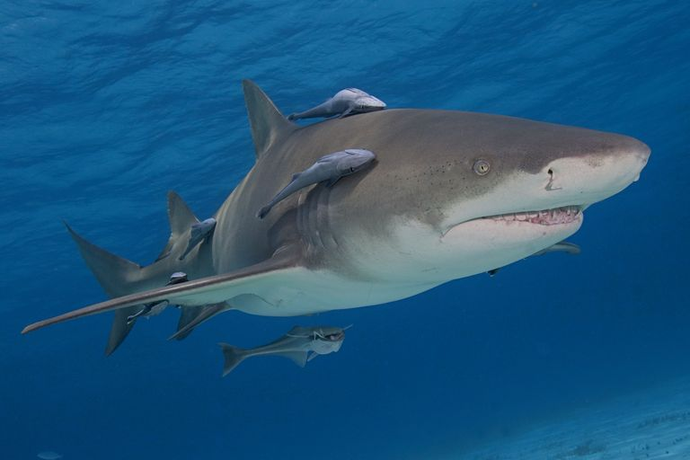
Essential Functions: Feeding Continued
b. Commensalism: Symbiotic relationship in which one member of the association benefits and the other is neither helped nor harmed.
Barnacles on a Whale

Slide 9
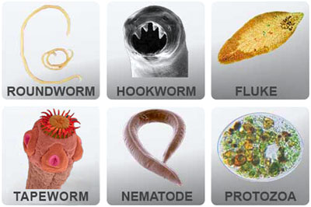
Essential Functions: Feeding Continued
c. Parasitism: Symbiotic relationship in which one organism lives in or on another organism and harms it.

Slide 10
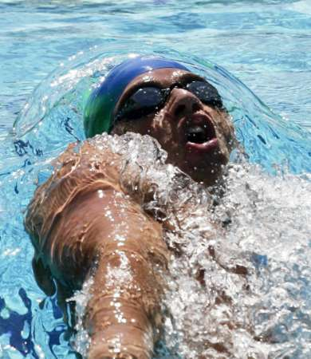
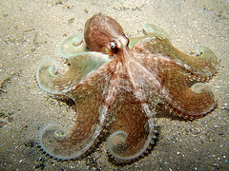
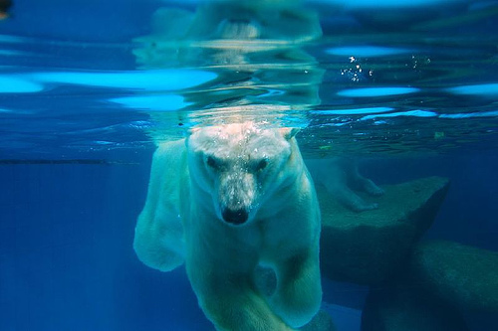
Essential Functions
Respiration: Whether they live in water or on land, all animals respire, which means they take in oxygen and give off carbon dioxide.
Some can rely on diffusion of these substances through their skin
Most have evolved complex tissues and organ systems for respiration

Slide 11
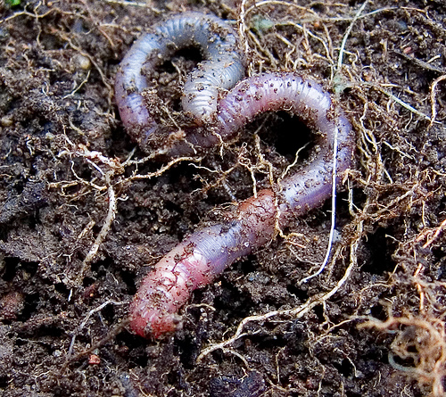
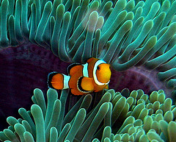
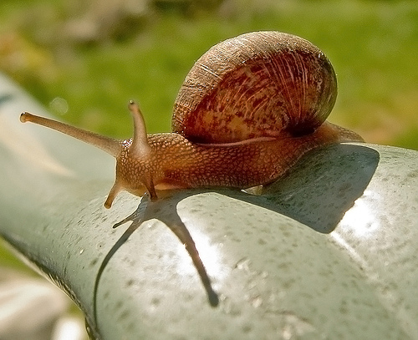
Essential Functions
Circulation: Many aquatic animals (ex: aquatic worms) rely solely on diffusion to transport oxygen & waste.
Larger animals have some kind of circulatory system to move materials around within their bodies.

Slide 12
Essential Functions
Excretion: A primary waste product of cellular metabolism is ammonia, a poisonous substance that contains nitrogen.
A buildup of ammonia & other wastes would kill an animal
Animals have excretory system that either eliminates ammonia quickly or converts it into a less toxic substance that is removed from the body.

Slide 13
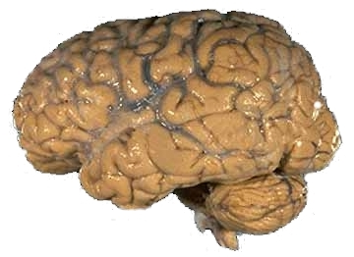
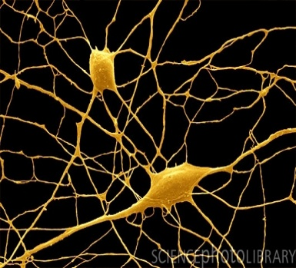
Essential Functions
Response: Animals respond to events in their environment using specialized cells called nerve cells.
Nerve cells hook up together to form a nervous system
Some nerve cells are receptors that respond to sound, light, and other stimuli
The arrangement of nerve cells in the body changes dramatically from phylum to phylum

Slide 14
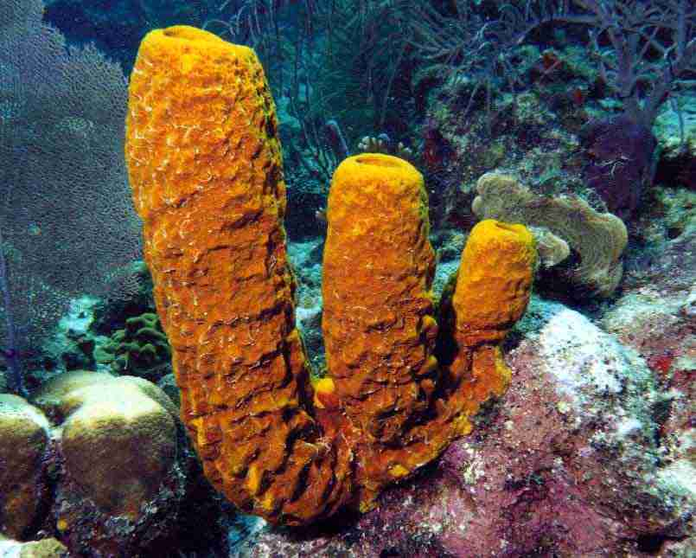
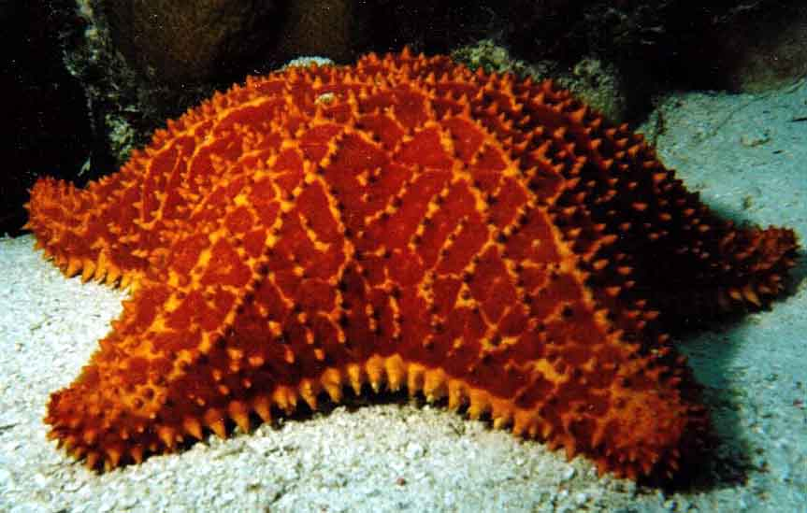
Essential Functions
Movement: Some live their entire lives attached to a single spot. Most are motile meaning that they move

Slide 15
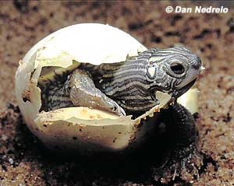
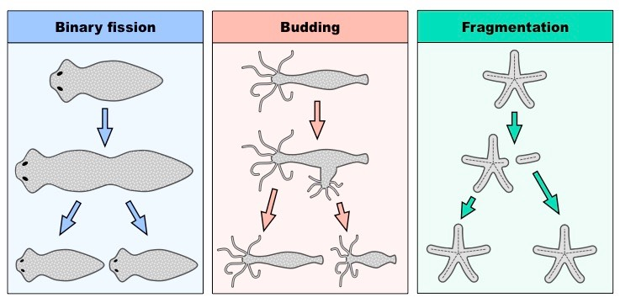
Essential Functions
Reproduction:
Sexual reproduction: Most reproduce sexually by producing gametes. Maintains genetic diversity in populations. Helps species evolve when the environment changes
Asexual Reproduction: Many reproduce asexually & allows to increase numbers rapidly

Slide 16
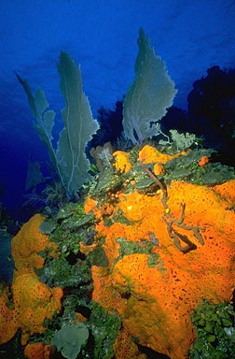
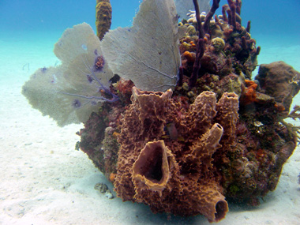
Symmetry
Asymmetrical: Has no definite shape.

Slide 17
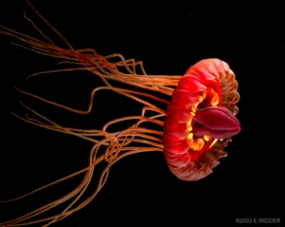
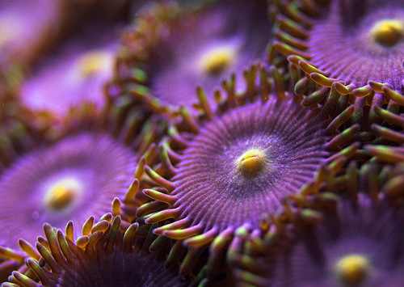
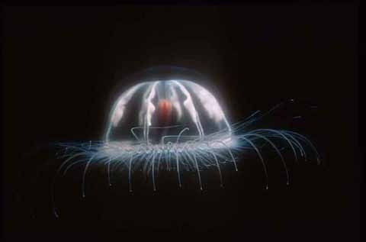
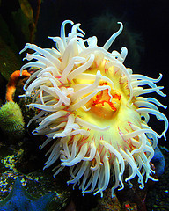
Symmetry
Radial Symmetry: Body is arranged in a circle like the spokes of a wheel.

Slide 18
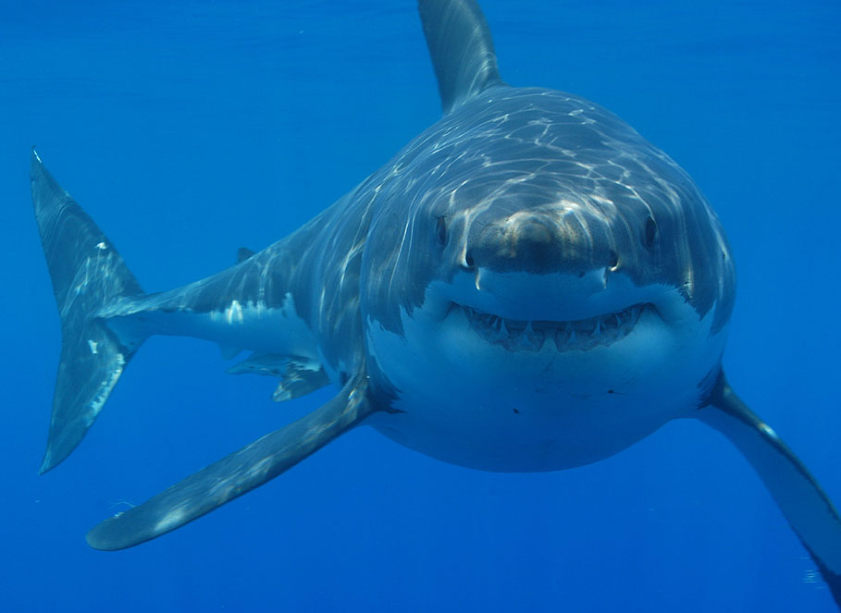
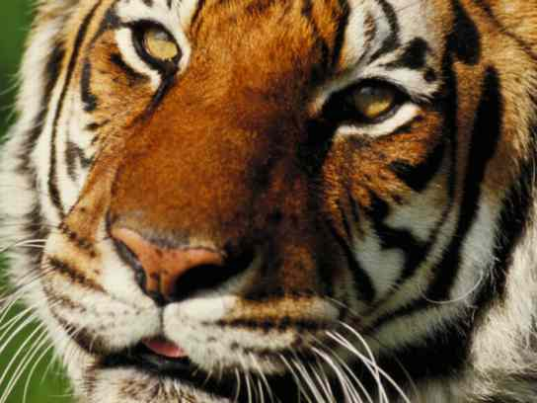
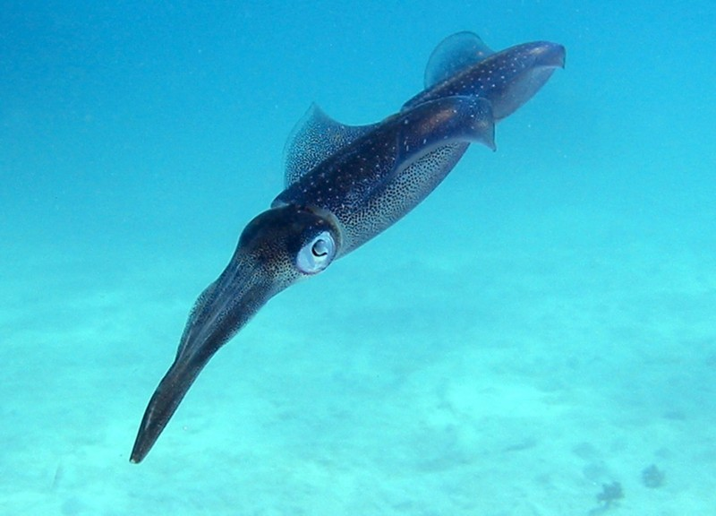
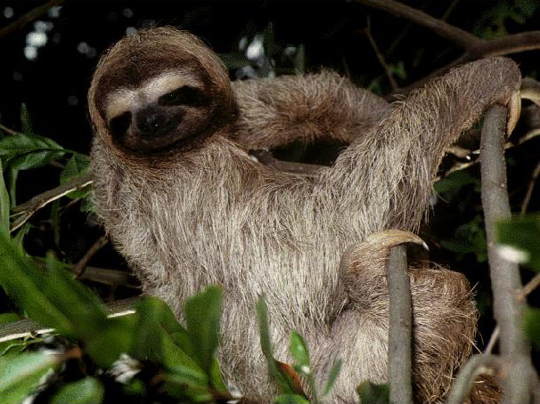
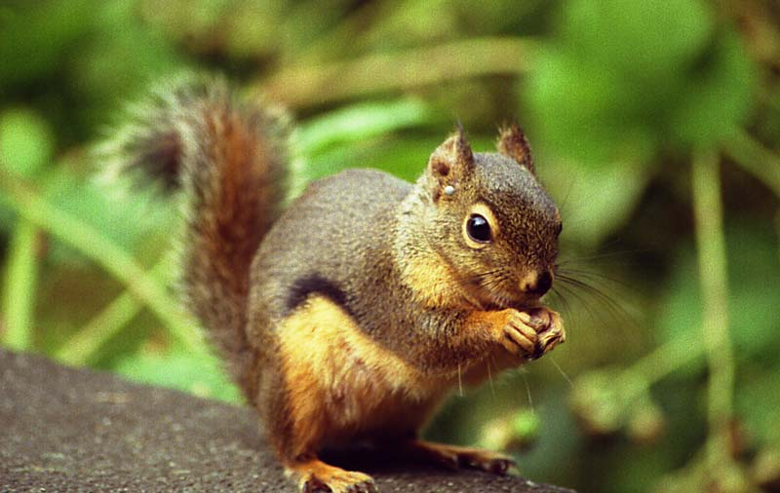
Symmetry
Bilateral Symmetry: If divided lengthwise in half, both sides will match.

Slide 19
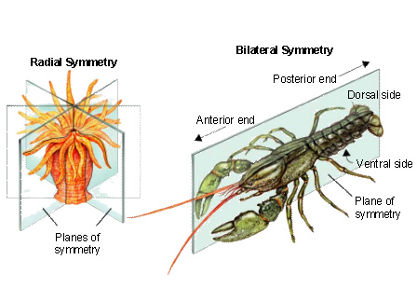
Bilateral Symmetry
Anterior End = Front End
Posterior End = Back End
Dorsal Side = Upper Side
Ventral Side = Lower Side

Slide 21
Animal Groupings to Know
Animal
Group Name
Sea Lions & Breeding birds & Penguins | Rookery
Baboons | Troop
Ants | Colony, Army, Swarm, Nest
Bass/fish | Shoal or school
Baby birds | Brood or clutch
Camels | Caravan
Crows | Murder or Horde
Dogs & wolves | Pack
Flying Hawks | Kettle
Hawks in general | Cast
Jellyfish | Smack or brood or swarm
Monkeys | Troop or tribe

Slide 22
Animal Groupings to Know
Animal
Group Name
Otters | Romp or raft
Porcupines | Prickle
Salmon | Run
Group of females (seals) | Harem
Walrus | Herd or pod
Weasels | Gang
Bears | Sleuth
Lion | Pride
Deer | Herd or mob
Frogs | Army or knot
Hippopotamus | Herd or bloat
Hummingbirds | Charm

