Slide 1
Basics of
Evolution

Slide 2
What is evolution?
Evolution encompasses all changes in the characteristics and diversity of life on earth throughout its history
is the biological change process by which descendants come to differ from their ancestors.
A species is a group of organisms that can reproduce and have fertile offspring.

Slide 3
Things to remember about evolution
a. Individuals cannot evolve. Populations evolve.
b. Natural selection is the mechanism of evolution.
c. Evolution occurs by chance (NOT GOAL ORIENTED).

Slide 4
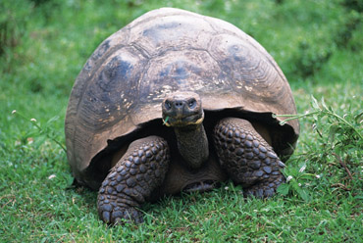
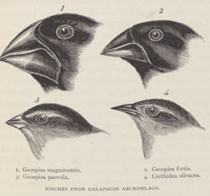
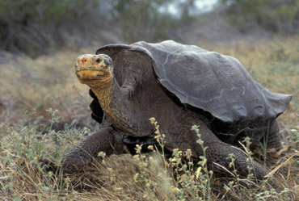
Variation is a difference in a physical trait among individuals in the same group to which it belongs to.

Slide 5
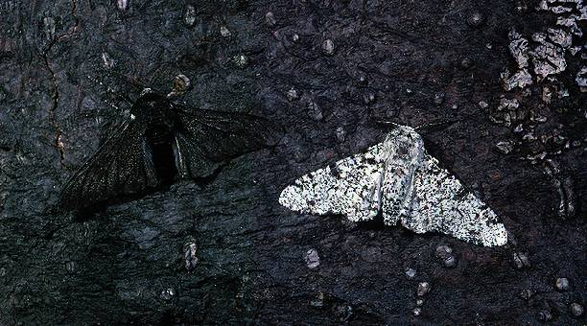
An adaptation is a feature that allow an organism to better survive in its environment.
Species are able to adapt to their environment.
Adaptations can lead to genetic change in a population.

Slide 6
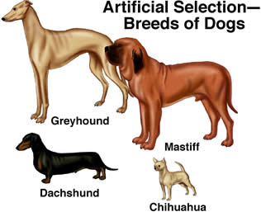
Artificial selection is the process by which humans select traits through breeding.
Humans act as the selective agent

Slide 7
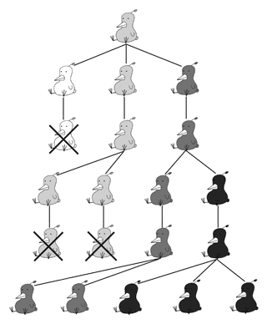
Natural selection is a mechanism by which individuals that have inherited beneficial adaptations produce more offspring on average than do other individuals.
The environment is the selective agent
Heritability is the ability of a trait to be passed down.

Slide 8
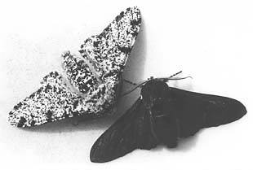
Four main principles to the theory of natural selection:
1) Variation: heritable differences will exist in every population
2) Overproduction: overpopulation will result in competition, not all will survive
3) Adaptation: one variation of a trait may be better suited for survival
4) Descent with modification: natural selection will result in a species with adaptions well suited for survival in an environment
Fitness is the measure of survival ability and ability to produce more offspring.

Slide 9
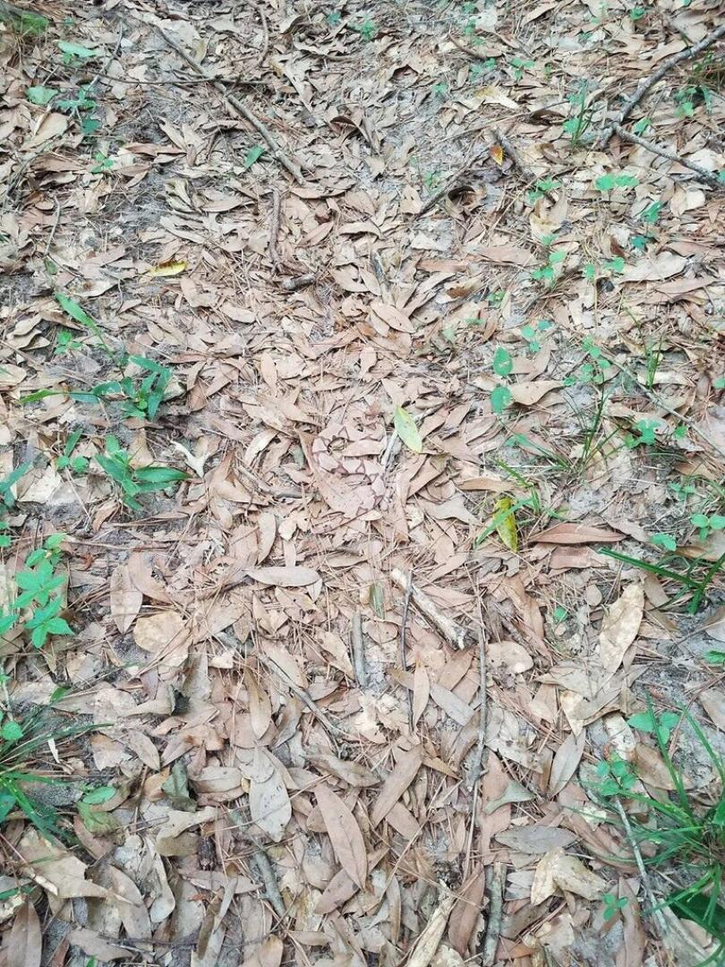
Natural Selection in Action
Camouflage

Slide 10
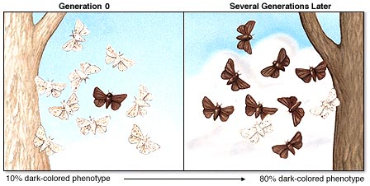
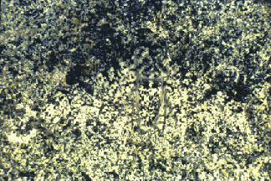
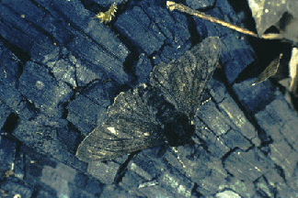
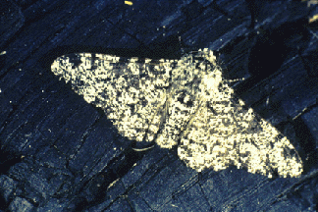
Natural Selection in Action
Industrial melanism

Slide 11
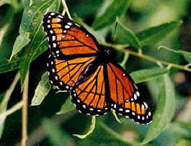
Natural Selection in Action
Mimicry
Monarch or Viceroy Butterfly

Slide 12
Natural Selection in Action
Mimicry
Coral vs. King Snakes: Red on yellow, kill a fellow, red on black won’t hurt Jack

Slide 13
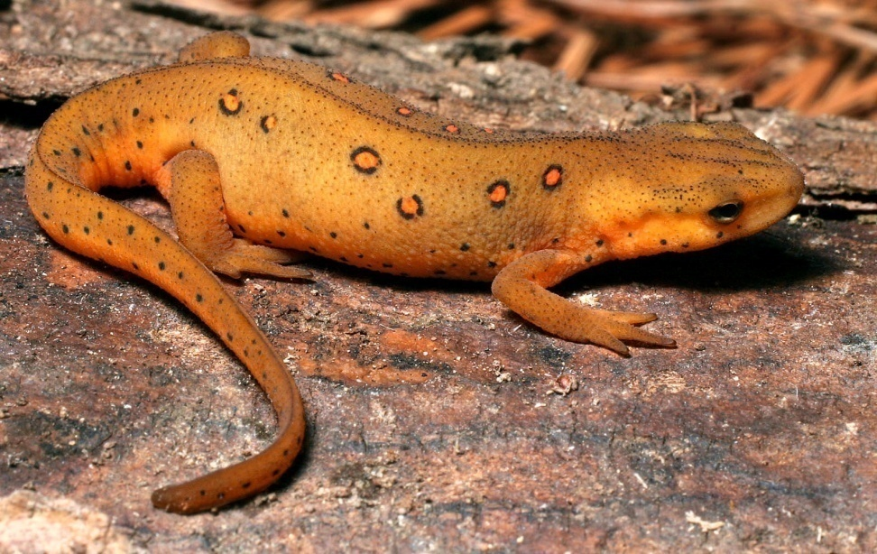
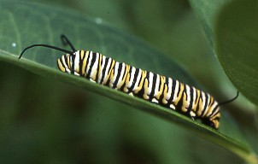
Natural Selection in Action
Warning Coloration

Slide 14
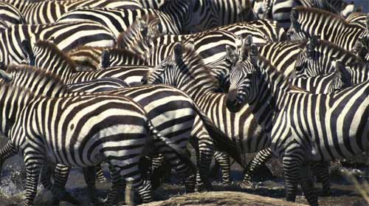
Natural Selection in Action
Disruptive Coloration

Slide 15
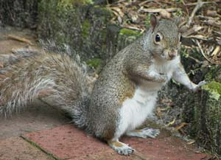
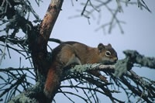
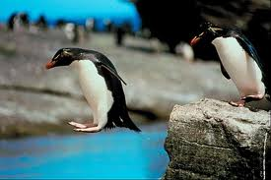
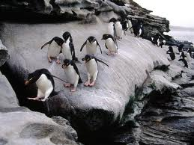
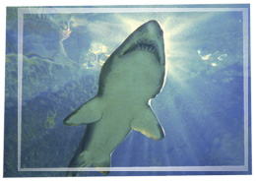
Natural Selection in Action
Counter Shading

Slide 16
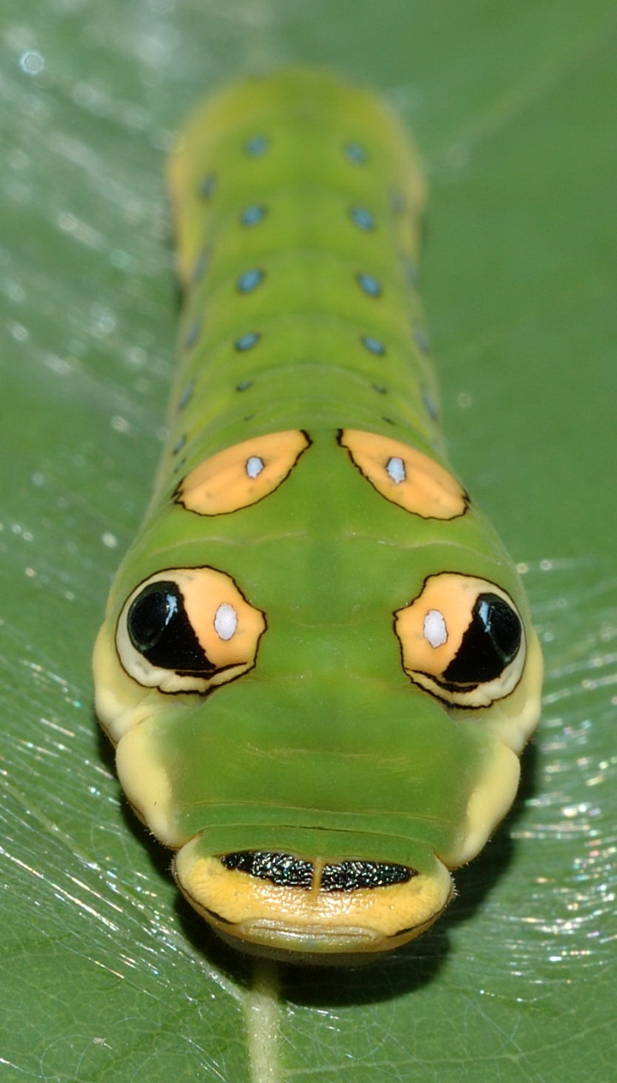
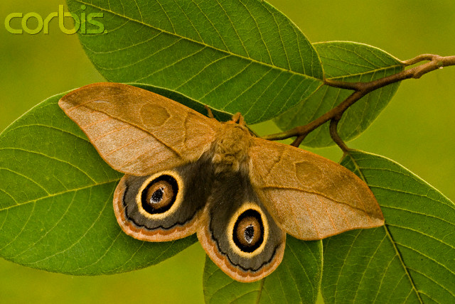
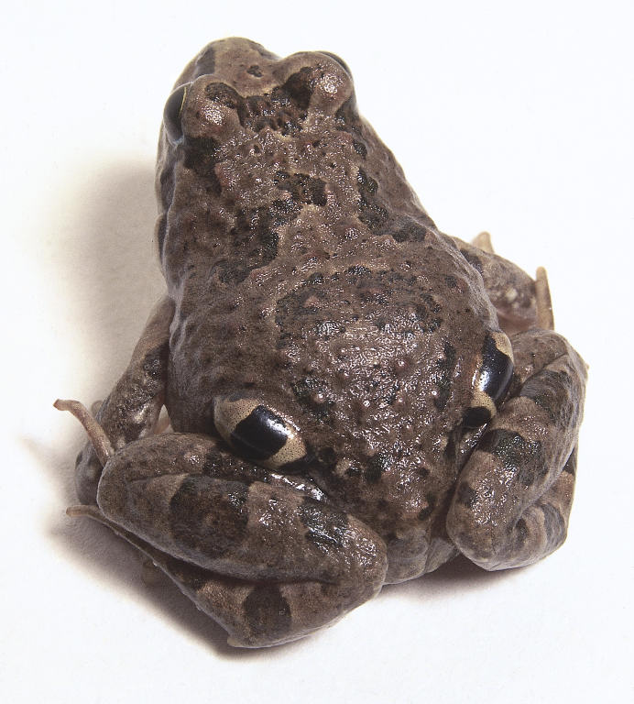
Natural Selection in Action
Eye spots

Slide 17
Evidence for Evolution

Slide 18
Evidence for Evolution
Homology is a characteristic shared by two species (or other taxa) that is similar because of common ancestry.

Slide 19
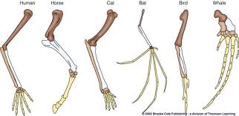
Morphological homology
Structures derived from a common ancestral structure are called homologous structures
Homologous structures are similar in structure but different in function.
Homologous structures are evidence of a common ancestor.

Slide 20
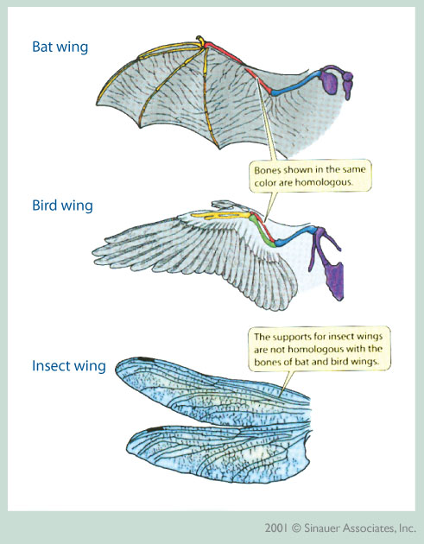
A structure that serves the same function in two taxa, but is NOT derived from a common ancestral structure is said to be an analogous structure
Analogous structures have a similar function but are not similar in origin
They are not evidence of a common ancestor.

Slide 22
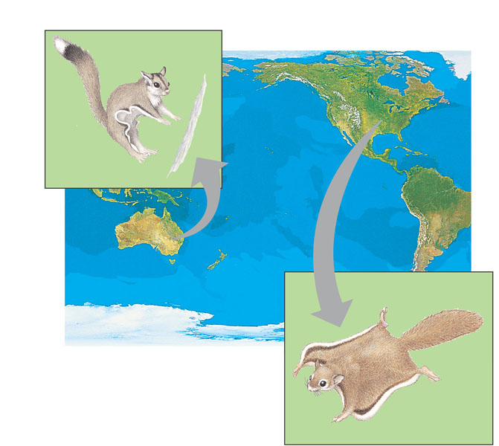
Some similar mammals that have adapted to similar environments
Have evolved independently from different ancestors
NORTH
AMERICA
Sugar
glider
AUSTRALIA
Flying
squirrel

Slide 23
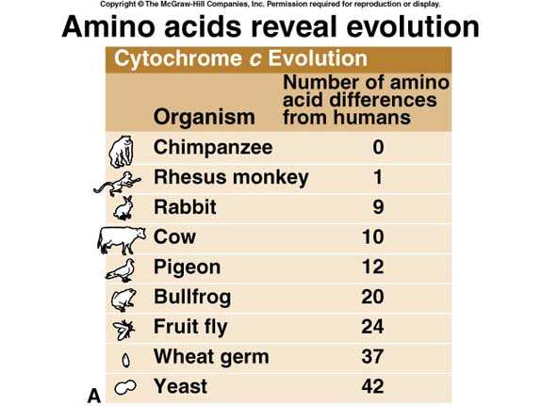
Molecular Homology
Molecular and genetic evidence support fossil and anatomical evidence.
Two closely-related organisms will have similar DNA sequences.

Slide 24
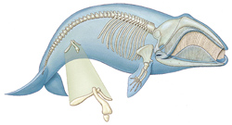
Vestigial Structures
Have marginal, if any use to the organisms in which they occur.
EXAMPLES:
femurs in pythonid snakes and pelvis in cetaceans (whales)
appendix in humans

Slide 25
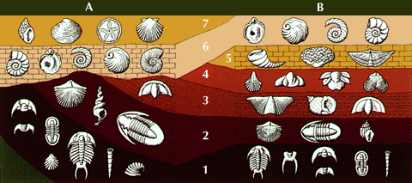
Fossils are traces of organisms that existed in the past
Fossils in older layers are more primitive than those in the upper layers.

Slide 26
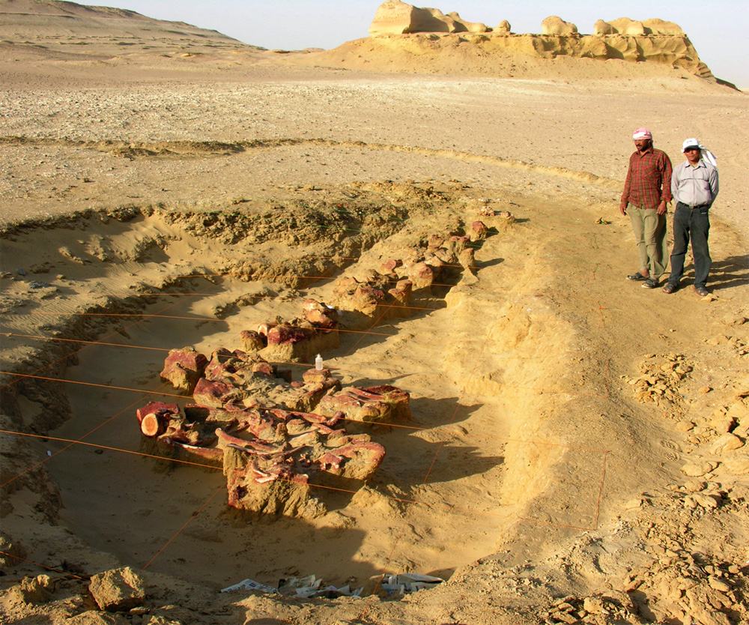
Paleontology is the study of fossils or extinct organisms.

Slide 27
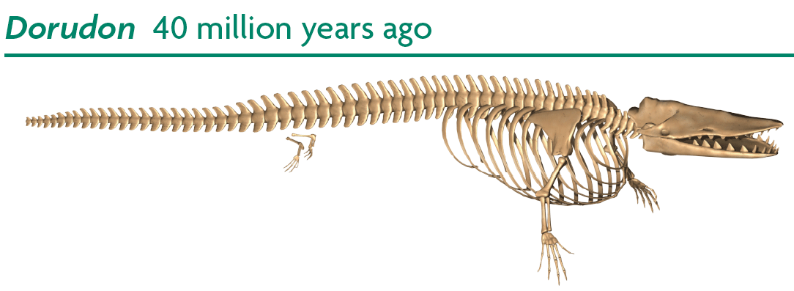
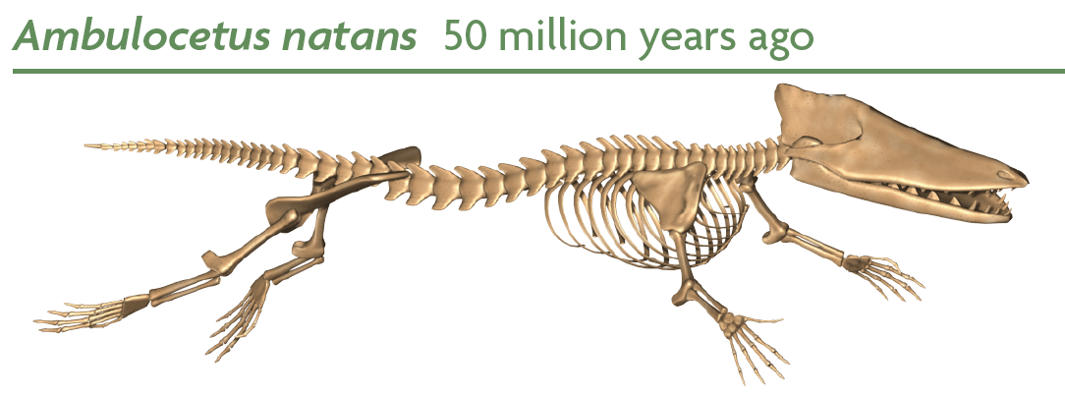
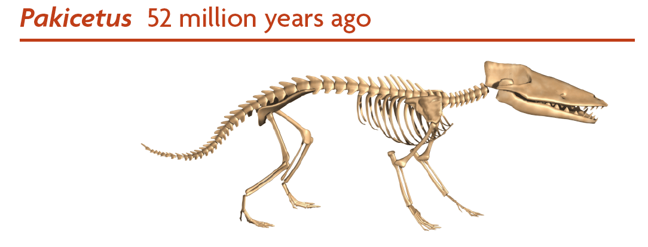
Paleontology provides evidence to support evolution.

