Slide 1
Forces

Slide 2
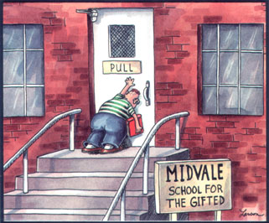
What is force?
A force is a push or pull
A force can cause the motion of an object to change

Slide 3
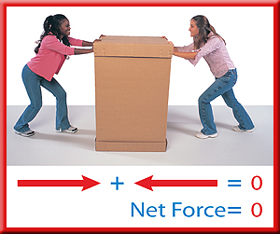
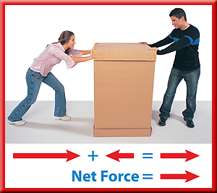
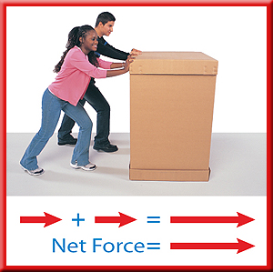
What is force?
When two or more forces act on an object at the same time, the forces combine to form the net force
Forces on an object that are equal in size and opposite in direction are called balanced forces

Slide 4
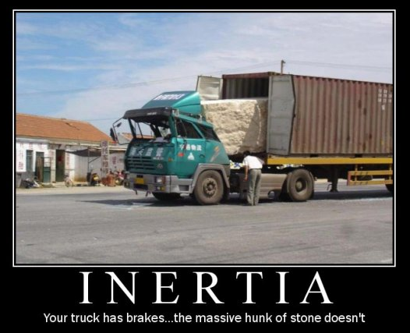
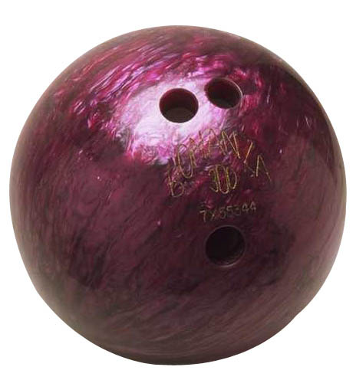
Inertia and Mass
Inertia is the tendency of an object to resist any change in its motion.
The inertia of an object is related to its mass. The greater the mass of an object is, the greater its inertia.

Slide 5
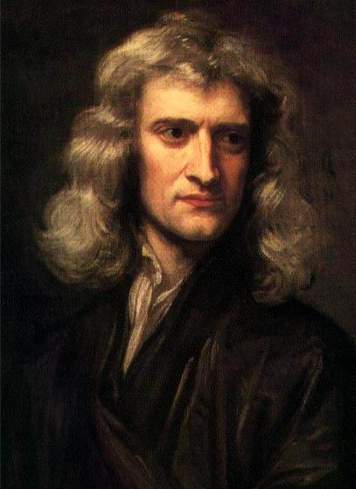
Newton’s Laws of Motion
Sir Isaac Newton was able to state rules that describe the effects of forces on the motion objects.
These rules are known as Newton’s Laws of Motion.
They apply to the motion of all objects

Slide 6
Newton’s First Law of Motion
An object moving at a constant velocity keeps moving at that velocity unless an unbalanced net force acts on it. If an object is at rest, it stays at rest unless an unbalanced net force acts on it.
This law is called the “law of inertia”

Slide 7
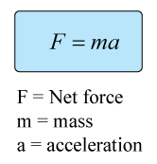
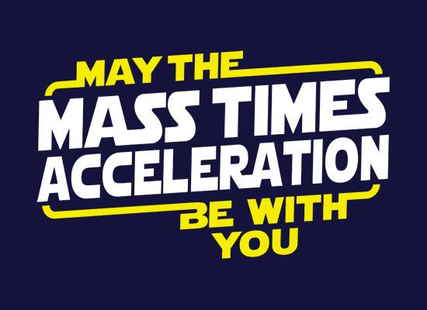
Newton’s Second Law of Motion
the acceleration of an object is in the same direction as the net force on the object, and the acceleration can be calculated from the following equation:
Units:
acceleration = m/s²
Force = N (newtons)
Mass = kg

Slide 8
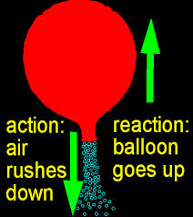
Newton’s Third Law of Motion
When one object exerts a force on a second object, the second one exerts a force on the first that is equal in strength and opposite in direction.
“For every action there is an equal and opposite reaction”

Slide 9
Types of Forces

Slide 10
Momentum
A moving object has a property called momentum that is related to how much force is need to change its motion.

Slide 11
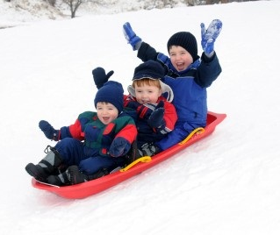
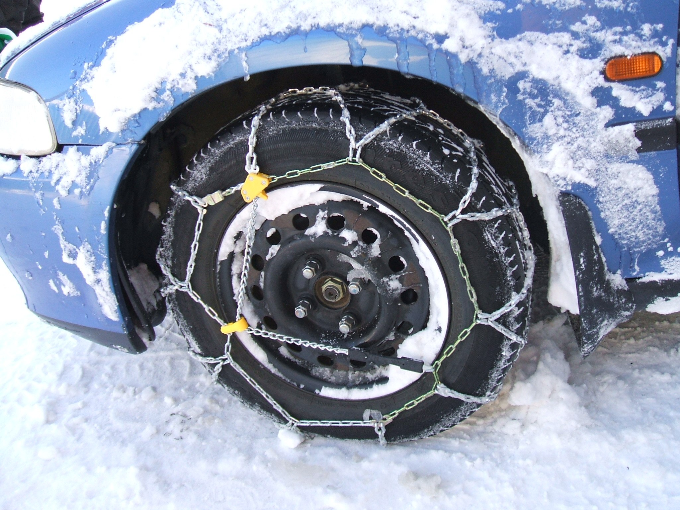
Friction
Friction is the force that opposes the sliding motion of two surfaces that are touching each other
Factors that affect the amount of friction:
types of surfaces
Force pressing the surfaces together

Slide 12
Static Friction
Static friction is the frictional force that prevents two surfaces rom sliding past each other.

Slide 13
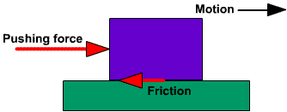
Sliding Friction
Sliding friction is the force that opposes the motion of two surfaces sliding past each other.

Slide 14
Air Resistance
Air resistance opposes the motion of objects that move through the air.
Air resistance causes objects to fall with different accelerations and different speeds.
The amount of air resistance on an object depends on the speed, size, and shape of the object

Slide 15
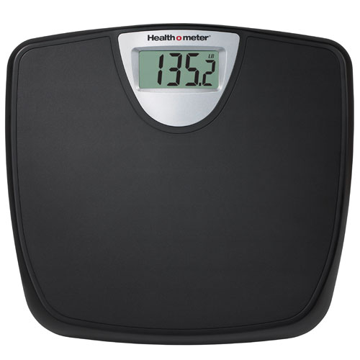
Gravity
Gravity is an attractive force between two objects that depends on the masses of the objects and the distance between them.
The gravitational force exerted on an object iscalled the object’s weight.
w = mg
weight (N) = mass (kg) x acceleration of gravity (m/s²)
G = 9.8 m/s²

Slide 16
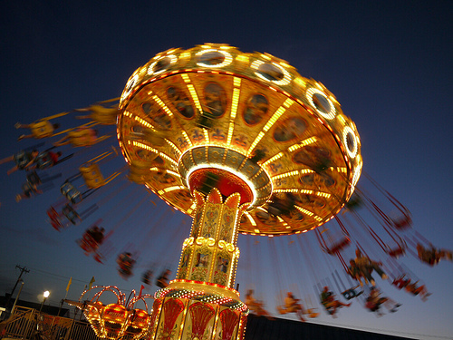
Centripetal Force
The net force exerted toward the center of a curved path is called centripetal force

