Slide 1
What is a Biome?

Slide 2
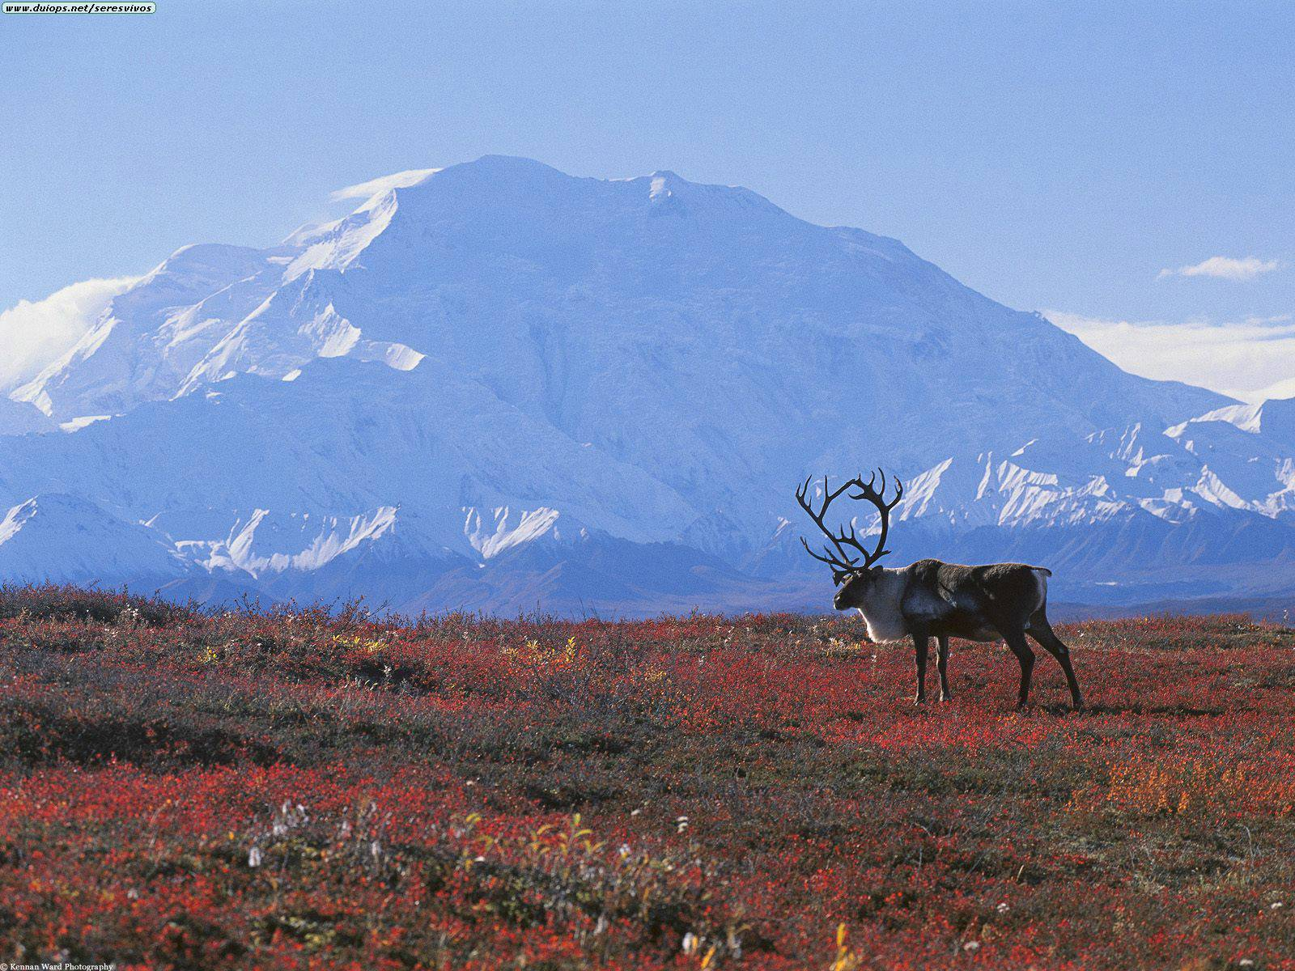
Biomes
Biome: is a large region characterized by a specific type of climate and certain types of plants and animal communities

Slide 3
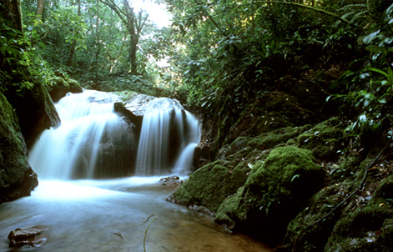
Biomes and Vegetation
Biomes are described by their vegetation because plants that grow in a certain region are most noticeable characteristics of that region
Depending on types of plants present in a biome determines what types of other organisms are found in a biome
Plants in a particular biome have adaptations that enable them to survive there.

Slide 4
Biomes and Climate
Biomes are defined by their plant life, but what factors determine which plants can grow in a certain area depends mainly on the climate.
Climate is the weather conditions over a longer period of time
Includes temperature, precipitation, humidity, and winds
Temperature and precipitation are the two most important factors

Slide 5
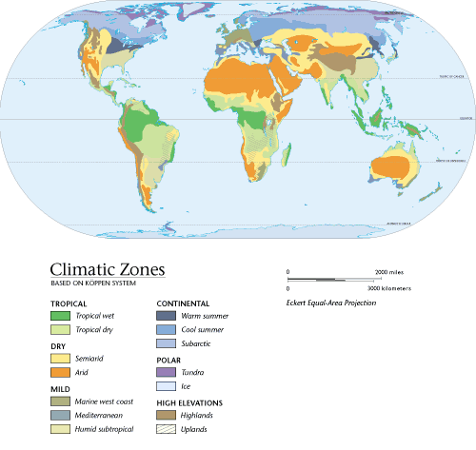

Slide 6
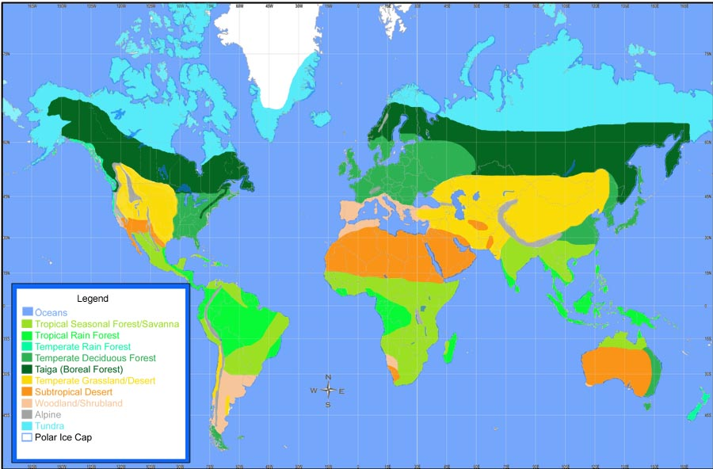

Slide 7
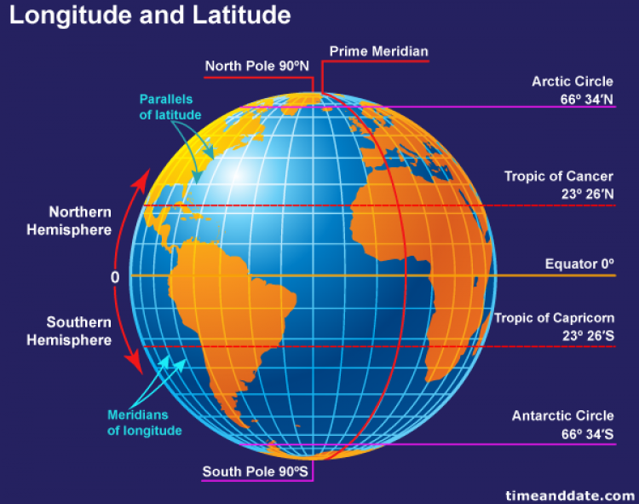
Latitude and Altitude
Biomes and vegetation vary with latitude and altitude.
Latitude is the distance north or south of the equator
Is measured in degrees
Altitude is the height of an object above sea level
Climate gets colder as latitude and altitude increase

Slide 8
