Slide 1
The Urinary System
https://www.youtube.com/watch?v=WtrYotjYvtU
Ch. 25

Slide 2
What are the fxns of the urinary system?
Removes- salts and nitrogenous wastes
Maintains- water and electrolytes
Regulates- pH and volume of body fluids
Controls- RBC production and blood pressure

Slide 3
What are the organs of the urinary system?
2 kidneys
Fxn-
Remove substances from blood and urine

Slide 4
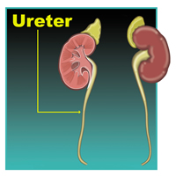
What are the organs of the urinary system? (cont.)
2 ureters
25 cm tube
Fxn- transport urine
Joins-
Kidney and bladder
Uses-
moves urine via peristalsis

Slide 5
What are the organs of the urinary system? (cont.)
1 Urinary Bladder
Fxn- stores urine
Trigone- 3 openings
Detrusor muscle-surrounds bladder
Internal urethral sphincter- If relaxed, you will pee

Slide 6
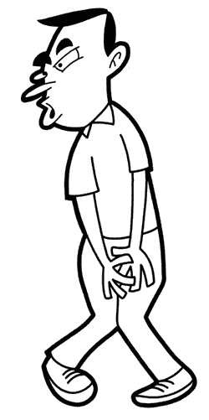
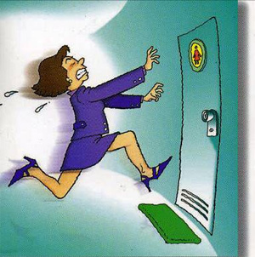
How much can the bladder hold?
300-600mL

Slide 7
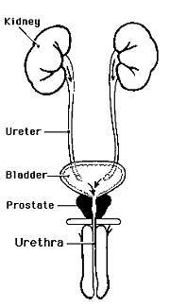
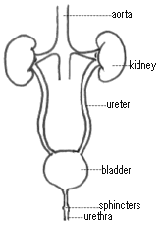
What are the organs of the urinary system? (cont.)
1 Urethra
Fxn- transports urine from bladder to outside of body
Urinary tract infections
(UTI’s)
Difference in
males and females-

Slide 8
Male-
Longer urethra through penis
20cm
Male urethra also part of reproductive system
Female-
Shorter
3cm
UTI susceptibility increases b/c bacteria don’t have to travel as far

Slide 9
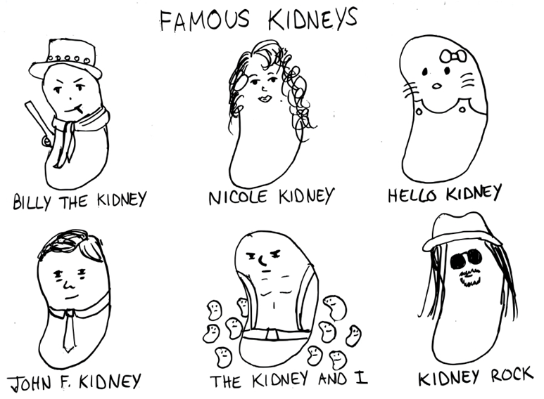

Slide 10
Important Vocab Roots
Retro= behind
Ren= kidney
Papilla= nipple
Calyc= small cup
Cort= covering
Medulla= marrow or pith (inside)
Detrus= to force away

Slide 11
Kidney Anatomy
Main organ(s) of urinary system-2
12 cm x 6cm x3cm thick
Location- positioned retroperitoneally- behind parietal peritoneum (against deep muscles of the back)
Left higher that right due to liver squishing down

Slide 12
Kidney Function
Remove wastes from blood
Remove excess water and electrolytes from blood
To form urine and excrete from body

Slide 14
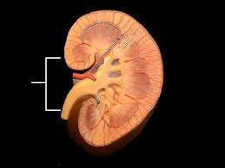
What are the structures of a kidney?
Hilum- indented portion of kidney where blood vessels, nerves, lymph vessels, and ureters enter kidney
Renal artery-
Carries oxygenated blood to kidney, smaller
Renal vein-
Carries deoxygenated blood from kidney, in front of R.A.
Hilum in lung

Slide 15
3 main areas

Slide 16
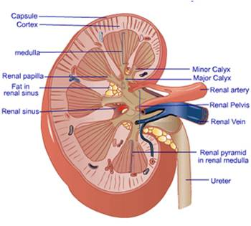
What are the structures of a kidney?
Renal capsule- covering of kidney
Renal cortex- outer region, contains upper portion of nephron
Renal medulla- inner region
Renal pyramid -transports urine to renal papillae, changes shape
Renal papillae -openings which join the calyces to renal pyramid

Slide 17
What are the structures of a kidney?
Calyx-”small cups”, subdivisions of renal pelvis “plumbing pipes”-
Transport urine to renal pelvis
Minor-smaller
Major-larger
Renal pelvis- funnel shaped sac where ureter expands, connects calyx to ureter

Slide 18
Checkpoint
What is the main organ of the urinary system?
Where are they located? What is their average size?
What are the functions of the kidney?
What are the three main areas of the kidney called?
What region connects ureter to the calyces?
What structure joins the calyces to the renal pyramid?

Slide 19
How to kidneys work?

