Slide 1
Metals
Chapter 19.1

Slide 2
Properties of Metals
Metals are found left of the stair-step line
Metals are usually:
Good conductors of heat and electricity
All but one is solid at room temp. – which one isn’t?
Reflect light (called luster)
Malleable
Ductile

Slide 3
Properties of Metals
Malleable: can be hammered or rolled into sheets
Ductile: can be drawn into wires

Slide 4
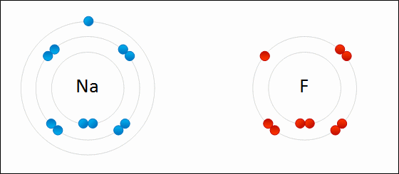
Ionic Bonding
When metals bond with a nonmetal it is an ionic bond

Slide 5
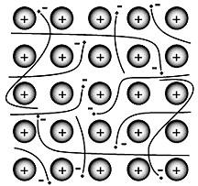
Metallic Bonding
Metallic Bonding: positively charged metallic ions are surrounded by a cloud of electrons. Outer-level electrons are not held tightly to the nucleus and therefore move freely among many positively charged ions

Slide 6
Alkali Metals
Found in Group 1
Are shiny, malleable and ductile, good conductors of heat and electricity
Softer than most other metals
Most reactive metals
Aren’t found in nature in their elemental form
1 electron in its outer shell

Slide 7
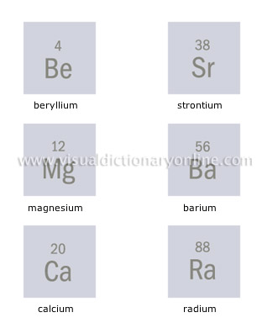
Alkaline Earth Metals
Group 2
Similar to all metals: Are shiny, malleable and ductile
Similar to Alkali metals: not found as free elements in nature
2 electrons in its outer shell

Slide 8
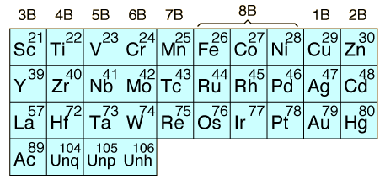
Transition Elements
Elements in groups 3 through 12
Are often found in nature as uncombined elements

Slide 9
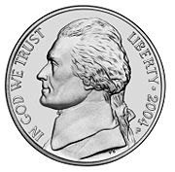
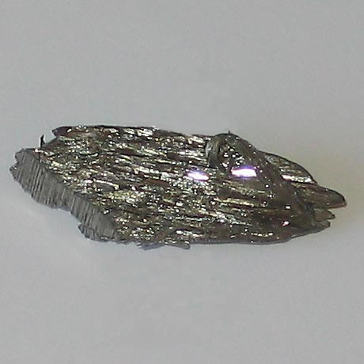
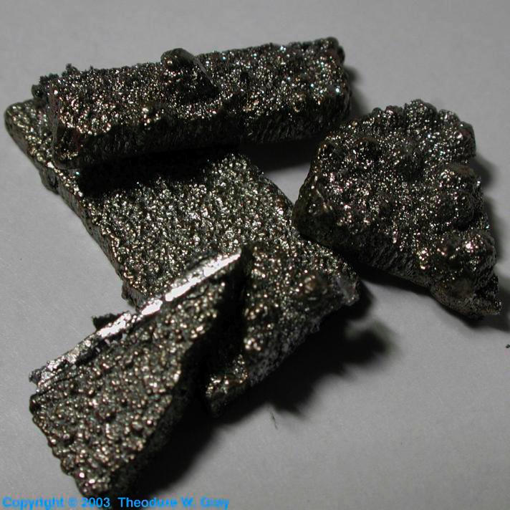
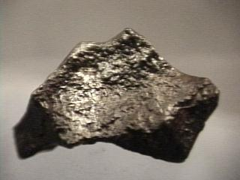
Iron, Cobalt and Nickel
Iron, Cobalt and Nickel form the “Iron Triad”
Used to make steel and other metal mixtures

Slide 10
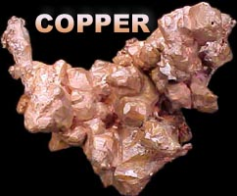
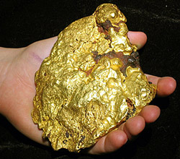
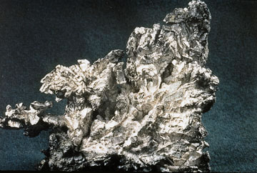
Copper, Silver and Gold
Called “Coinage Metals”
All in group 11
Are very stable and malleable and found as free elements in nature

Slide 11
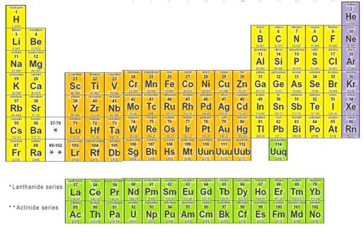
Inner Transition Metals
The two rows of elements that seem to be disconnected from the rest of the table are called the inner transition elements
Fit in the periodic table between groups 3 and 4

Slide 12
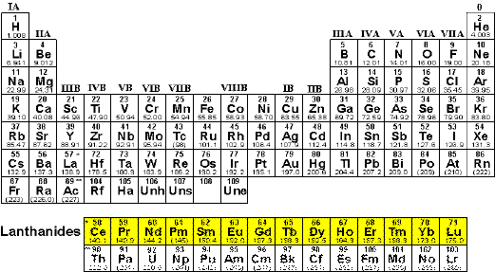
Lanthanides
Top row of inner transition metals
Elements 58-71
Called lanthanides because they follow the element lanthanum

Slide 13
Actinides
Second row of the inner transition metals
Elements 90-103
Follow the element actinium
All are radioactive and unstable

