Slide 1
Mixed Groups
Chapter 19.3

Slide 2
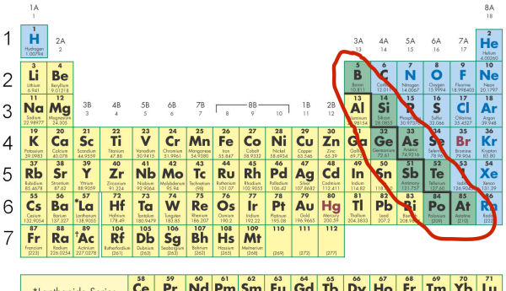
Properties of Metalloids
Metalloids:
Form ionic and covalent bonds with other elements
can have metallic and nonmetallic properties
Are located along the stair step line

Slide 3
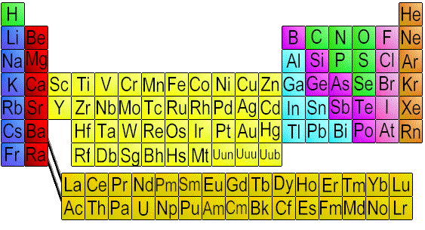
The Boron Group
Boron = metalloid
Located in group 13
Also in group 13 is Aluminum
Most abundant element in the Earth’s crust

Slide 4
The Carbon Group
Group 14 = the Carbon family
Each has 4 valence electrons
Carbon = nonmetals
Silicon and Germanium = metalloids
Tin and Lead = metals

Slide 5
The Carbon Group
Silicon occurs as an allotrope = different forms of the same element
Silicon is also the main component in semiconductors = elements that conduct an electric current under certain conditions

Slide 6
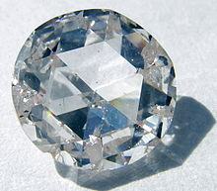
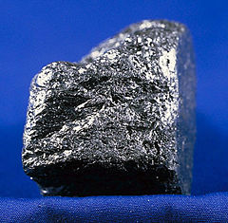
The Carbon Group
Allotropes of carbon

Slide 7
The Nitrogen Group
Group 15
Each has 5 valence electrons
Nitrogen and phosphorus are nonmetals
Arsenic and antimony are metalloids
Bismuth is a metal

Slide 8
The Oxygen Group
Group 16
6 valence electrons
Oxygen, sulfur and selenium are nonmetals
Tellurium and polonium are metalloids

Slide 9
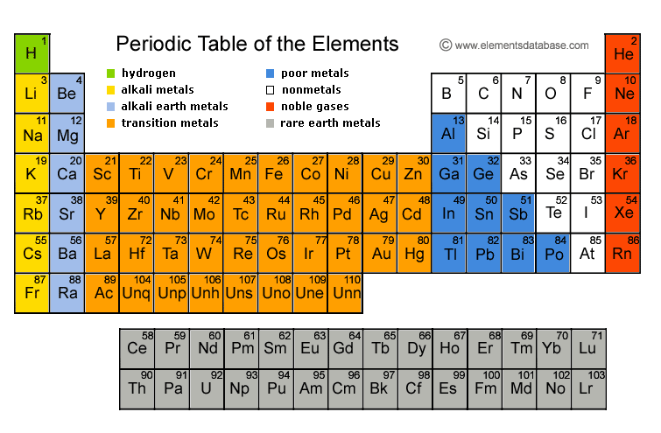
Synthetic Elements
Are made by scientists by smashing particles into atoms
Include Technetium 43 and Promethium 61 and elements has an atomic number 93 and higher

Slide 10
Synthetic Elements
Transuranium elements have more than 92 protons
They do not exclusively belong to the metal, nonmetal or metalloid group
All of them are synthetic and unstable and many of them disintegrate quickly

