Slide 1
Nonmetals
Chapter 19.2

Slide 2
Properties of Nonmetals
Nonmetals are
Usually gases or brittle solids at room temperature
Not malleable or ductile
Most do not conduct heat or electricity well
Are not shiny
All by hydrogen are locate to the right of the stair step line

Slide 3
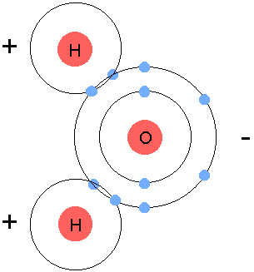
Bonding in Nonmetals
Metal bonds to a nonmetal = ionic bond
Nonmetal bonds to a nonmetal = covalent bond
Covalent bond:

Slide 4
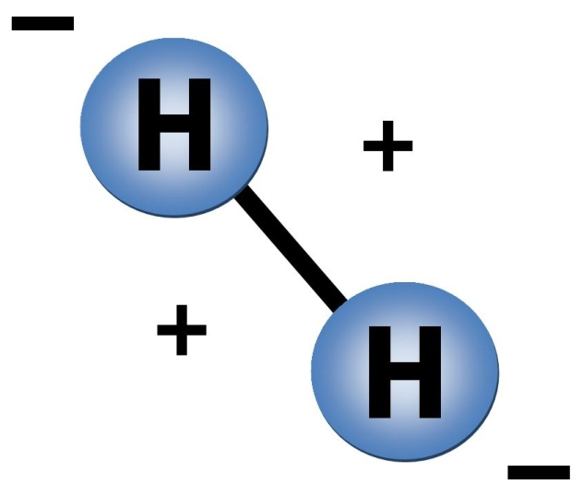
Hydrogen
90% of all atoms in the universe are hydrogen
Forms a diatomic molecule (consists of 2 atoms of the same element in a covalent bond) H₂
Is highly reactive

Slide 5
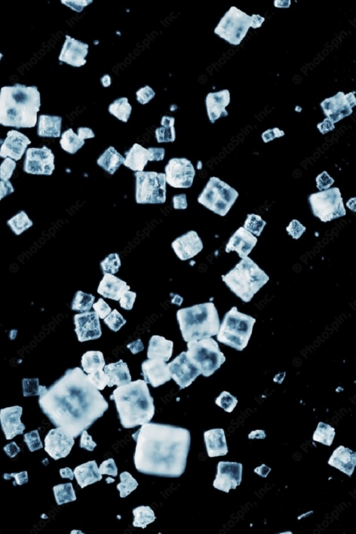
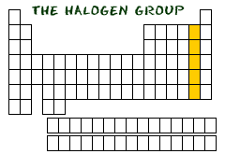
Halogens
Group 17
Very reactive in their elemental form
When they form an ionic bond, the compound is called a salt

Slide 6
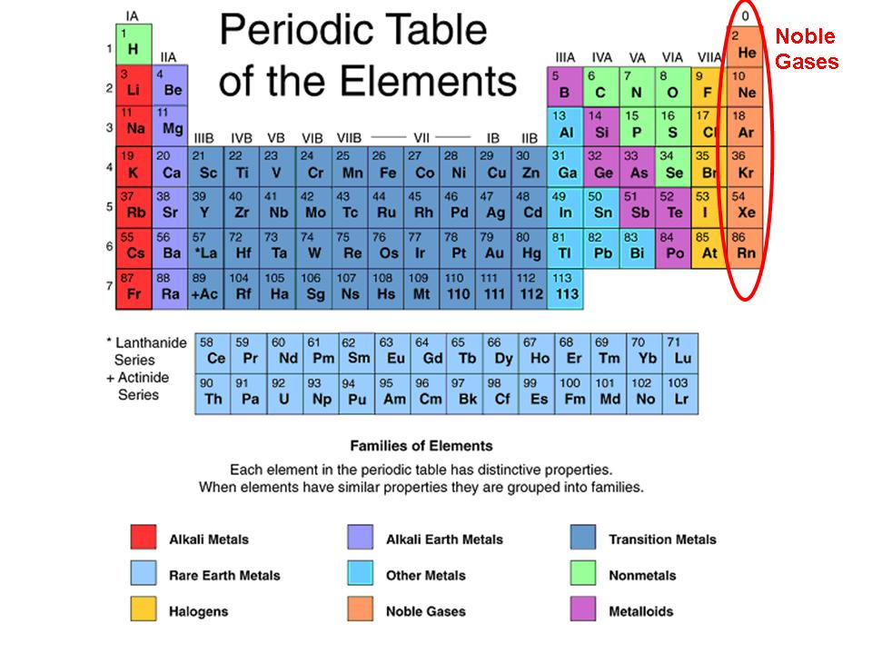
Noble Gases
Group 18
Exists as isolated atoms
Are stable because their outermost energy levels are full (they have 8 electrons in them)

