Slide 1
Marine Ecosystems
Chapter 7.2

Slide 2
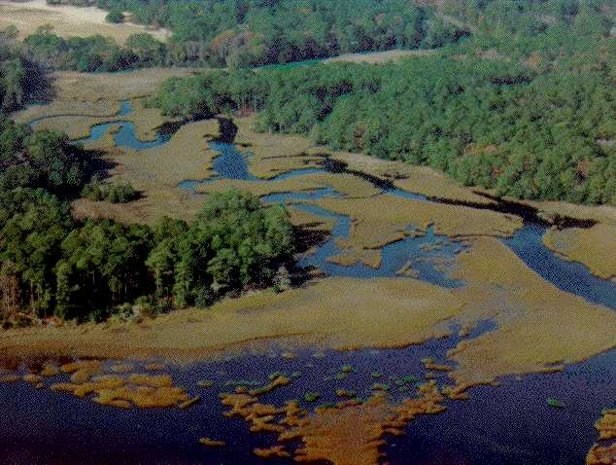
Coastal Wetlands
Coastal land areas that are covered by salt water for all or part of the time
Absorb excess rain to protect from flooding

Slide 3
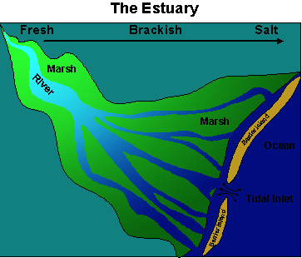
Coastal Wetlands
Estuaries
An area in which fresh water from a river mixes with salt water from the ocean
As the currents meet, it causes mineral-rich mud and dissolved nutrients to fall to the bottom.
Very productive ecosystems because they constantly receive fresh nutrients

Slide 4
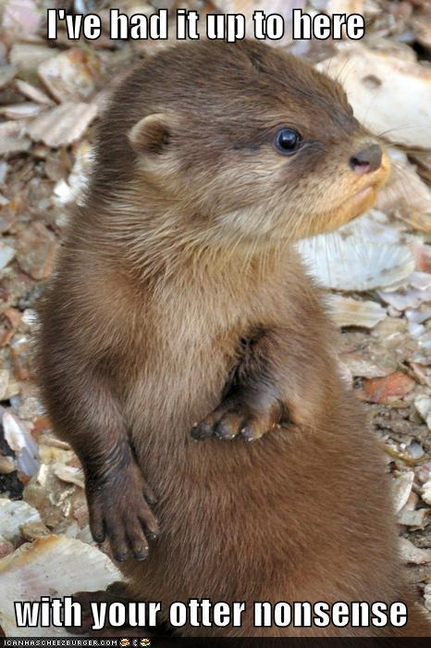
Coastal Wetlands
Plants and animals of estuaries:
Shoe crabs
Dolphins
Manatees
Otters
Oysters
Barnacles
clams

Slide 5
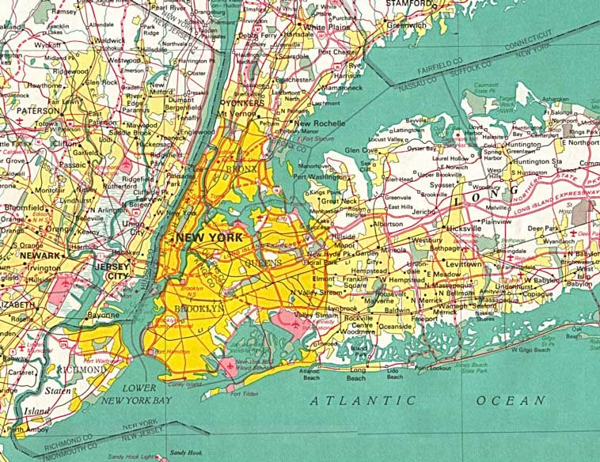
Coastal Wetlands
Of the 32 largest cities in the world, 22 are located on estuaries
Includes: New York City, New Orleans, London, Tokyo, Rio de Janeiro, Shanghai, Buenos Aires

Slide 6
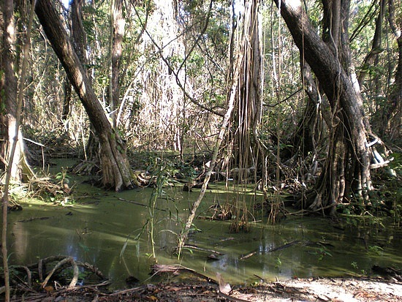
Coastal Wetlands
In estuaries, where rivers deposit their load of mineral-rich mud, salt marshes form.
Home to clams, fish, aquatic birds, shrimp, crabs
Mangrove swamps are dense growths of mangrove trees in swampy areas

Slide 7
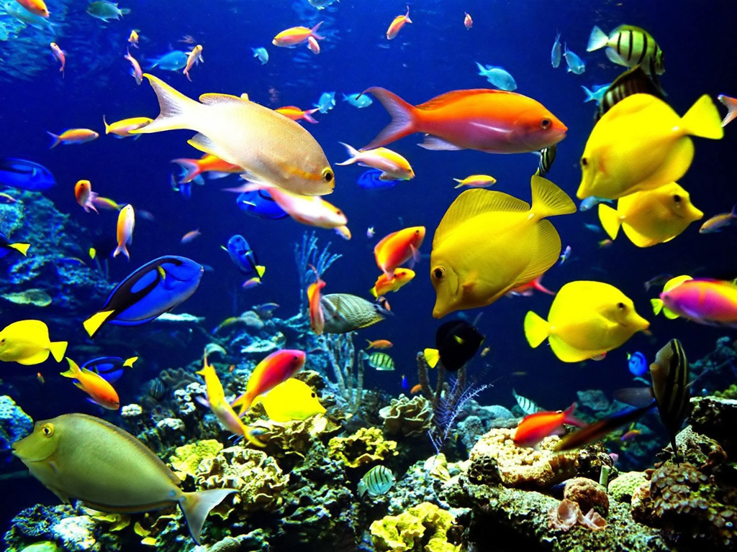
Coral Reefs
Are limestone ridges built by tiny coral animals called coral polyps and the algae that live inside them
Coral polyps secrete skeletons of limestone that slowly accumulate and form coral reefs
Thousands of plants and animals live in the cracks of the coral which make it among the most diverse ecosystems on earth
Found in warm salt water that is shallow and clear (tropical seas)

Slide 8
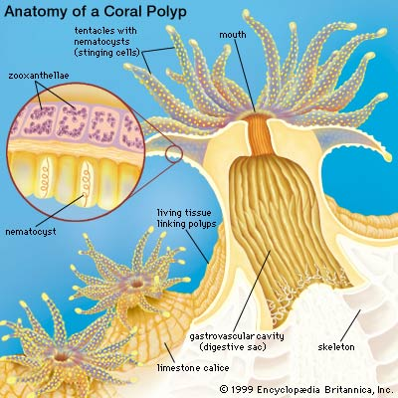
Coral reefs
Only the outer layer of the reef contains living coral
Coral is a predator that never chases their prey.
Their stinging polyps capture small animals that float/swim close to the reef

Slide 9
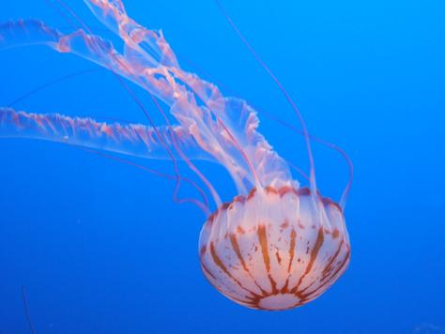
Oceans
Sunlight only penetrates about the 100m into the ocean
As a result, most of the ocean’s life is concentrated in the shallow, coastal waters
Open ocean is one of the least productive all ecosystems
Organisms include zooplankton which feed on phytoplankton
Jellyfish, tiny shrimp

Slide 10
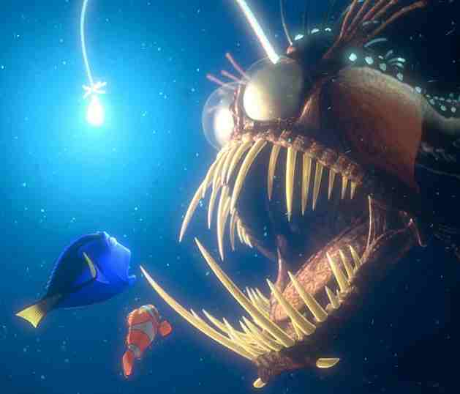
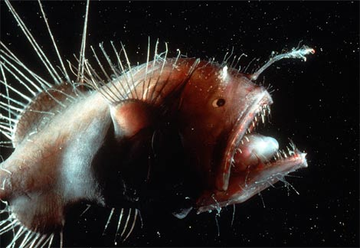
Oceans
Depths of the ocean are dark, so most food consists of dead organisms that fall from the surface
Decomposers, filter feeds and the organisms that eat them live in the deep areas of the ocean

