Slide 1
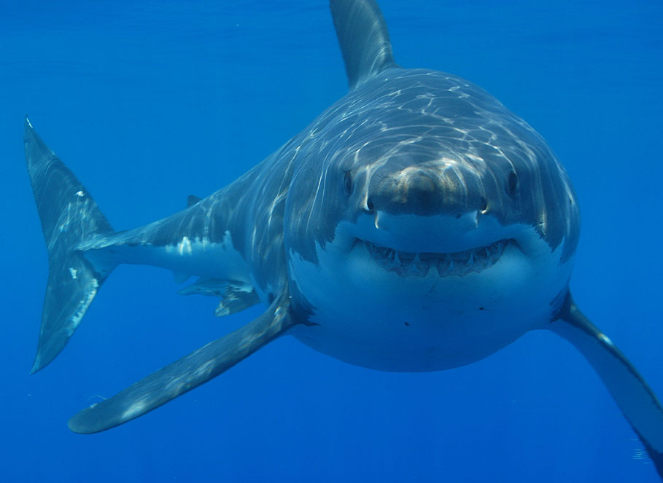
Sharks

Slide 2
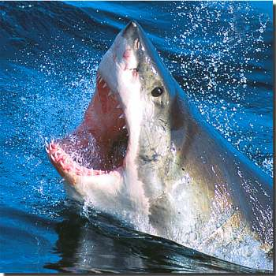
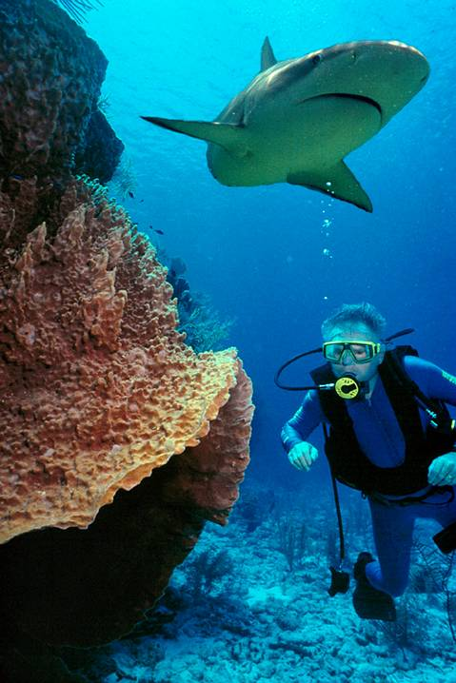
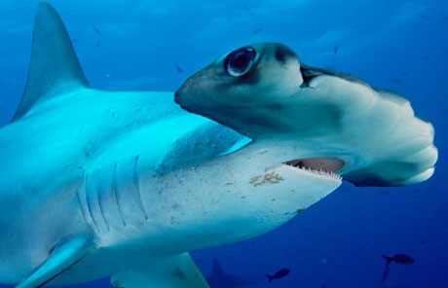
Sharks
Kingdom Animalia
Phylum Chordata
Subphylum Vertebrata
Class Chondrichthyes (Cartilaginous Fish)

Slide 3
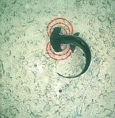
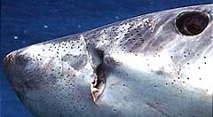
Extra Sense
Ampullae of Lorenzini are special sensing organs, forming a network of jelly-filled canals.
Are capable of detecting the electrical fields generated by moving animals

Slide 4
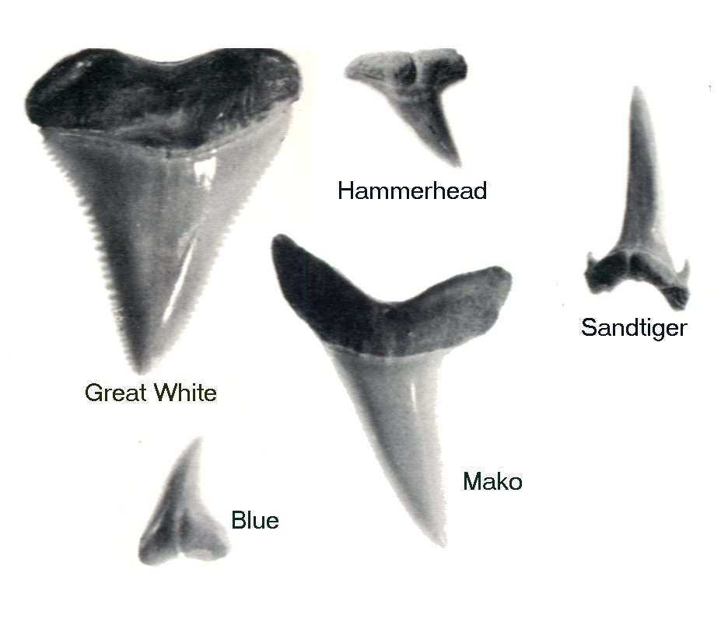
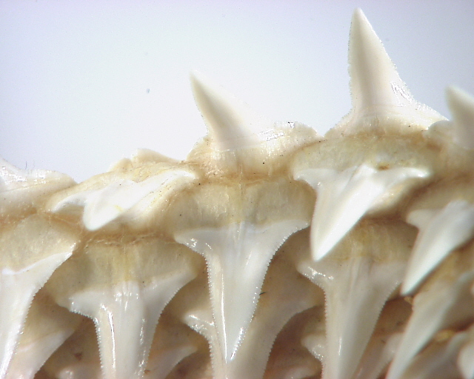
Teeth
A single shark can go through about 50,000 teeth in a life time.
Have a conveyor belt of teeth. When one is lost, a new one rotates up to take its place.
Each tooth shape has a different function.

Slide 5
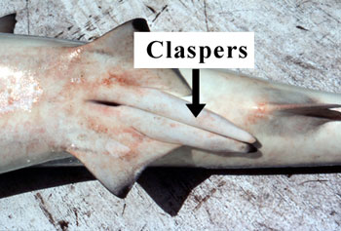
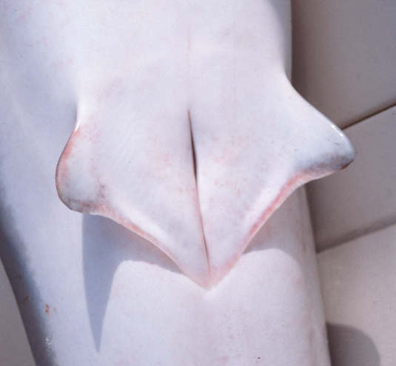
Male & Female Sharks
Males have claspers – Sperm transfer organs
Females don’t have claspers
Male Shark
Female Shark

Slide 6
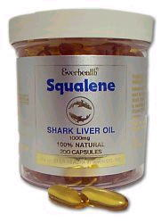
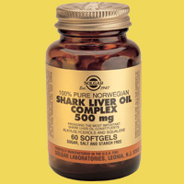
Sharks have a “Cancer Shield”
It was once thought that sharks never get cancer.
They do get cancer, but very very seldom.
Sharks injected with carcinogens, have detoxified these pathogens and survived apparently without ill effects.
Scientists have been researching the shark’s ability to prevent cancer to help humans fight cancer.
Shark liver oil and shark cartilage is believed to cure cancer, but this is NOT true!

Slide 7
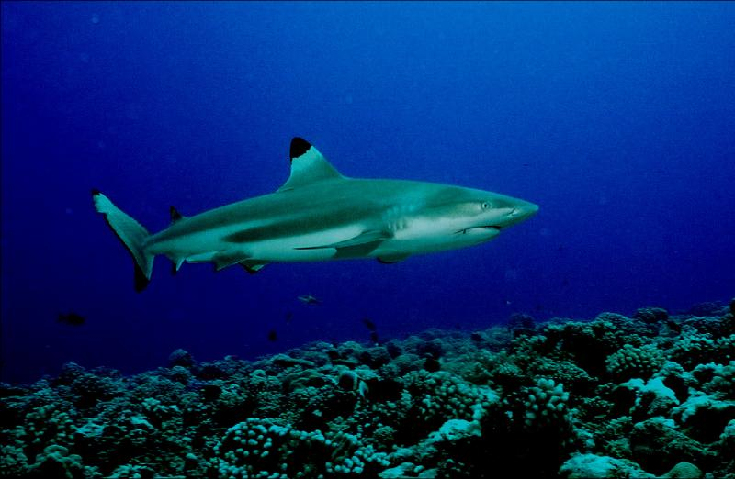
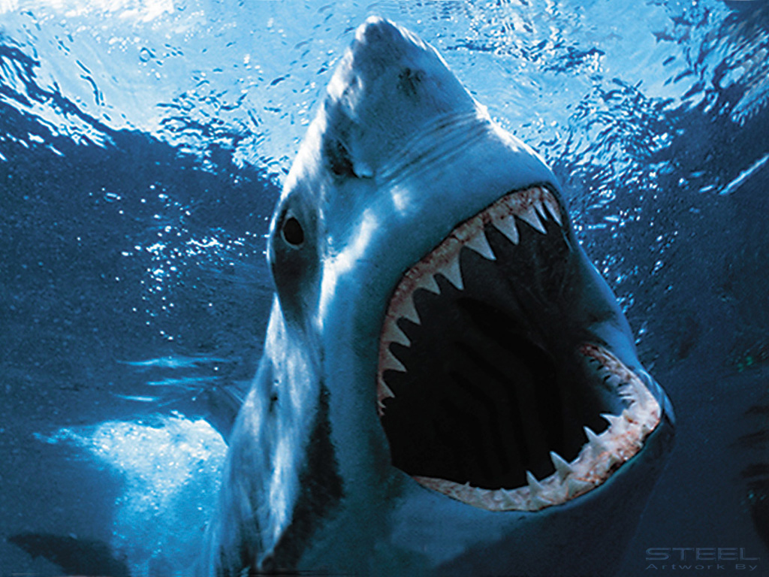
Villains
Most shark attacks are accidental & rarely end in fatalities.
There are around 50-75 shark attacks every year WORLDWIDE. Only 8-10 end in fatalities.
Sharks can go days or weeks before eating again.
Great white, tiger, and bull sharks are the most prone to attack humans.

Slide 8
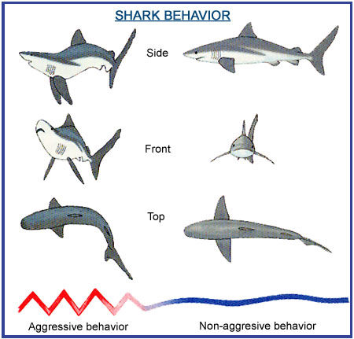
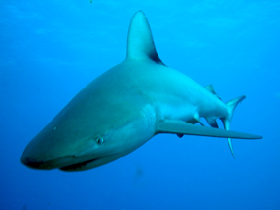
Villains?
Reasons for attacking:
Territorial, mistaken identity, & breeding season.
Some sharks even warn before attacking with an arched back posture (similar to a cat).

Slide 9
How to Avoid a Shark Attack
When swimming at a beach, stay in a group and do not go too far from the shore.
Avoid being in the water during the hours of twilight, early morning, and darkness, when sharks are most active.
Stay out of the water if you are bleeding.
Do not enter the water wearing shiny jewelry or bright clothing.
Avoid areas being used by fishermen, especially if you see diving birds or other signs of bait fishes and feeding activity.
Exercise caution when entering murky waters and areas near sandbars or steep drop-offs.
Do not enter the water if sharks are known to be present, and evacuate the water if you see a shark.

Slide 10
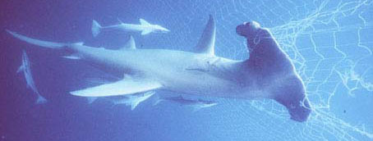
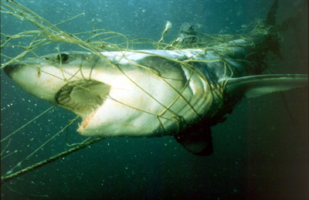
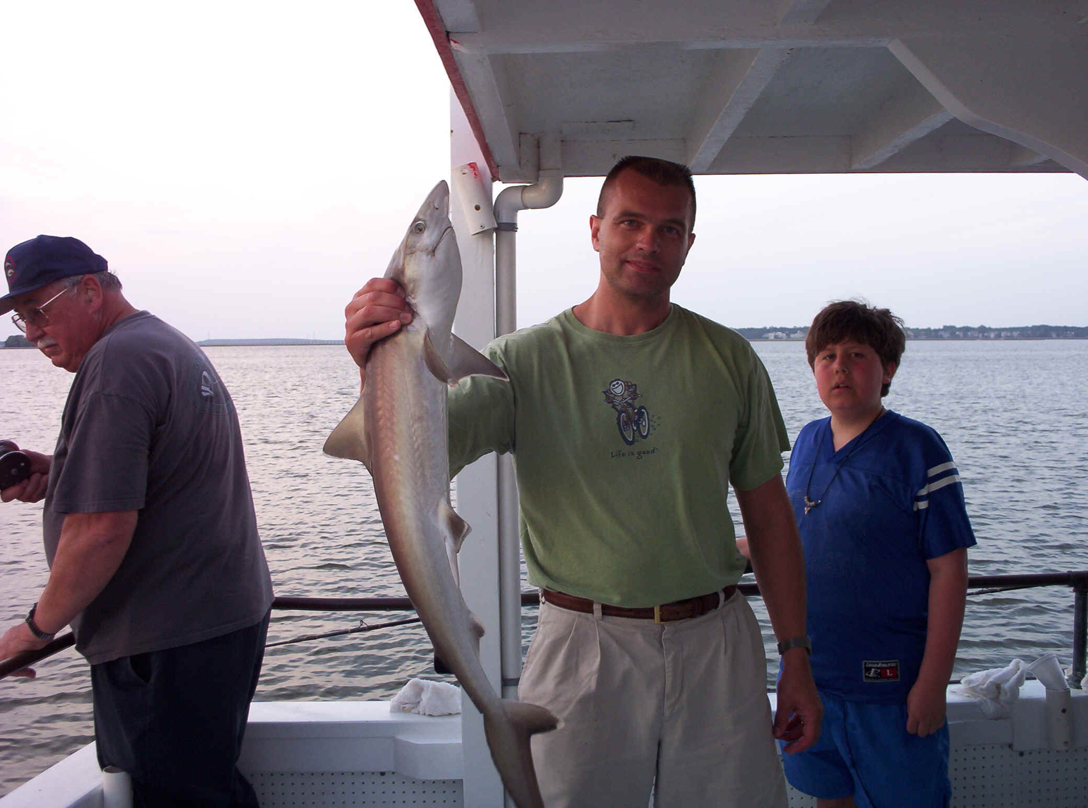
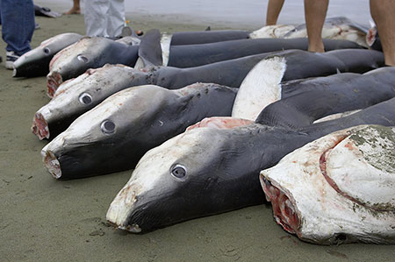
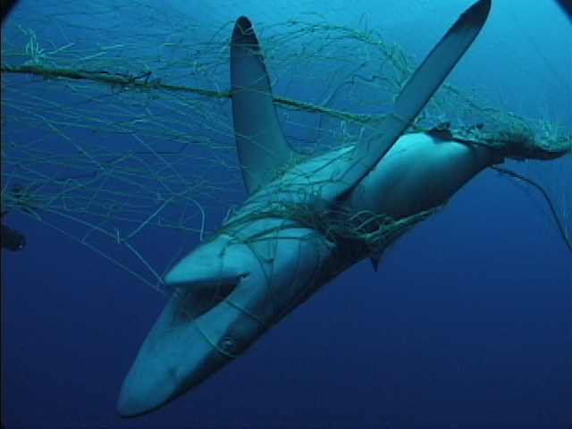
Victims
Not only are sharks fished for their meat, fins or cartilage, millions of them die needlessly as undesirable bycatch in nets & longlines.
A study in 1991, found that out of 8.3 million sharks that were caught, more then 87% were thrown back…dead.

Slide 11
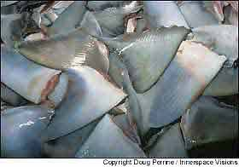
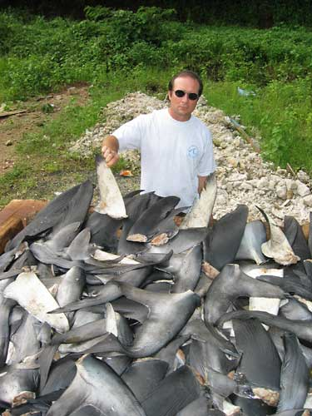
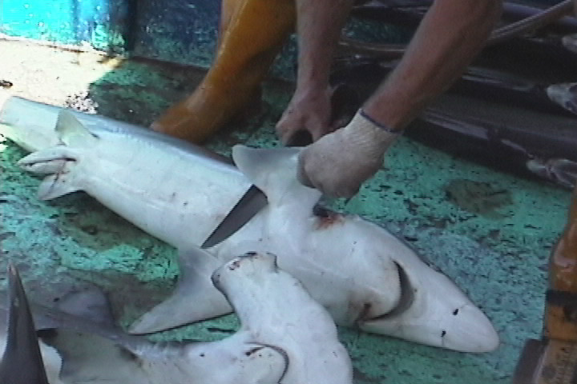
Shark Finning
Shark Finning is the cutting off of the fins,
and throwing the body back into the ocean.
The rest of the body could also be used, but is wasted!

Slide 12
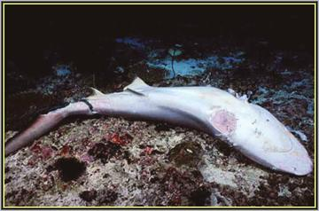
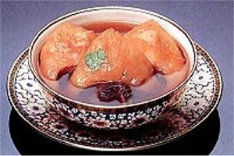
Shark Finning
Reason: Shark Fin Soup – A very expensive dish
Price runs between $100-$400 per bowl!
Disney World in Hong Kong had plans of adding shark Fin Soup to their menu, but is faced opposition.

Slide 13
Searching for Solutions
The new tools include electronic beach shields and chemical repellents.
Researchers have been extracting certain chemicals out of these dead carcasses, purifying them and testing them on sharks. It works very well.
Ironically, this technology not only saves humans from sharks, but sharks from humans.

Slide 14
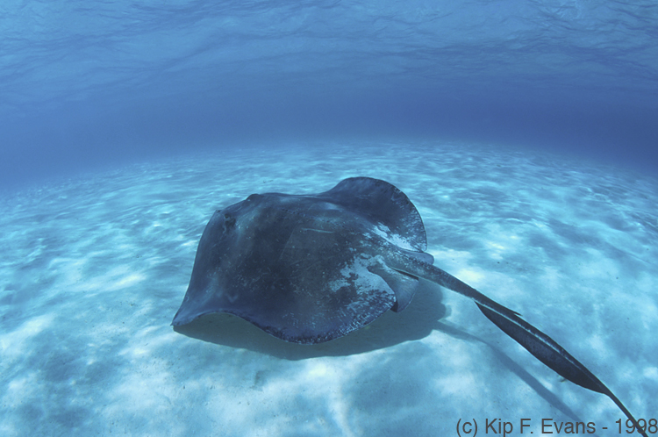
Rays & Skates

Slide 15
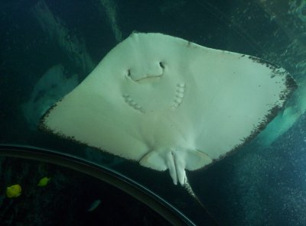
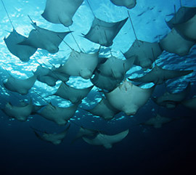
Rays & Skates
Characterized by their flattened shape and long, spine-bearing tails, stingrays are unique and cartilaginous cousins of the sharks.
Stingrays have pectoral fins that are fused to the sides of their rostrum or "head."

Slide 16
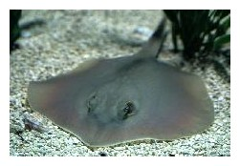
Rays & Skates
External gill openings are located on the stingray's ventral side or "underside."
Benthic rays, such as the Atlantic stingray, are often found buried in the sand.
Benthic: Associated with the seafloor.
They usually have a rounded or "diamond-shaped" body and their stingers/barbs, when present, are located near the middle or lower third of their "tail." As mostly bottom feeders, these rays generally feed on worms, clams, shrimp, crabs, snails and occasionally fish.

Slide 17
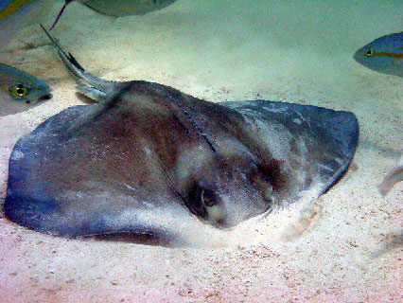
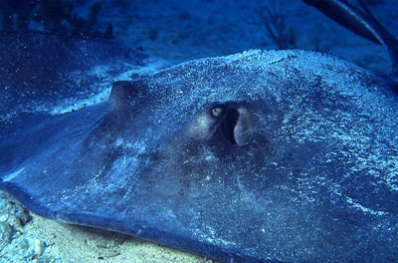
Rays & Skates
Spiracles are small openings on the surface of some sharks, all rays & skates that lead to the respiratory system.
Is found behind each eye, and is often used to pump water through the gills while the animal is at rest.
Helps rays breath while buried in the sand.

Slide 18
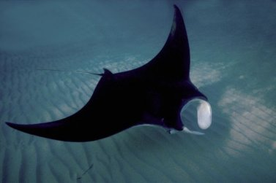
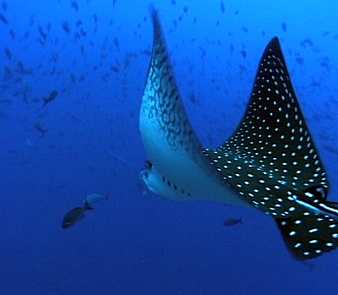
Rays & Skates
Pelagic rays, like the spotted eagle ray and manta ray below, are more active swimmers that have a "bat-like" shape.
Pelagic: Open water column.

Slide 19
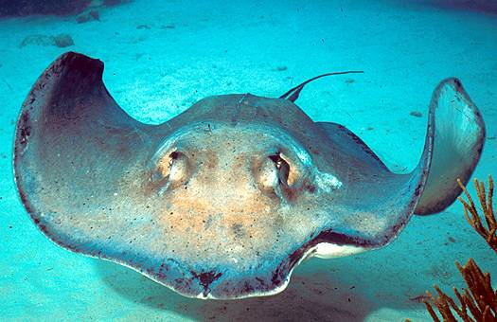
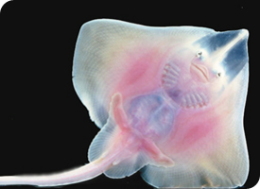
Difference Between Rays & Skates
Skates are a type of "ray" that differ considerably from stingrays.
Skates, such as the clearnose skate, do not possess venomous barbs like stingrays although many do have sharp thorns located on their dorsal surface and tails.

Slide 20
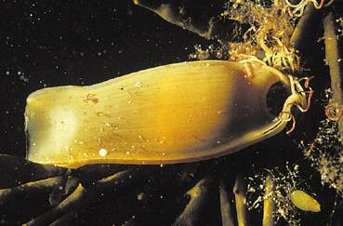
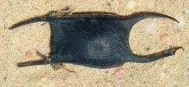
Differences Between Rays & Skates
Also, unlike stingrays, skates primarily live in marine habitats and rarely enter brackish or freshwater environments.
The most prominent difference between the two groups is that all stingrays give birth to live young while skates reproduce by laying eggs in leathery capsules sometimes called mermaid's purses.

Slide 21
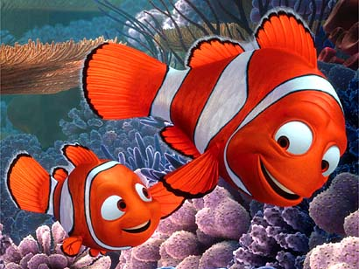
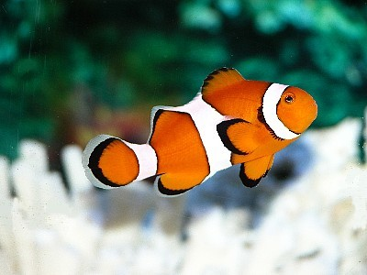
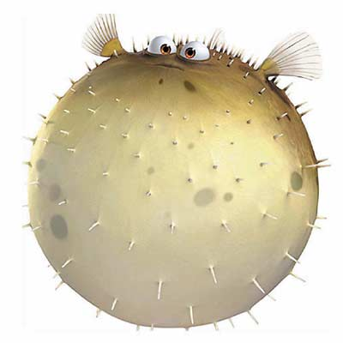
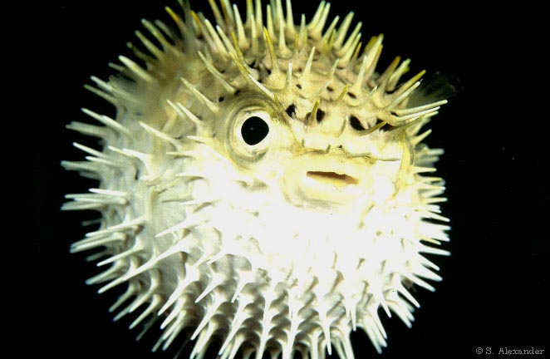
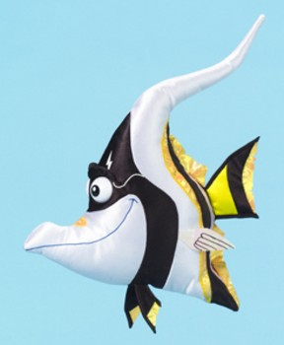
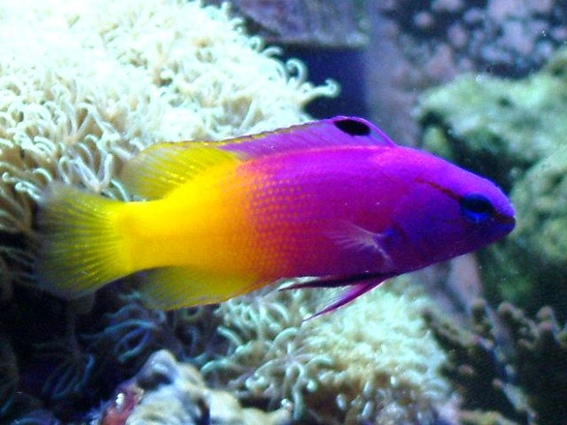
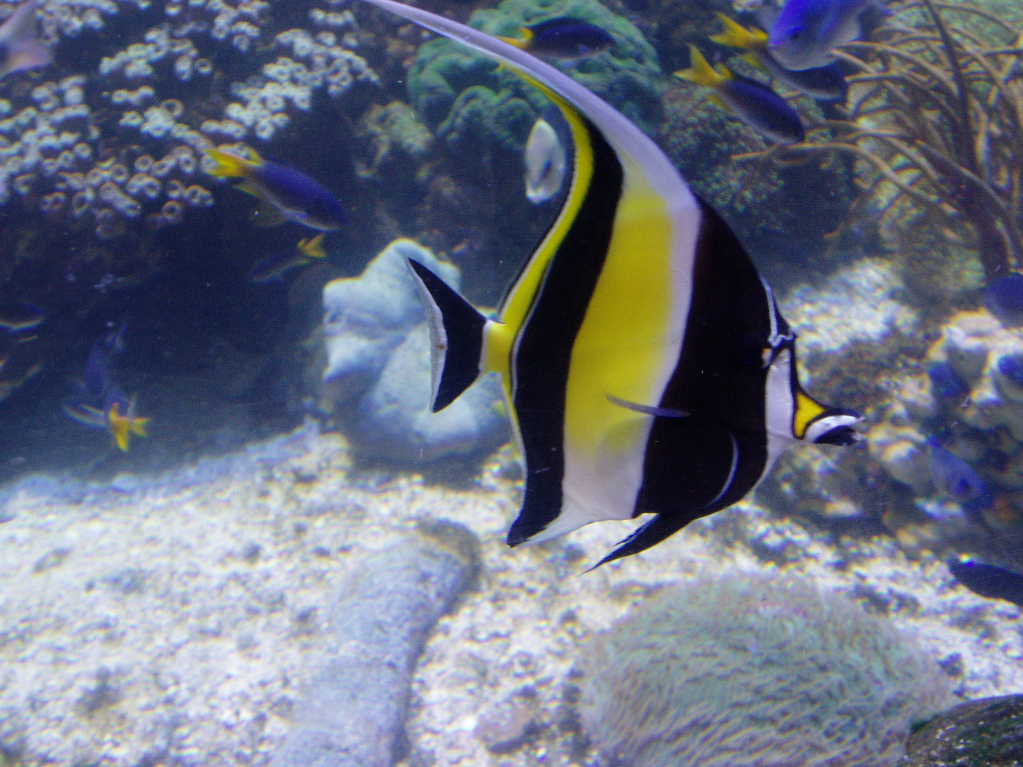
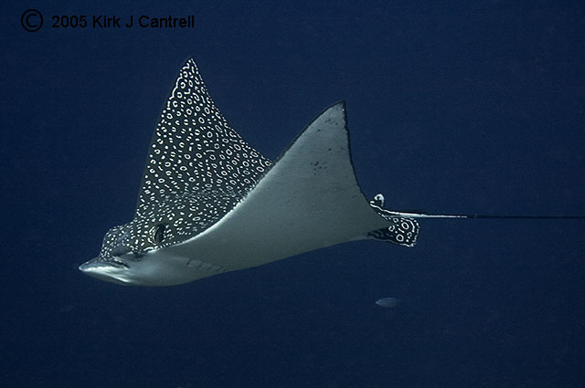
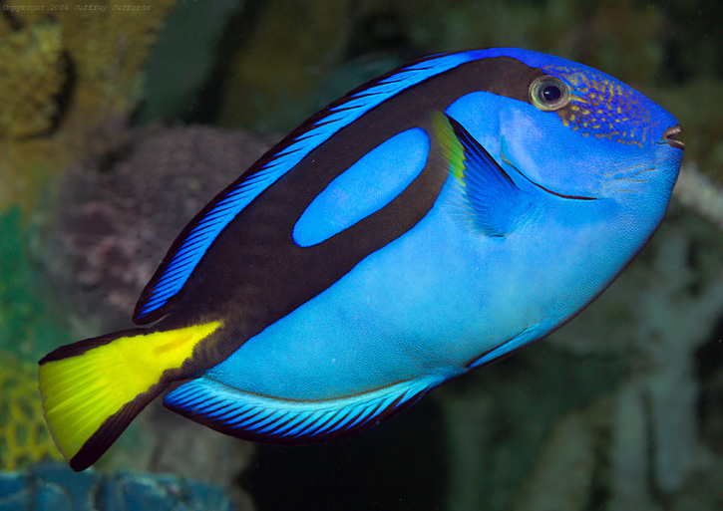
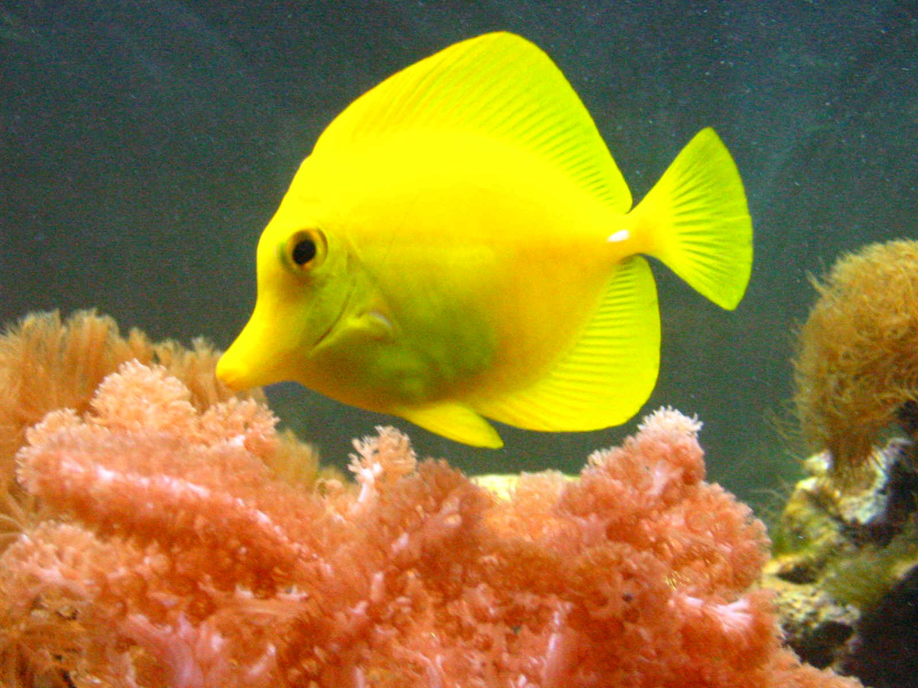
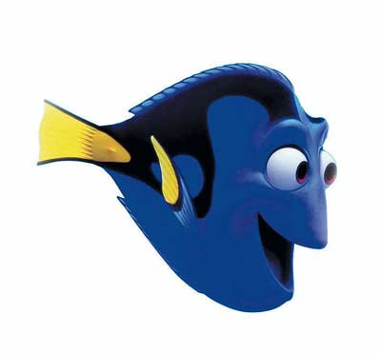
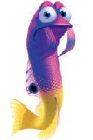
The End

Slide 22
Infraphylum Hyperotreti Class Myxini
Hagfish!!!
20 different species
Brains enclosed by a fibrous sheath
Body is supported by cartilaginous bars
Mouth is surrounded by sensory tentacles
Slime glands produce a large amount of slime (hard to grab the animal if it is covered in slime)
* Hagfish slime
Live in cold-water marine habitats
Both Northern & Southern hemispheres
Bury themselves in the sand and mud
Eat soft-bodied invertebrates & dead/dying animals
Can also swim into a fish’s mouth and eat the organs while the fish is still alive
Some hagfish are endangered due to overfishing for their soft, tough skin

Slide 23
Infraphylum Vertebrata Class Petromyzontida
Lampreys!!!
Found in marine & freshwater environments
Temperate regions
Adults prey on other fishes
Larvae filter feed
Mouth is modified into suckers
Surrounded by lips with sensory & attachment functions
Teeth line the mouth & cover a movable tongue
Lampreys use their mouths to scrape away scales
Secrete an anticoagulant to suck blood from their prey
Lamprey video

Slide 24
Infraphylum Vertebrata Class Petromyzontida
Lampreys!!!
Not all lampreys are predators
Brook lampreys feed only as larvae (for 3 years)
As adults, they do not eat. They simply reproduce and then die.
Adult lampreys live in either the ocean or the Great Lakes
Lampreys travel to freshwater streams to spawn (mate & lay eggs)
Once they have constructed their nest, the females attach to stone with their mouths
The males attach to the female heads with their mouths during mating.
Eggs are shed in batches over the course of a few hours- External fertilization

