Slide 1
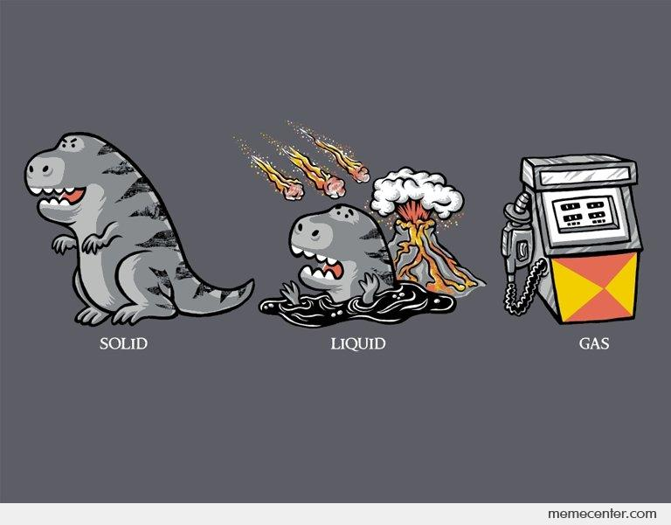
States of Matter
Physical Science Chapter 16

Slide 2
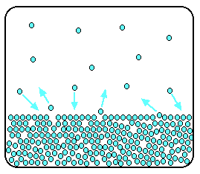
Kinetic Theory
Kinetic theory is an explanation of how matter behaves.
All matter is composed of small particles (atoms, molecules, and ions)
These particles are in constant, random motion
These particles are colliding with each other and the walls of their container.

Slide 3
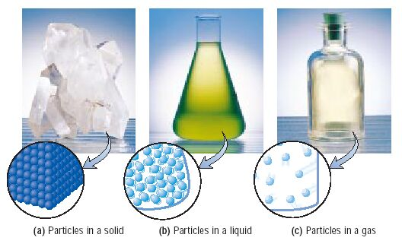
States of matter
Solid- matter that can not flow (definite shape) and has definite volume.
Liquid- definite volume but takes the shape of its container (flows).
Gas- a substance without definite volume or shape and can flow.

Slide 4
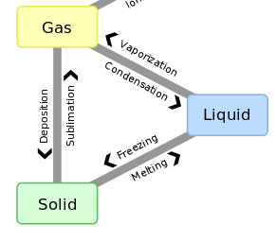
Phase changes

Slide 5
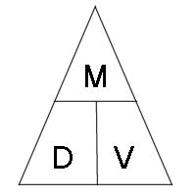
Calculating Density
Density = Mass / volume
D = m/v
What is the density of a 500 g object that takes up 10 mL of space?

Slide 6
Check for understanding
If an object has a mass of 50 g and takes up 25 mL of space, what is the density of this object?
What is the phase change called when something changes from a gas to solid?
If an something melts, is this a physical or chemical change?

