Slide 1
Terrestrial Biomes
APES 1.2

Slide 2
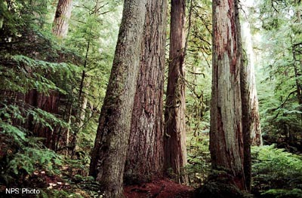
Forest biomes
Forests are the most widespread and are home to the greatest diversity of plants, animals and other organisms
Greatest species diversity
Trees need lots of water, so precipitation must be plentiful

Slide 3
Tropical Rain Forests
Tropical rain forests are located in a belt around the equator
They help regulate world climate and play vital roles in the nitrogen, oxygen and carbon cycles
Humid and warm and get around 200-450 cm of rain a year
Strong sunlight year round
Ideal for a wide variety of plans and animals

Slide 4
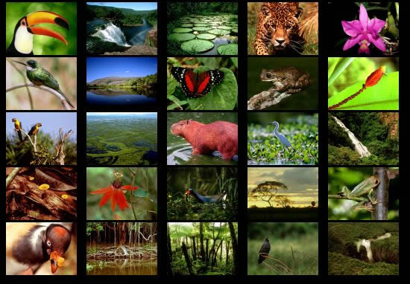

Slide 5
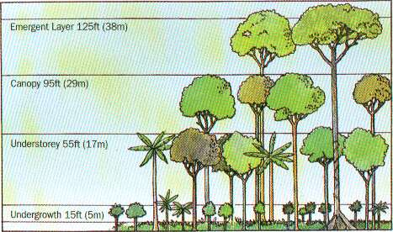
Tropical Rain forests
Layers of the Rain Forest
Emergent layer: top layer
Canopy: primary layer; divided into the upper and lower
Understory: little to no sunlight, short plants

Slide 6
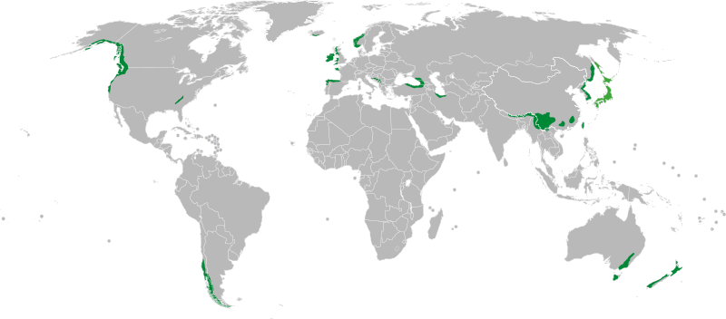
Temperate rain Forests
Temperate Rain forest have large amounts of precipitation, high humidity and moderate temperatures
Main plants: Evergreen trees, ferns, Douglas fir, redwoods

Slide 7
Temperate Deciduous Forests
Temperate deciduous forests: trees drop their leaves each fall
Located between 30º ^{to} 50º north latitudes
Seasons – temperatures range from below freezing to 35ºC
Plants: grow in layers like the tropical rain forest – includes maples, oaks, birch, shrubs, ferns, mosses
Animas – bears, squirrels, deer, birds (migrate south)

Slide 8
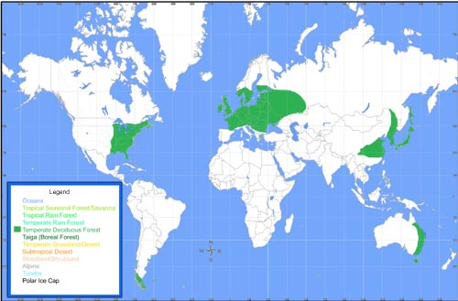

Slide 9
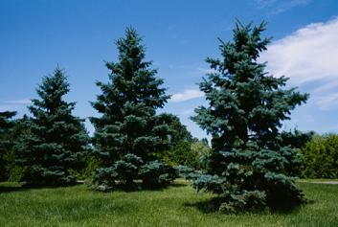
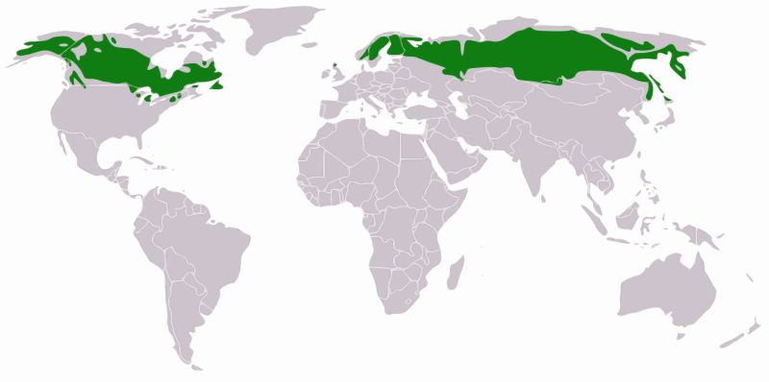
Taiga
Taiga is the northern coniferous forest that stretches in a broad band across the Northern hemisphere just below the artic circle
Plant growth is most abundant during the summer
Plants: conifer trees (needle-like leaves)
Animals: birds that migrate south, many animals migrate in the winter,

Slide 10
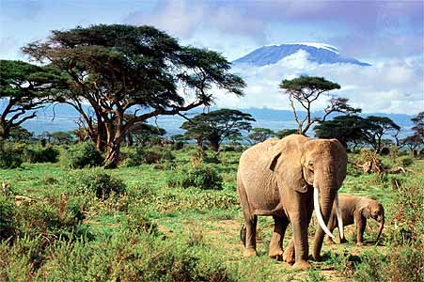
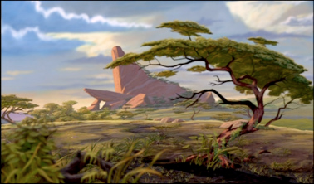
Savannas
Savanna is a tropical biome dominated by grasses, shrubs, and small trees
Wet season for a few months of the year
Animals: antelopes, giraffes, elephants, cheetahs, lions, hyenas
Plants: must be able to survive the long dry seasons

Slide 11
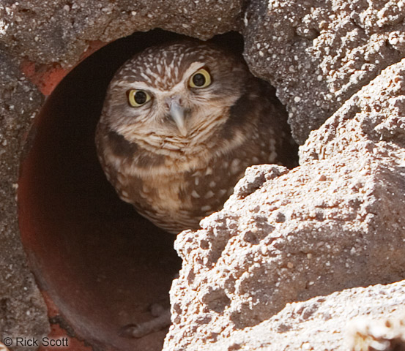
Temperate Grasslands
Temperate grassland covers large areas of the interior of continents
Plants: grasses and wildflowers, shrubs and trees only grow where the soil contains extra water like on banks of streams
Animals: bison, badgers, prairie dogs, burrowing owls

Slide 12
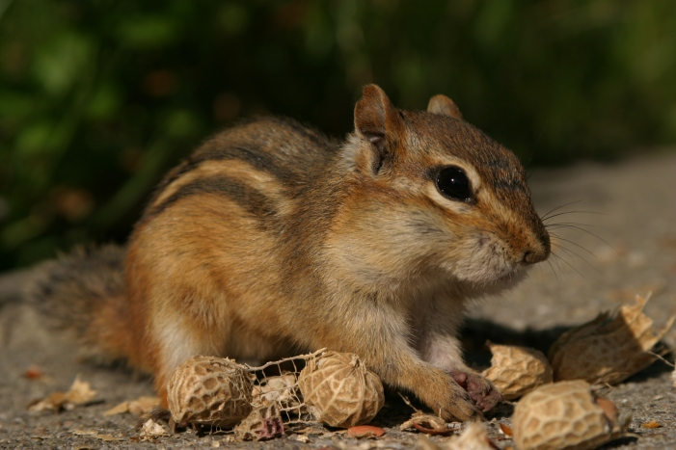
Chaparral
Chaparral is a temperate shrubland that has moderately dry, coastal climates, with little or no rain in the summer
Plants: low-lying, evergreen shrubs and small trees that tend to grow in dense patches
Animals: are often camouflaged including quails, lizards, chipmunks

Slide 13
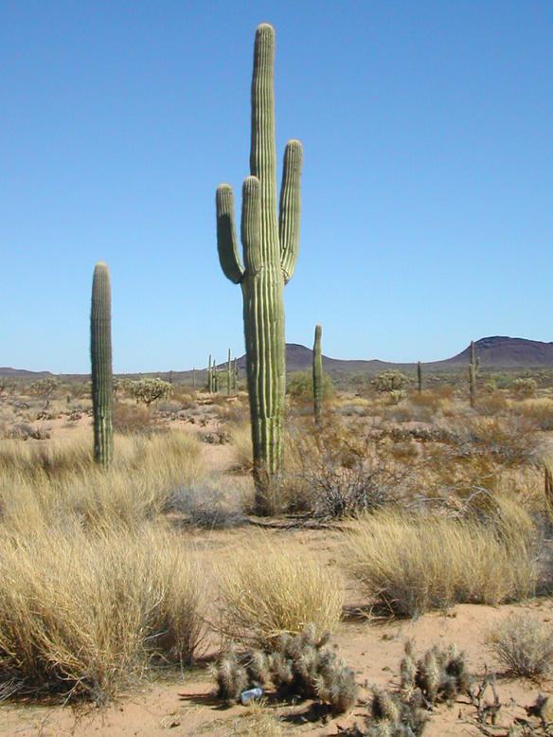
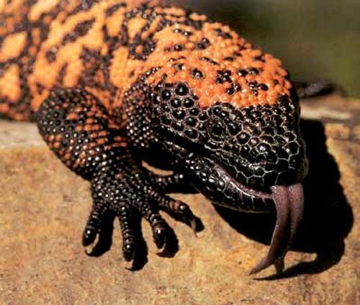
Deserts
Deserts are areas that have widely scattered vegetation and receive very little rain
Plants: all plants have adaptations for obtaining and conserving water
Animals: reptiles with thick, scaly skin that prevents water loss; insects and spiders that have body armor to help them retain water

Slide 14
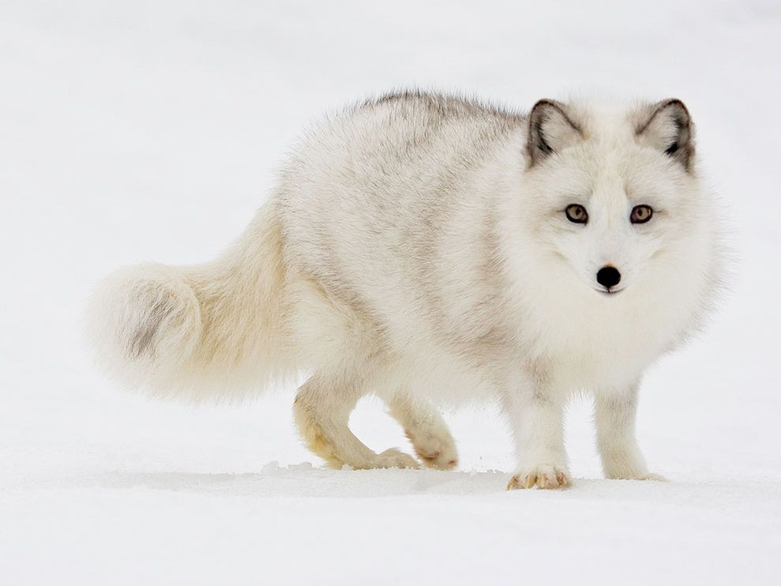
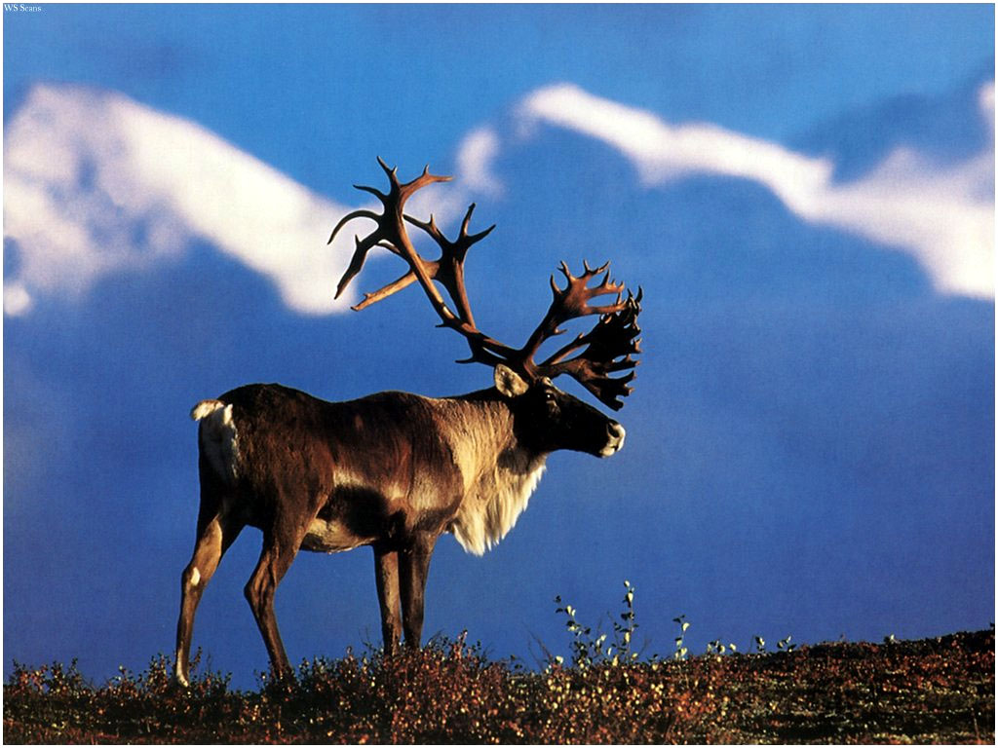
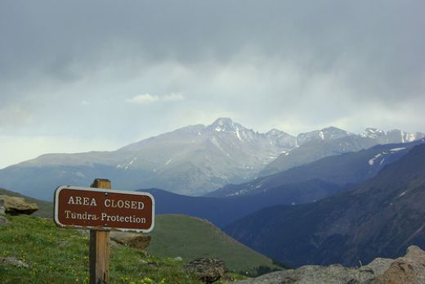
Tundra
Tundra is located in northern artic regions
Permafrost = deeper layers of soil are permanently frozen throughout the year
Vegetation: mosses and lichens cover the rocks, wildflowers, dwarf versions of willows and birch trees
Animals: migratory birds, caribou, wolves, moose, artic foxes

Slide 15
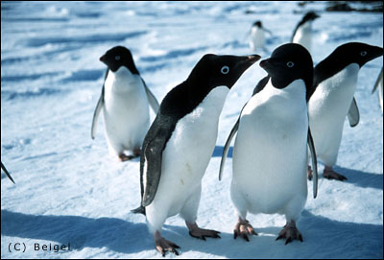
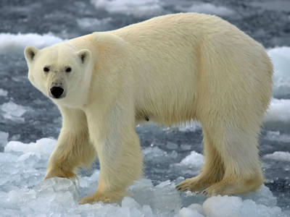
Polar Ice
Climate: pretty much below freezing year round
Antarctica and Most of Greenland
Plants: It’s ICE – there are no higher plants. In some cases algae may grow in the snow which gives it a pinkish color
Animals: polar bears, penguins, seals, whales

