Slide 1
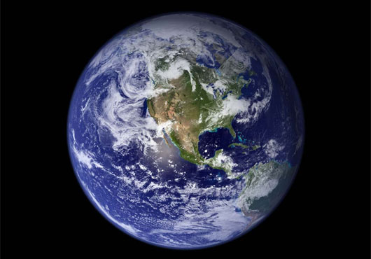
The Dynamic Earth
Chapter 3 notes

Slide 2
Geosphere
The solid part of earth that consists of all rock as well as soil and loose rocks make up the geosphere
Majority of the geosphere is located in the earth’s interior

Slide 3
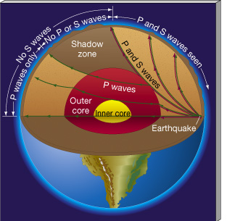
Earth’s interior
Scientists used seismic waves to learn about Earth’s interior
Seismic waves are the waves that travel through earth’s interior during an earthquake
The waves are altered as they pass through different material, allowing seismologists to learn what the earth is made up

Slide 4
Plate tectonics
The lithosphere is divided into pieces called tectonic plates
The plates glide across the asthenosphere like a chunk of ice drifts across a pond

Slide 5
Plate boundaries
Tectonic plates may move away from one another, collide with one another or slip past one another
When they move it can cause earthquakes, mountains to form, or volcanoes to erupt

Slide 6
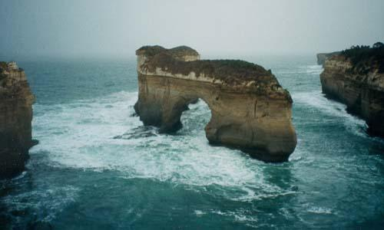
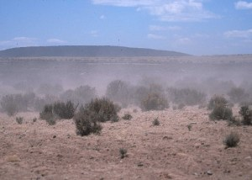
Erosion
Erosion is the removal and transport of surface material
Can occur by wind or water

