Slide 1
Phylum Chordata
Urochordata, Cephalochordata, and Vertebrates

Slide 2
Characteristics
Bilateral symmetry
At some stage: notochord, pharyngeal slits or pouches, dorsal tubular nerve cord, postanal tail
Endostyle or thyroid gland
4. Complete digestive tract
5. Ventral contractile blood vessel (heart)

Slide 3
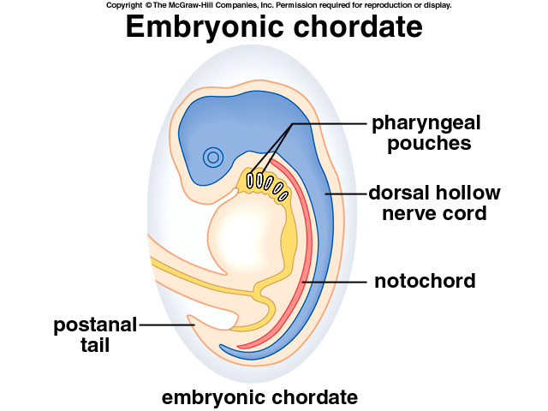
1. The notochord
Supportive, dorsal cord, runs through body cavity to tail
Allows for lateral (side to side) movement
In adult vertebrates, cartilage or bone replace notochord

Slide 4
2. Pharyngeal slits/pouches
Openings between digestive tract and outside
Some do not open out – pharyngeal pouches
Ancestrally used for feeding (some still do)
Gills for gas exchange
In terrestrial vertebrates, mainly embryonic

Slide 5
3. Dorsal Nerve Cord
Runs dorsal to notochord
Expand anteriorly as brain
Responsible for complex systems
Sensory
Perception
Integration
Motor response

Slide 6
4. Post anal tail
Extends posteriorly beyond anal opening
Notochord or vertebral column support tail

Slide 7
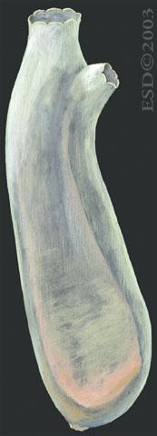
Subphylum Urochordata
Tunicates or sea squirts
Ascidians – largest class
Sessile adults
Solitary or colonial
Appendicularians & thaliaceans
Planktonic as adults

Slide 8
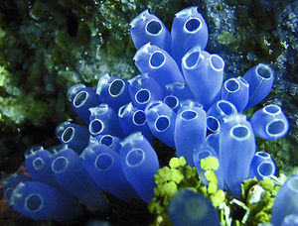
Sessile tunicates
Attach to solid substrate
Unattached end has 2 openings
Oral
Opposite of attached end
Takes water in
Serves as mouth
Atrial siphon
Lets water out

Slide 9
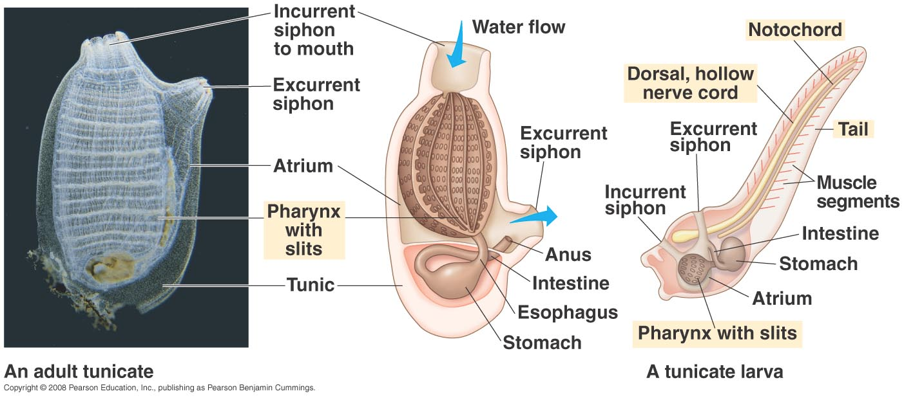
Tunicate body wall
Tunic – connective-tissue-like covering
Appears as gel – often quite tough
Root-like stolons may connect to substrate or colony

Slide 10
Tunicate Muscles
Longitudinal and circular muscles change shape
Work against elastic tunic and hydrostatic skeleton

Slide 11
Tunicate Nervous system
Mostly in body wall (plexus)
Single ganglion between openings
Mechano- and chemoreceptors all over body wall (more near openings)

Slide 12
Big old pharynx
Tentacles around oral opening keep large objects out.
Pharyngeal slits called stigmas feature cilia that bring water into pharynx → stigma → atrium → out atrial siphon

Slide 13
Digestion
Continues from pharynx along mucus tract created by endostyle
Digestion occurs in stomach
Absorption occurs in intestine
Exits through anus

Slide 14
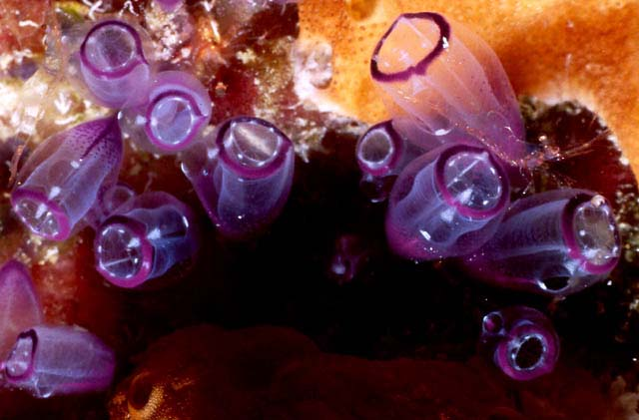
Gas exchange
Occurs in pharynx as water circulates

Slide 15
Circulation
Heart near base of pharynx
One vessel toward endostyle, one toward digestive organs and gonads

Slide 16
Excretion
Ammonia diffuses into water
Pyloric glands may have excretory functions

Slide 17
Development
Starts as free swimming larva, does not feed
Attaches to substrate
Outer epidermis shrinks
Brings notochord and tail inside
180° turn to make digestive tract U shaped

Slide 18
Subphylum Cephalochordata
Lancelets – clearly demonstrate 4 chordate characteristics
2 genera
Branchiostoma (amphioxus)
Asymmetron
45 species
Worldwide and coastal in clean sand substrates

Slide 19
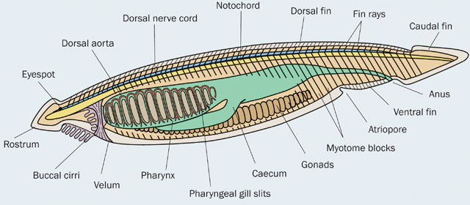
Body Plan
Small and tadpole-like (up to 5 cm long)
Laterally flattened
Weak swimmers, live in burrows
Filter feeders, anterior end exposed

Slide 20
Body plan
Notochord runs from tail to head (origin of name)
Most notochord cells are muscle cells
Contract – become more rigid
Relax – become more flexible

Slide 21
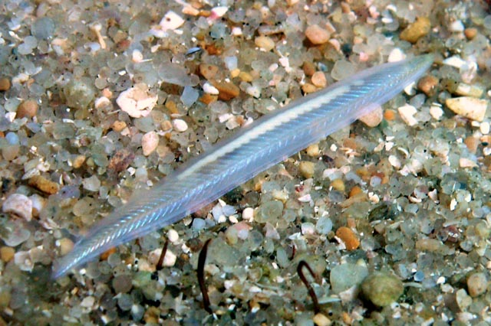
Swimming
Muscles on side of notochord cause undulations
Longitudinal ventrolateral folds stabilize
Dorsal and caudal (tail) fins aid in swimming

Slide 22
From front to back
Anterior oral hood protects cirri – fingerlike feeding tentacles
Posterior of oral hood has mouth leads to pharynx with many pharyngeal slits supported by gill bars
Atrium forms outside pharynx
Atrium opening is called atriopore

Slide 23
Eating
Filter feeders, eat mostly buried
Large particles build up and are shaken off of cirri
Water carries small food particles in → stick to endostyle-created mucus → digestion is extracellular & intracellular

Slide 24
Other maintenance
No true heart, vessel contractions move blood which has amoeboid cells
Excretory tubules work with blood vessels in coelom
Coelom is reduced and limited to small canals

