Slide 1
Waves
Physics Notes

Slide 2
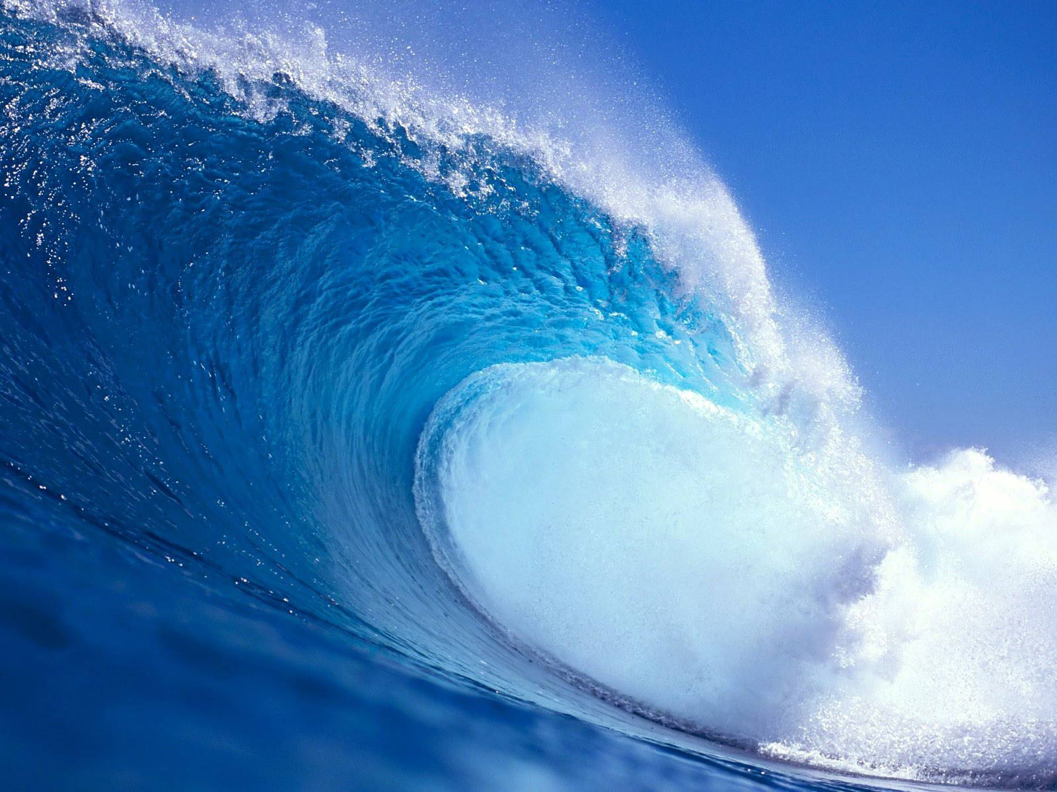
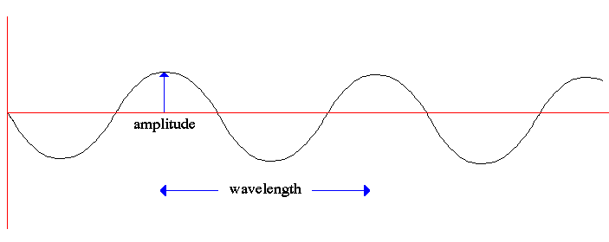
Waves
Wave: A disturbance propagated from one place to another with no actual transport of matter.
All waves carry energy without transporting matter.
A wave will continue to travel as long as it has energy
Periodic – repeating pattern

Slide 3
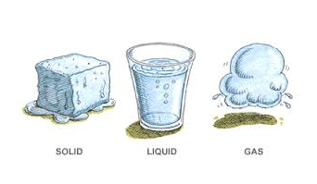
Mechanical Waves
Mechanical waves are waves that travel through a medium.
A medium can be a solid, a liquid, a gas, or a combination of these.
A wave transports energy NOT matter.
Mechanical waves can either be compressional waves (also called longitudinal) or transverse waves.

Slide 4
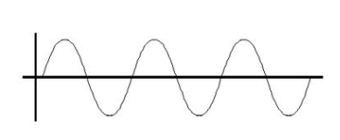
Transverse Wave
Transverse wave: A wave in which the individual particles of a medium vibrate from side to side in a direction perpendicular to the direction in which the wave travels.
Ex. Light waves

Slide 5
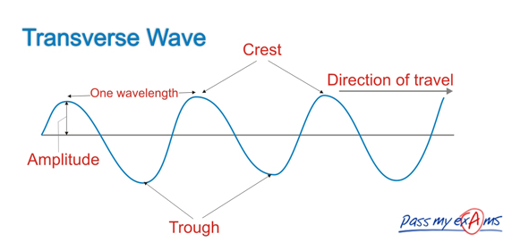
Transverse Wave
Amplitude: For a wave or vibration, the maximum displacement on either side of the equilibrium position (vertical distance)
Higher the amplitude, the more energy the wave has
Wavelength: The distance between successive crests, troughs, or identical parts of a wave.

Slide 6
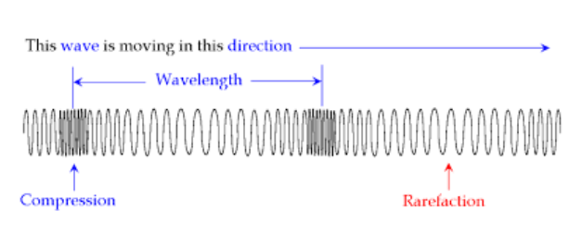
Longitudinal Wave
A wave in which the individual particles of a medium vibrate back and forth in a direction parallel to the direction in which the wave travels.
Also called compressional wave
Ex. Sound

Slide 7
Surface wave
Wave that consists of a combination if transverse and longitudinal waves and occurs at the surface between two different mediums.
Ex. Ocean

Slide 8
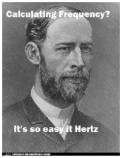
Frequency ( f ) :The number of wave that pass a particular point per unit time. Units are in hertz (Hz )
Period (T) : The time (seconds) required for a vibration or a wave to make a complete cycle; equal to 1 / frequency
1
1
f =
T =
T
f

Slide 9
Wave Speed : The speed with which waves pass by a particular point.
Wave Speed = Frequency × Wavelength
v = f × λ

Slide 10
What affects the speed of waves?
1. Increases or decrease on the wavelength
2. Increases or decrease in the frequency
3. Density of the medium
4. Elasticity of the medium
Elasticity : The ability of a medium to return quickly to its original shape after being disturbed.
Sound waves travel fastest in solids then liquids then gases
Light waves travel slower in liquids and solids than they do in gases or empty space.

Slide 11
Warm Up
Draw and label a transverse wave.

Slide 12
Waves part 2

Slide 13
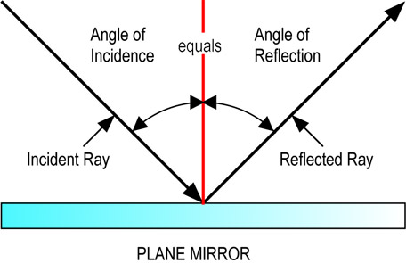
Reflection:
The bouncing back of waves upon reaching another surface.

Slide 14
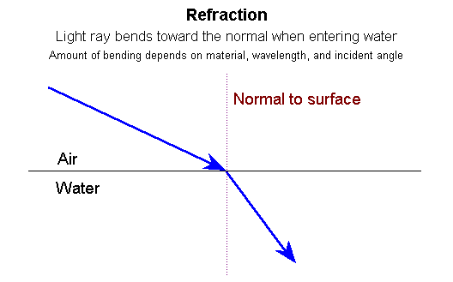
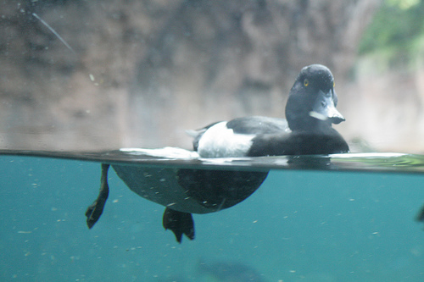
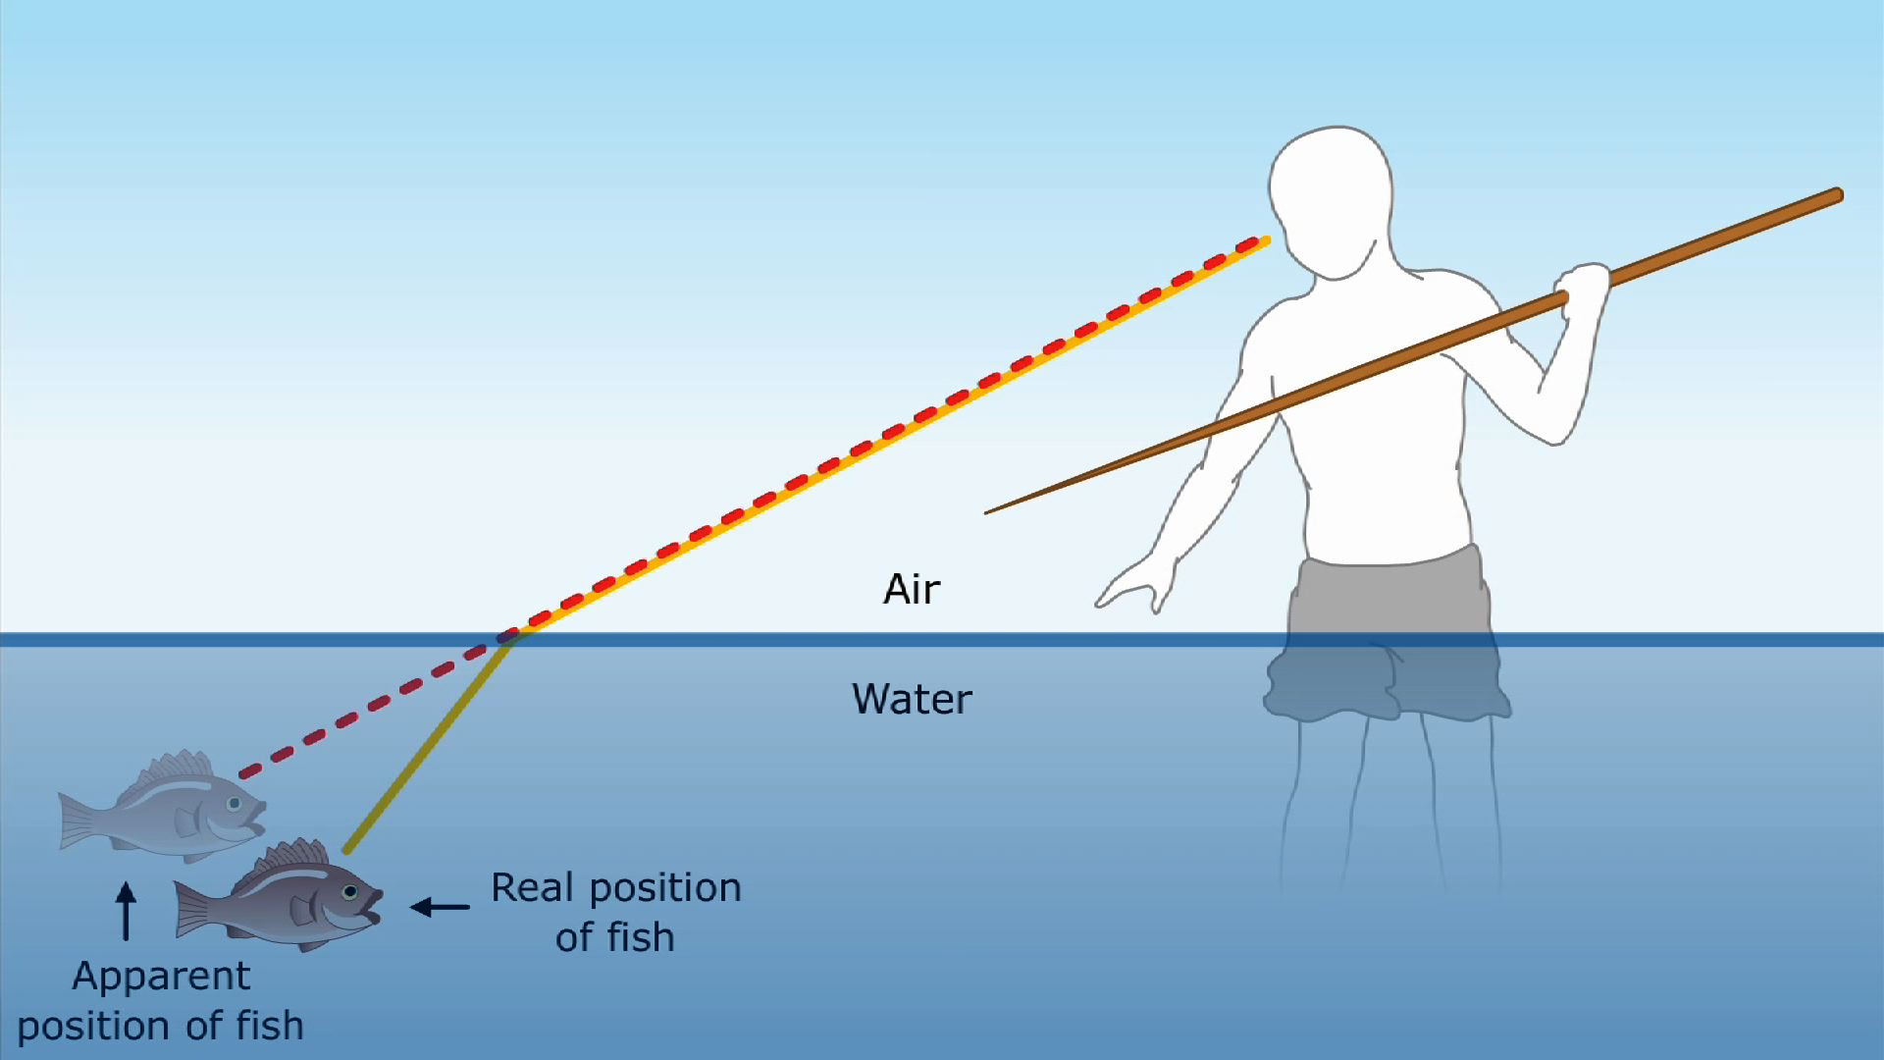
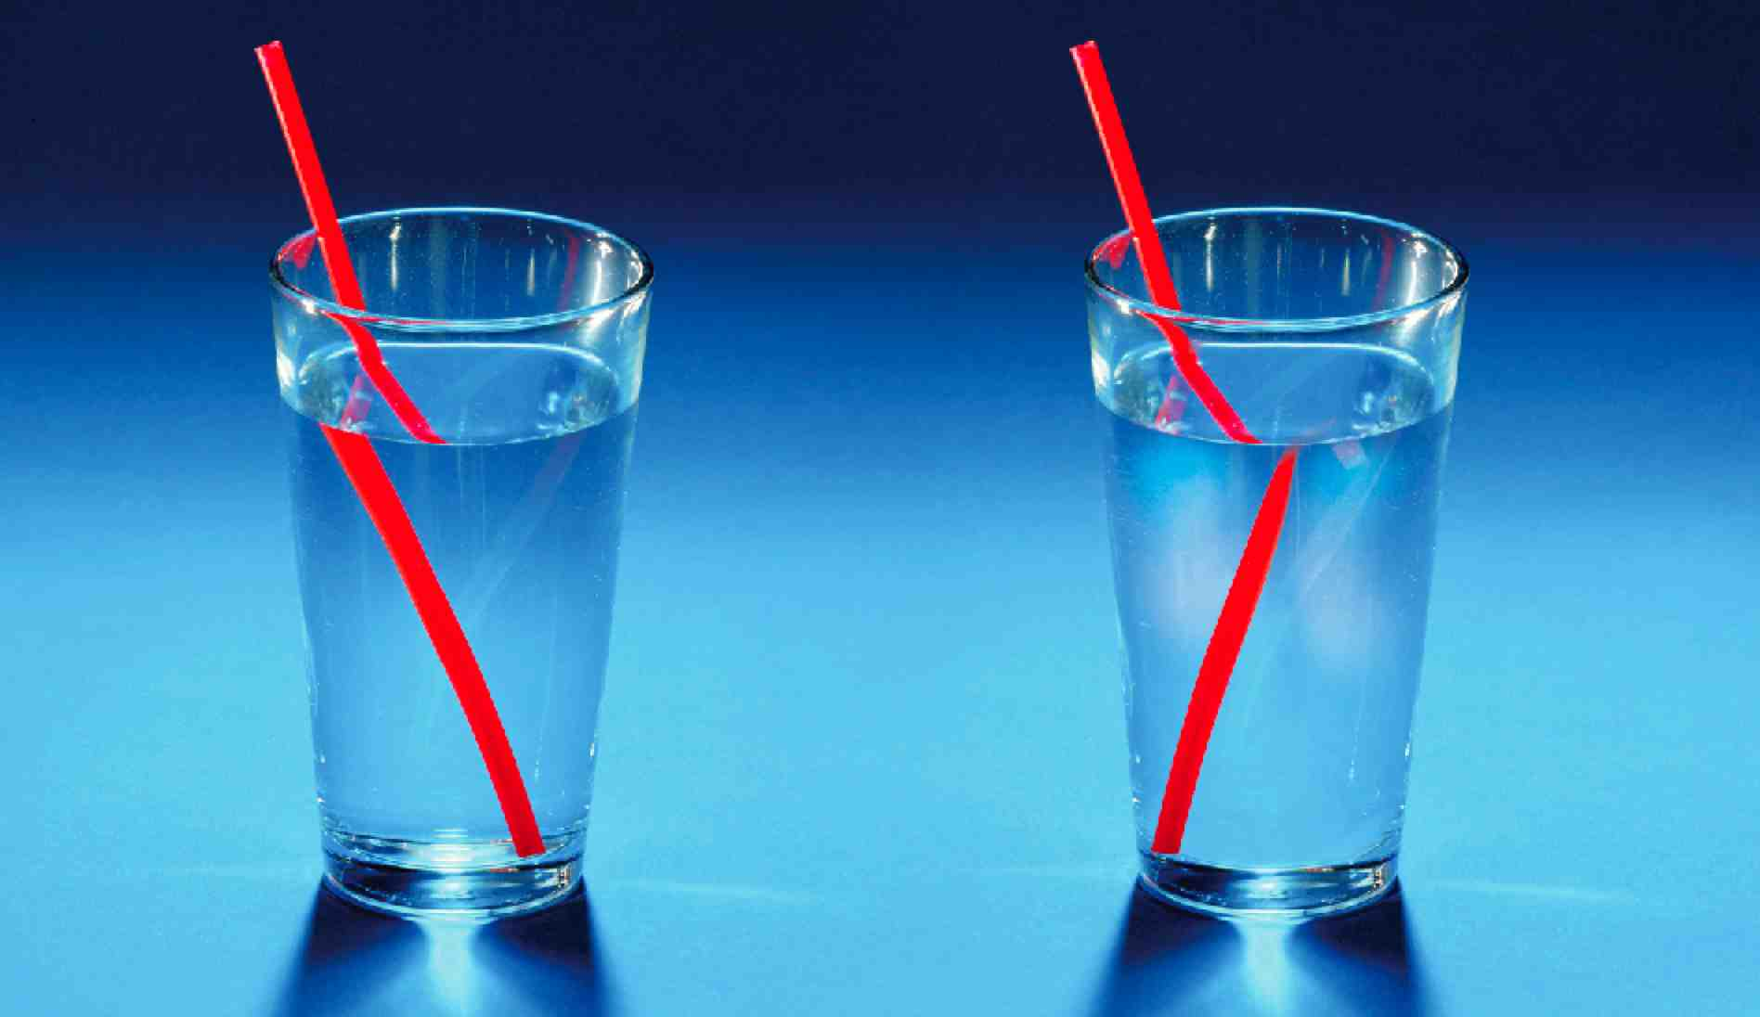
Refraction:
The bending of waves due to a change in wave speed.

Slide 15
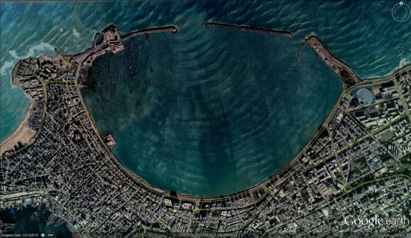
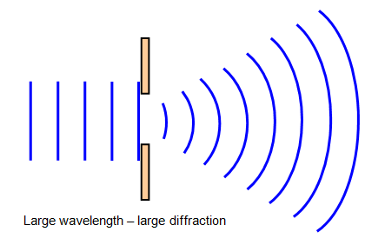
Diffraction:
The bending of waves around a barrier, such as an
obstacle or edges of an opening.

Slide 16
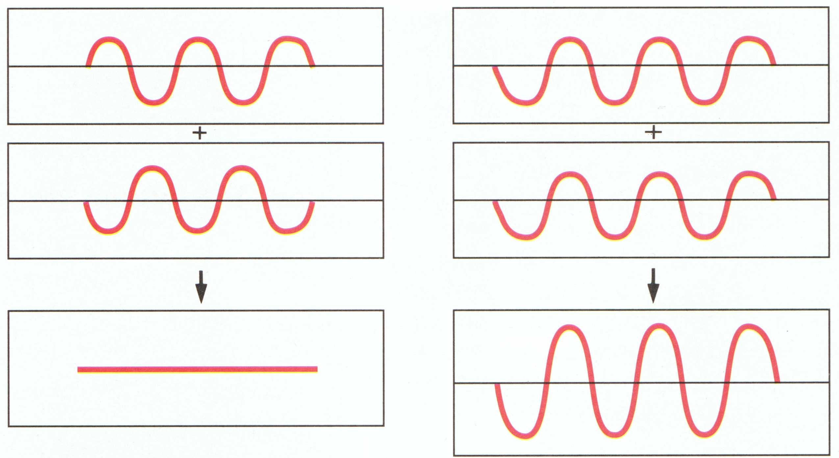
Interference:
The interaction of waves that occur at the same place at the same time.
Destructive
Constructive

Slide 17
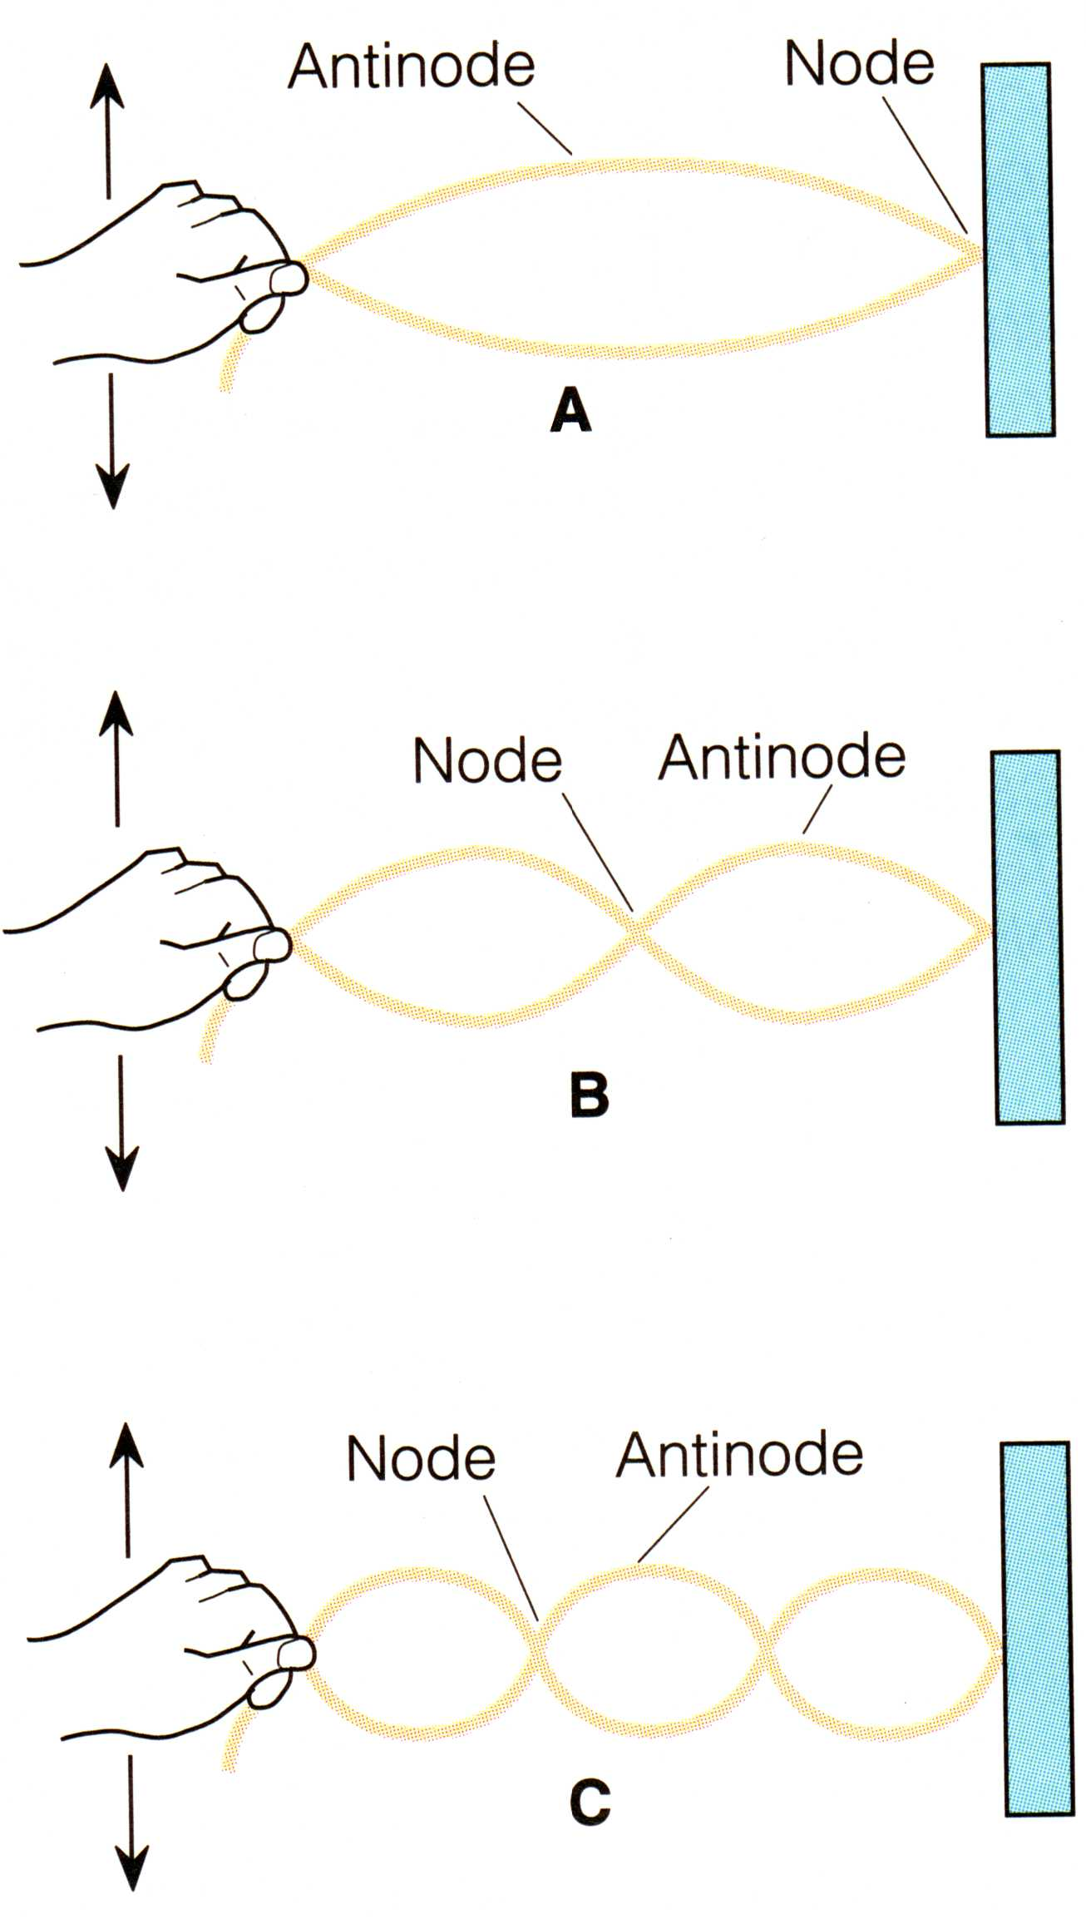
Standing Wave:
A stationary wave pattern formed in a medium
when two sets of identical waves pass through
the medium in opposite directions.

Slide 18
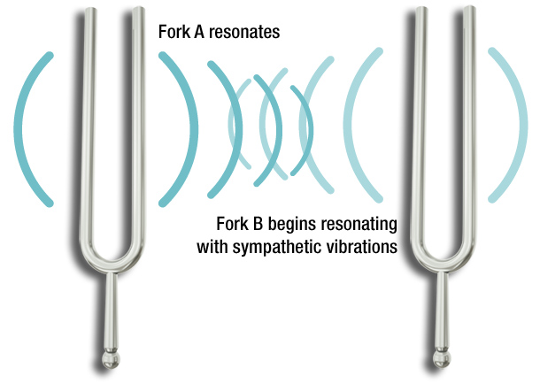
Resonance:
The setting up of vibrations in an object at its natural vibration frequency by a vibrating force or wave having the same frequency.

Slide 19
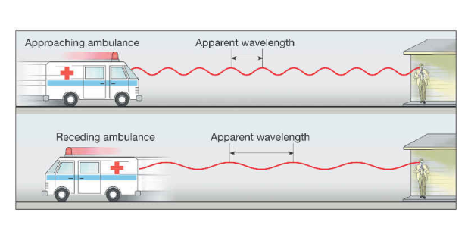
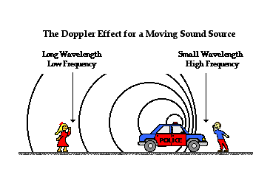
Doppler Effect
Doppler Effect: The change in pitch or wave frequency due to a moving wave source

Slide 20
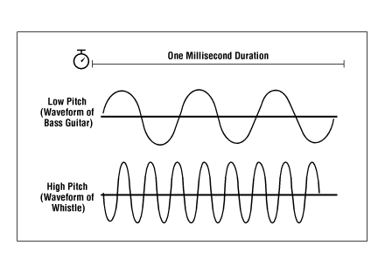
Pitch
Pitch is how high or low a sound seems to be. The pitch of a sound is related to the frequency of the sound wave.
As frequency of a sound wave decreases, the pitch becomes lower.

