Slide 1
APES C2L5 What are systems and how do they respond to change?
Concept 2-5: Systems have inputs, flows, and outputs of matter and energy, and feedback can affect their behavior.

Slide 2
Systems Have Inputs, Flows, & Outputs
A system is a set of components that function and interact in some regular way.
Scientists use systems to study how components of a system interact.
Most systems have the following key components:
Inputs from the environment,
Flows or Throughputs of matter and energy within the system, and
Outputs to the environment.

Slide 3
Systems Have Inputs, Flows, & Outputs

Slide 4
Environmental Systems - Bozeman Science
https://www.youtube.com/watch?v=jfgE-LAJ8fA

Slide 5
Systems Respond to Change Through Feedback Loops
Most systems are affected in one way or another by feedback.
Feedback is any process that increases (positive feedback) or decreases (negative feedback) a change to the system.
Such a process, called a feedback loop, occurs when an output of matter, energy, or information is fed back into the system as an input and leads to changes in that system.

Slide 6
Systems Respond to Change Through Feedback Loops
A positive feedback loop causes a system to change further in the same direction.
Accelerating positive feedback loops are of great concern to environmental scientists.
Ex: Increased erosion due to decreasing vegetation.
Ex: Melting of the polar ice cap.

Slide 7
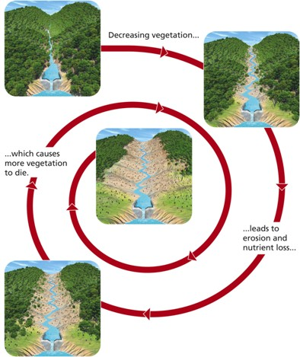
Systems Respond to Change Through Feedback Loops
Positive Feedback Loop
Decreasing vegetation in a valley causes increasing erosion and nutrient losses that in turn cause more vegetation to die, resulting in more erosion and nutrient losses.

Slide 8
Systems Respond to Change Through Feedback Loops
A negative, or corrective, feedback loop causes a system to change in the opposite direction from which it is moving.
A simple example is a thermostat.
Turns on when house reaches a certain temperature, then turns off when reaches set temperature setting.
Another example is the recycling and reuse of resources such as aluminum.
When we recycle, the output becomes an input.

Slide 9
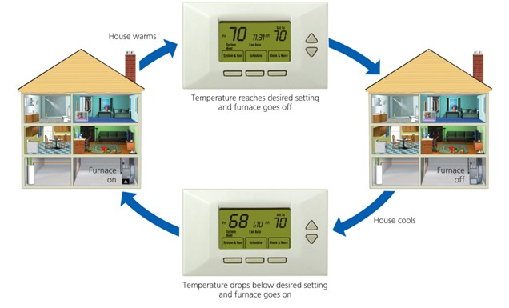
Systems Respond to Change Through Feedback Loops
Negative Feedback Loop
When a house being heated by a furnace gets to a certain temperature, its thermostat is set to turn off the furnace, and the house begins to cool instead of continuing to get warmer. When house temperature drops below the set point, this information is fed back to turn the furnace on until the desired temperature is reached again.

Slide 10
Feedback Loops: How Nature Gets Its Rhythms - Anje-Margriet Neutel (TEDEd)
https://www.youtube.com/watch?v=inVZoI1AkC8

Slide 11
It Can Take a Long Time for a System to Respond to Feedback
A complex system will often show a time delay, or a lack of response during a period of time between the input of a feedback stimulus and the system’s response to it.
Ex: Scientists can plant trees in order to reduce erosion. There is a time delay because it takes years for the trees to grow.
Time delays can allow an environmental problem to build slowly until it reaches a threshold level or tipping point.
A tipping point is the point at which a fundamental shift in the behavior of a system occurs.
Prolonged delays dampen the negative feedback mechanisms that might slow, prevent, or halt environmental problems.

Slide 12
System Effects Can Be Amplified through Synergy
A synergistic interaction, or synergy, occurs when 2 or more processes interact so that the combined effect is greater than the sum of their separate effects.
Positive Example
You may be able to study longer if you are working with a partner. Synergistic effect of you and your partner working together can make your individual systems capable of accomplishing more in the same amount of time.
Negative Example
Smoking and exposure to asbestos. Nonsmokers exposed to asbestos for long periods increase cancer risk by 5X. Smokers who are exposed to asbestos have 50 times the risk that nonsmokers have for lung cancer.

Slide 13
Chapter 2: Big Ideas
There is no away.
According to the law of conservation of matter, no atoms are created or destroyed when ever matter undergoes a physical or chemical change. Thus, we cannot do away with matter; we can only change it from one physical state or chemical form to another.

Slide 14
Chapter 2: Big Ideas
You cannot get something for nothing.
According to the first law of thermodynamics, of the law of conservation of energy, whenever energy is converted from one form to another in a physical or chemical change, no energy is created of destroyed. This means that in such changes, we cannot get more energy out than we put in.

Slide 15
Chapter 2: Big Ideas
You cannot break even.
According to the second law of thermodynamics, whenever energy is converted from one form to another in a physical or chemical change, we always end up with lower-quality or less usable energy than we started with.

